Slide 1
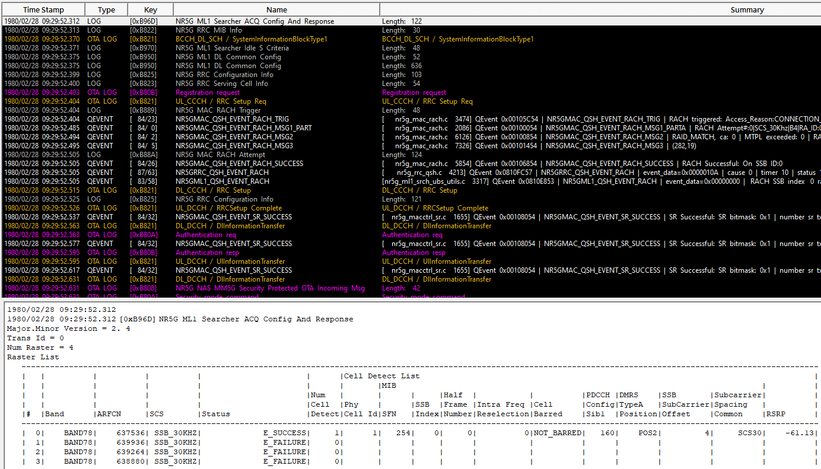
<dlFreqInfo>
<absFreqPointA>3554700</absFreqPointA>
<absArfcnPointA>636980</absArfcnPointA>
<absFreqSsb>3563040</absFreqSsb>
<absArfcnSsb>637536</absArfcnSsb>●
<nrFreqBand>78</nrFreqBand>
<subCarrierCfg>
<offsetToCarrier>0</offsetToCarrier>
<subCarrierSpacing>KHz30</subCarrierSpacing>
<carrierBw>273</carrierBw>
</subCarrierCfg>
<bSChannelBwDL>100MHZ</bSChannelBwDL>
<dlEarfcn>640256</dlEarfcn>
</dlFreqInfo>
<ulFreqInfo>
<absFreqPointA>3554700</absFreqPointA>
<absArfcnPointA>636980</absArfcnPointA>
<nrFreqBand>78</nrFreqBand>
<subCarrierCfg>
<offsetToCarrier>0</offsetToCarrier>
<subCarrierSpacing>KHz30</subCarrierSpacing>
<carrierBw>273</carrierBw>
</subCarrierCfg>
<bSChannelBwUl>100MHZ</bSChannelBwUl>
<freqShft7p5khz>7P5KHZ_DISBL</freqShft7p5khz>
<addtionalSpectrumEmission>0</addtionalSpectrumEmission>
<pMax>33</pMax>
<ulEarfcn>640256</ulEarfcn>
</ulFreqInfo>
<nDlCenterFreq>3603840</nDlCenterFreq>
<nUlCenterFreq>3603840</nUlCenterFreq>
<nDlBw>100</nDlBw>
<nUlBw>100</nUlBw>

Slide 2
<dlFreqInfo>
<absFreqPointA>3554700</absFreqPointA>
<absArfcnPointA>636980</absArfcnPointA>
<absFreqSsb>3563040</absFreqSsb>
<absArfcnSsb>637536</absArfcnSsb>●
<nrFreqBand>78</nrFreqBand>
<subCarrierCfg>
<offsetToCarrier>0</offsetToCarrier>
<subCarrierSpacing>KHz30</subCarrierSpacing>
<carrierBw>273</carrierBw>
</subCarrierCfg>
<bSChannelBwDL>100MHZ</bSChannelBwDL>
<dlEarfcn>640256</dlEarfcn>
</dlFreqInfo>
<ulFreqInfo>
<absFreqPointA>3554700</absFreqPointA>
<absArfcnPointA>636980</absArfcnPointA>
<nrFreqBand>78</nrFreqBand>
<subCarrierCfg>
<offsetToCarrier>0</offsetToCarrier>
<subCarrierSpacing>KHz30</subCarrierSpacing>
<carrierBw>273</carrierBw>
</subCarrierCfg>
<bSChannelBwUl>100MHZ</bSChannelBwUl>
<freqShft7p5khz>7P5KHZ_DISBL</freqShft7p5khz>
<addtionalSpectrumEmission>0</addtionalSpectrumEmission>
<pMax>33</pMax>
<ulEarfcn>640256</ulEarfcn>
</ulFreqInfo>
<nDlCenterFreq>3603840</nDlCenterFreq>
<nUlCenterFreq>3603840</nUlCenterFreq>
<nDlBw>100</nDlBw>
<nUlBw>100</nUlBw>

Slide 3
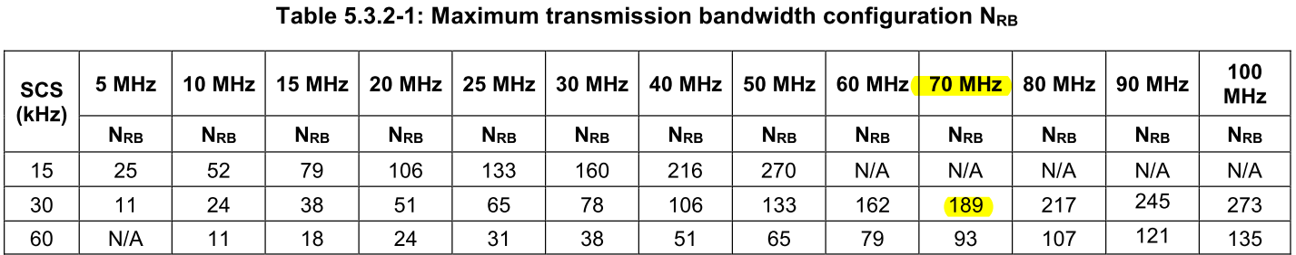
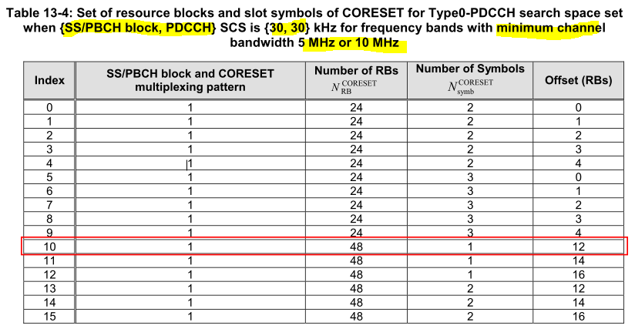
BW (MHz) | offsetToCarrier | Kssb | offsetToPointA | Result | numRb | carrierBw | bSChannelBwDL | bSChannelBwUl | nDlBw | nUlBw | absFreqPointA | absArfcnPointA | absFreqSsb | absArfcnSsb (620000 – <2> – 653332) | GSCN GSCN=7499+N (7711 – <1> – 8051)
100 | 0 | 4 | 26 | PASS | 273 | 273 | 100MHZ | 100MHZ | 100 | 100 | 3554700 | 636980 | 3563040 | 637536 | N=391, GSCN=7890
 | 0 | 4 | 34 | PASS | 273 | 273 | 100MHZ | 100MHZ | 90 | 90 | 3554700 | 636980 | 3564480 | 637632 | N=392, GSCN=7891
90 | 0 | 4 | 30 | PASS | 245 | 245 | 90MHZ | 90MHZ | 80 | 80 | 3559740 | 637316 | 3568800 | 637920 | N=395, GSCN=7894
80 | 0 | 4 | 26 | PASS | 217 | 217 | 80MHZ | 80MHZ | 60 | 60 | 3564780 | 637652 | 3573120 | 638208 | N=398, GSCN=7897
70 | 0 | 4 | 30 | DU Not support | 189 | 189 | 70MHZ | 70MHZ | 70 | 70 | 3569820 | 637988 | 3578880 | 638592 | N=402, GSCN=7901
60 | 0 | 16 | 26 | PASS | 162 | 162 | 60MHZ | 60MHZ | 40 | 40 | 3574680 | 638312 | 3583200 | 638880 | N=405, GSCN=7904
50 | 0 | 4 | 30 | PASS | 133 | 133 | 50MHZ | 50MHZ | 50 | 50 | 3579900 | 638660 | 3588960 | 639264 | N=409, GSCN=7908
 | 0 | 4 | 38 | PASS | 133 | 133 | 50MHZ | 50MHZ | 50 | 50 | 3579900 | 638660 | 3590400 | 639360 | N=410, GSCN=7908
 | 0 | 4 | 46 | PASS | 133 | 133 | 50MHZ | 50MHZ | 50 | 50 | 3579900 | 638660 | 3591840 | 639456 | N=411, GSCN=7908
 | 0 | 4 | 54 | PASS | 133 | 133 | 50MHZ | 50MHZ | 50 | 50 | 3579900 | 638660 | 3593280 | 639552 | N=412, GSCN=7908
 | 0 | 4 | 62 | PASS | 133 | 133 | 50MHZ | 50MHZ | 50 | 50 | 3579900 | 638660 | 3594720 | 639648 | N=413, GSCN=7908
40 | 0 | 16 | 26 | PASS | 106 | 106 | 40MHZ | 40MHZ | 40 | 40 | 3584760 | 638984 | 3593280 | 639552 | N=412, GSCN=7911
30 | 0 | 16 | 30 | PASS | 78 | 78 | 30MHZ | 30MHZ | 40 | 40 | 3589800 | 639320 | 3599040 | 639936 | N=416, GSCN=7915
20 | 0 | 4 | 28 | FAIL | 51 | 51 | 20MHZ | 20MHZ | 20 | 20 | 3594660 | 639644 | 3603360 | 640224 | N=419, GSCN=7918
ret_t gnb_du_rrm_cell::set_ssb_prb_and_subcarrier_offset()
validate_and_calc_cs0

Slide 4
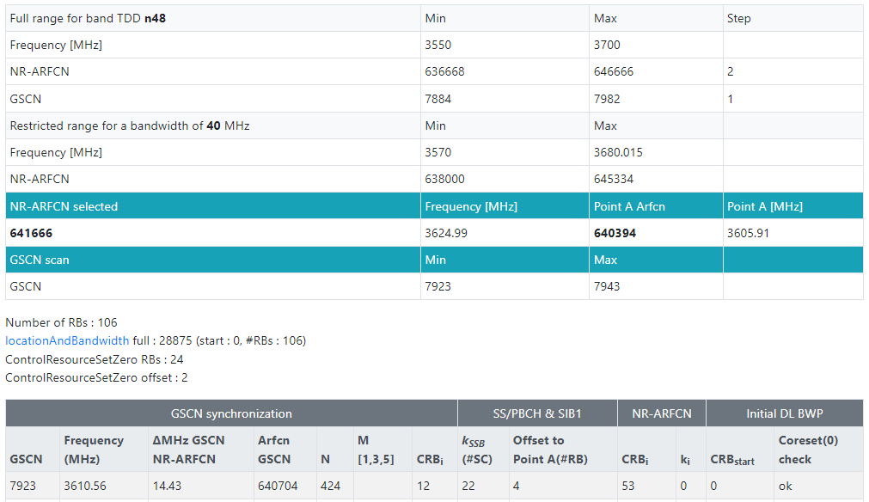
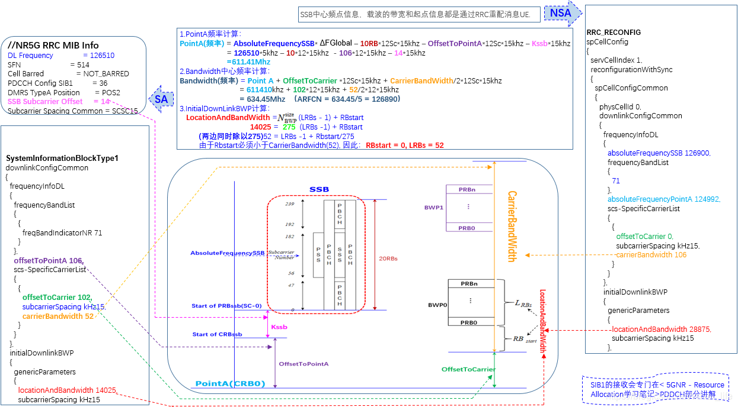
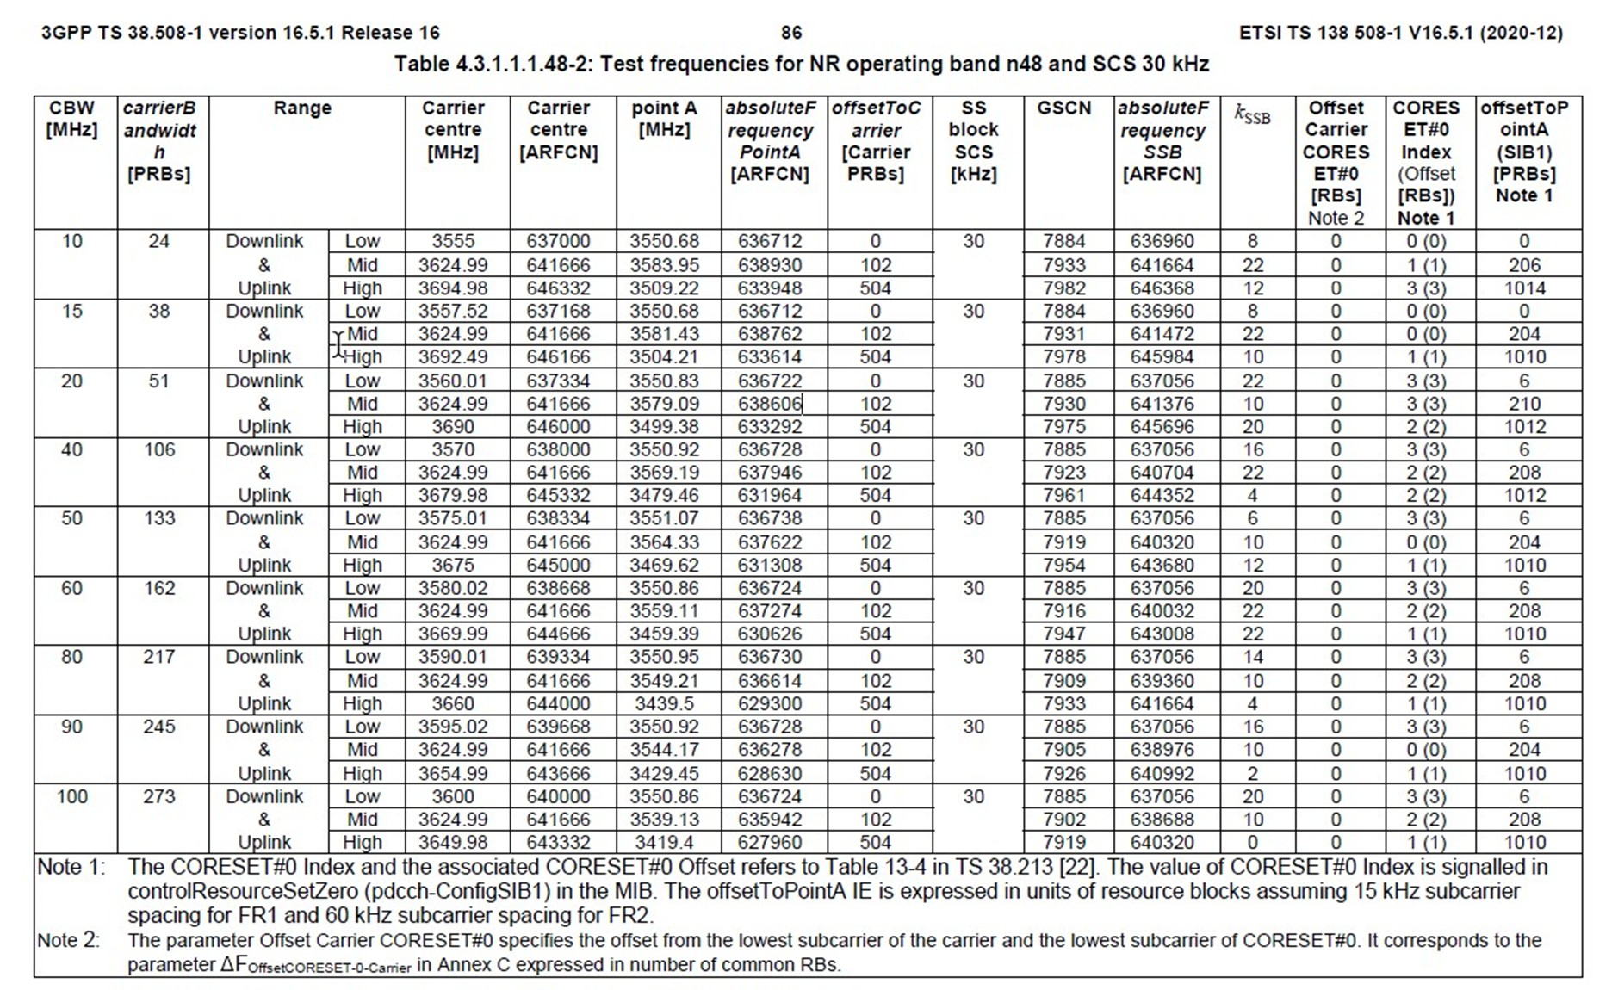
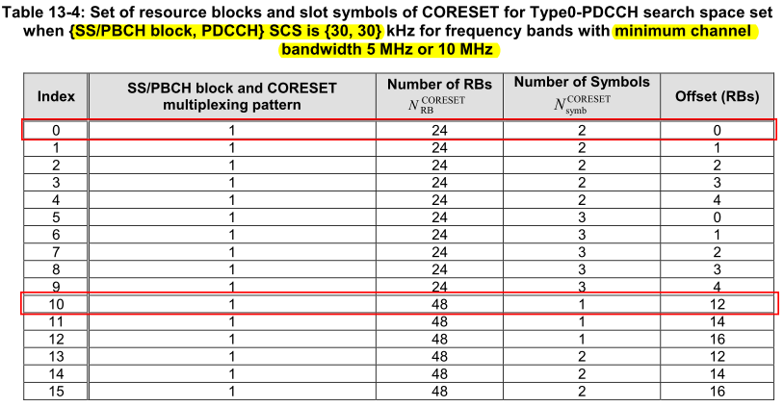
3644070
3614550
Offset(RB)
24 RB*30 scs*12
106/2*12 *30
3610560
CORESET 0(48 RB)
CS0 is within the bandwidth part
10*12*30
3624990
3599760
106/2*12 *30
BW | 106 | carrierBw
point A [MHz] | 3569190 | absFreqPointA
absoluteFrequencyPointA [ARFCN] | 637946 | absArfcnPointA
absoluteFrequencySSB [ARFCN] | 3610560 | absFreqSsb
arfcnSSB | 640704 | absArfcnSsb
Carrier centre [MHz] | 3624990 | nDlCenterFreq
Carrier centre [ARFCN] | 641666 | dlEarfcn
offsetToCarrier [Carrier PRBs] | 102 | offsetToCarrier
Kssb | 22
offsetToPointA (SIB1) [PRBs] Note 1 | 208
GSCN | 7923
Offset Carrier CORESET#0 [RBs] Note 2 | 0
CORESET#0 Index (Offset [RBs]) Note 1 | 2 (2) | 從code去選擇
=22*15
3606630
Offset(RB)
=2RB*30 scs*12
3605910
3605910
102*12*30
=208*12*15
3569190

Slide 5
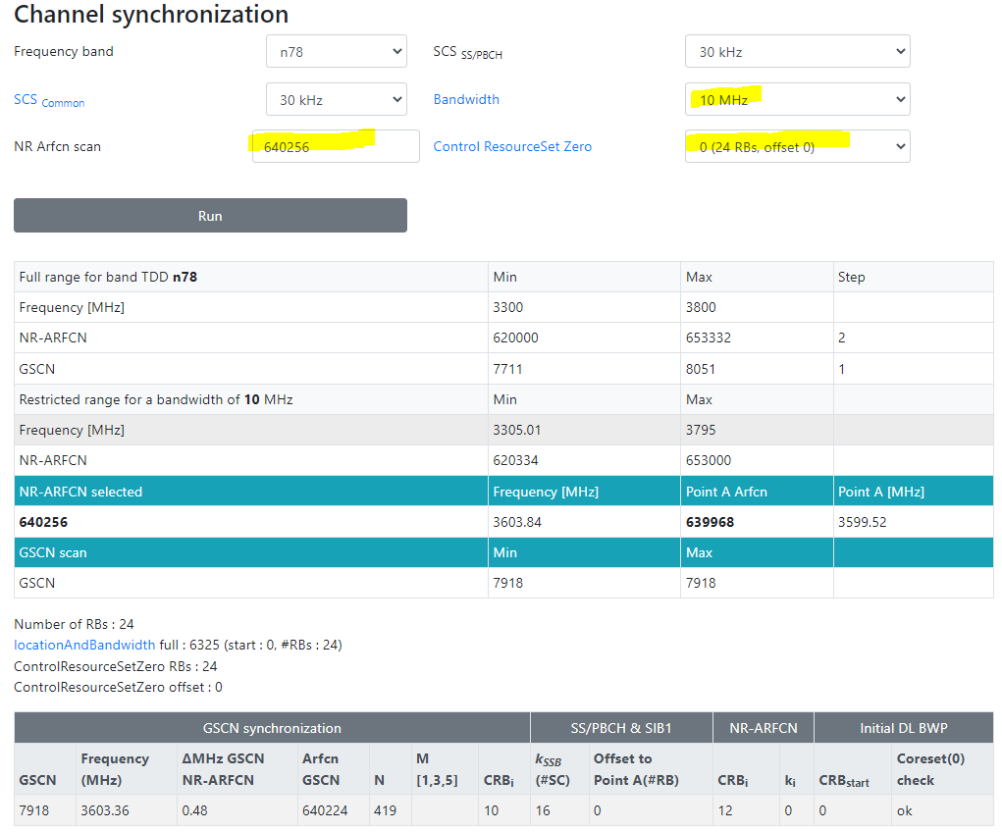
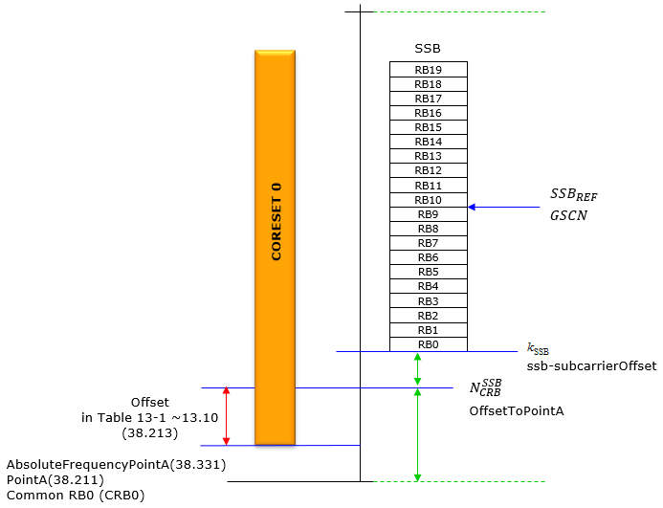
https://www.sqimway.com/nr_refA.php
3608160
3608160
載波中心頻率 dlEarfcn 640256 = nDlCenterFreq 3603840,
SSB Subcarrier Offset =16, offsetToCarrier=0, offsetToPointA=0
Point A = nDlCenterFreq – carrierBw/2*12 sub*subCarrierSpacing – offsetToCarrier *12*15
SSB Freq = Point A + offsetToPointA*12*15 + SSB Subcarrier Offset *15 + 10RB*12*subCarrierSpacing
Ex:
Point A = 3603840 – 24/2*12 *30 – 0 *12*15 = 3599520
SSB Freq = 3599520+ 0*12*15 + 16*15 + 10*12*30 = 3603360 = 3000000+N*1440
<dlFreqInfo>
<absFreqPointA>3599520</absFreqPointA>
<absArfcnPointA>639968</absArfcnPointA>
<absFreqSsb> 3603360 </absFreqSsb>
<absArfcnSsb>640224</absArfcnSsb>
<nrFreqBand>78</nrFreqBand>
<subCarrierCfg>
<offsetToCarrier>0</offsetToCarrier>
<subCarrierSpacing>KHz30</subCarrierSpacing>
<carrierBw>24</carrierBw>
</subCarrierCfg>
<bSChannelBwDL>100MHZ</bSChannelBwDL>
<dlEarfcn>640256</dlEarfcn>
</dlFreqInfo>
<nDlCenterFreq>3603840</nDlCenterFreq>
<nUlCenterFreq>3603840</nUlCenterFreq>
Offset(RB)
24 RB*30 scs*12
24/2*12 *30
3603360
CORESET 0(24 RB)
CS0 is within the bandwidth part
10*12*30
3603840
24/2*12 *30
16*15
3599520
Offset(RB)
0RB*30 scs*12
0*12*15
3594660
3599520
0 *12*15
3599520
MIB
PDCCH Config SIB1 = 0 = 0000 0000

Slide 6
來自 <https://blog.csdn.net/travel_life/article/details/110038572>

Slide 7
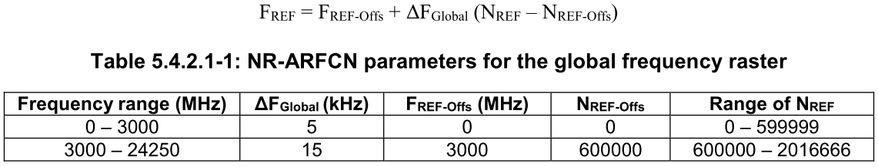
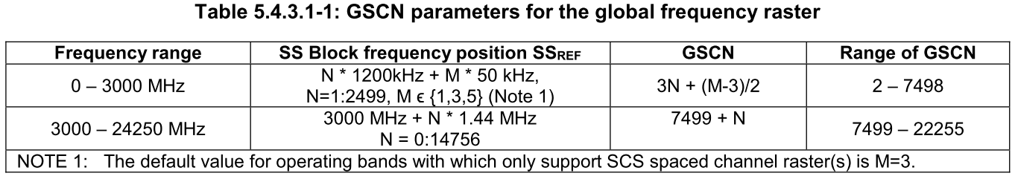
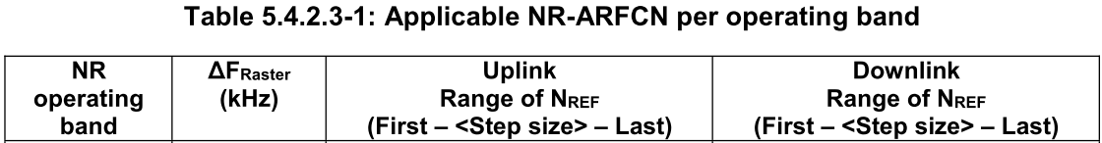
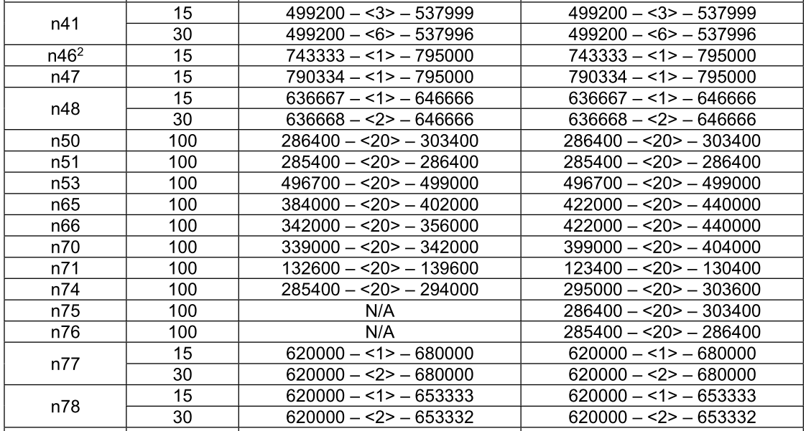
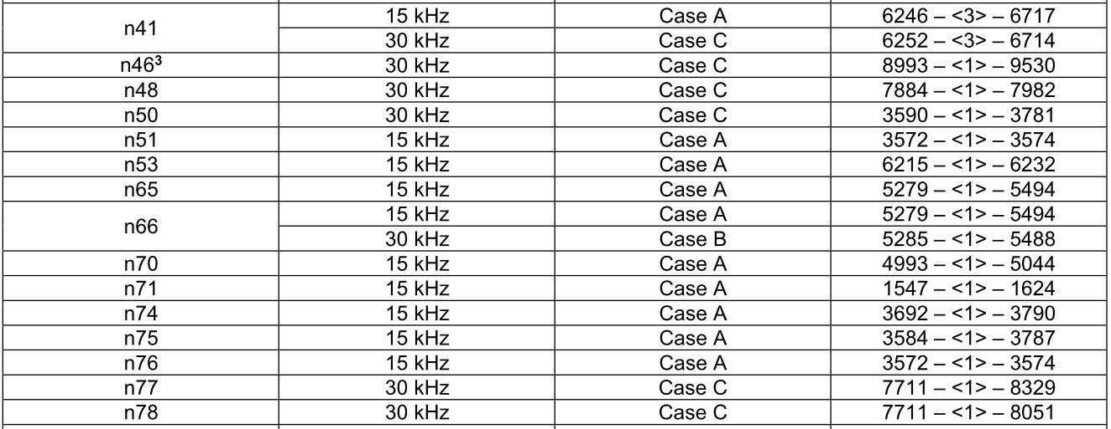
載波中心頻率 dlEarfcn 513150 = nDlCenterFreq 2565750,
SSB Subcarrier Offset =4, offsetToCarrier=0, offsetToPointA=26
Point A = nDlCenterFreq – carrierBw/2*12 sub*subCarrierSpacing – offsetToCarrier *12*15
SSB Freq = Point A + offsetToPointA*12*15 + SSB Subcarrier Offset *15 + 10RB*12*subCarrierSpacing
Ex:
Point A = 2565750 – 273/2*12 *30 – 0 *12*15 = 2516610
SSB Freq = 2516610 + 26*12*15 + 4*15 + 10*12*30 = 2524950
<dlFreqInfo>
<absFreqPointA>2516610</absFreqPointA>
<absArfcnPointA>503322</absArfcnPointA>
<absFreqSsb>2524950</absFreqSsb>
<absArfcnSsb>504990</absArfcnSsb>
<nrFreqBand>41</nrFreqBand>
<subCarrierCfg>
<offsetToCarrier>0</offsetToCarrier>
<subCarrierSpacing>KHz30</subCarrierSpacing>
<carrierBw>273</carrierBw>
</subCarrierCfg>
<bSChannelBwDL>100MHZ</bSChannelBwDL>
<dlEarfcn>513150</dlEarfcn>
</dlFreqInfo>
<nDlCenterFreq>2565750</nDlCenterFreq>
<nUlCenterFreq>2565750</nUlCenterFreq>
2614890
2534250
Offset(RB)
48 RB*30 scs*12
273/2*12 *30
2524950
CORESET 0(24 RB)
CS0 is within the bandwidth part
10*12*30
2565750
1980/01/07 06:01:29.079 [0xB822] NR5G RRC MIB Info
DL Frequency = 504990
SSB Subcarrier Offset = 4
Subcarrier Spacing Common = SCSC30
273/2*12 *30
4*15=60
[0xB821] BCCH_DL_SCH / SystemInformationBlockType1
frequencyInfoDL
{
frequencyBandList
{
{
freqBandIndicatorNR 41
}
},
offsetToPointA 26,
scs-SpecificCarrierList
{
{
offsetToCarrier 0,
subcarrierSpacing kHz30,
carrierBandwidth 273
}
}
},
initialDownlinkBWP
{
genericParameters
{
locationAndBandwidth 1099,
subcarrierSpacing kHz30
},
Offset(RB)
12RB*30 scs*12
2516970
2521290
2516610
26*12*15=4680
0 *12*15
2516610
(3000M以下) F = 0 + 0.005*(ARFCN-0)
(3000M以上) F = 3000 + 0.015*(ARFCN-600000)
Ex: F = 2524950 = 2524.95 MHz
2524.95 = 0+0.005(ARFCN-0)
ARFCN = 504990
2524.95 = N*1.2+3*0.05, N=2104
GSCN= 3*2104+(3-3)/2 = 6312
(3000M以下) F = 0 + 0.005*(ARFCN-0)
(3000M以上) F = 3000 + 0.015*(ARFCN-600000)
Ex: F = 2565750 = 2565.75 MHz
2565.75 = 0 + 0.005*(ARFCN-0)
ARFCN = 513150
Notes:
載波中心頻率 dlEarfcn 513150 = nDlCenterFreq 2565750
Point A = nDlCenterFreq – carrierBw/2*12 sub*subCarrierSpacing – offsetToCarrier *12*15
SSB Freq = Point A + offsetToPointA*12*15 + SSB Subcarrier Offset *15 + 10RB*12*subCarrierSpacing
Ex:
Point A = 2565750 – 273/2*12 *30 – 0 *12*15 = 2516610
SSB Freq = 2516610 + 26*12*15 + 4*15 + 10*12*30 = 2524950

Slide 8
載波中心頻率 dlEarfcn 513150 = nDlCenterFreq 2565750,
SSB Subcarrier Offset =4, offsetToCarrier=0, offsetToPointA=26
Point A Freq = nDlCenterFreq – carrierBw/2*12 sub*subCarrierSpacing – offsetToCarrier *12*15
SSB Freq = Point A + offsetToPointA*12*15 + SSB Subcarrier Offset *15 + 10RB*12*subCarrierSpacing
CS0 is within the bandwidth part:
Ex:
Point A Freq = 2565750 – 273/2*12 *30 – 0 *12*15 = 2516610
SSB Freq = 2516610 + 26*12*15 + 4*15 + 10*12*30 = 2524950
Kssb = (2524950- 2516610-10*12*30)%(30*12) = 60
OffsetToPointA=(2524950- 2516610-10*12*30)-(2524950- 2516610-10*12*30)%(30*12)=4680
CS0 low: 2524950-10*12*30-4*15-12*30*12 > (2565750-273/2*12 *30)
CS0 high: 2524950-10*12*30-4*15-12*30*12+48*30*12 < (2565750+273/2*12 *30)
2614890
2534250
273/2*12 *30
<dlFreqInfo>
<absFreqPointA>2516610</absFreqPointA>
<absArfcnPointA>503322</absArfcnPointA>
<absFreqSsb>2524950</absFreqSsb>
<absArfcnSsb>504990</absArfcnSsb>
<nrFreqBand>41</nrFreqBand>
<subCarrierCfg>
<offsetToCarrier>0</offsetToCarrier>
<subCarrierSpacing>KHz30</subCarrierSpacing>
<carrierBw>273</carrierBw>
</subCarrierCfg>
<bSChannelBwDL>100MHZ</bSChannelBwDL>
<dlEarfcn>513150</dlEarfcn>
</dlFreqInfo>
<nDlCenterFreq>2565750</nDlCenterFreq>
<nUlCenterFreq>2565750</nUlCenterFreq>
Offset(RB)
48 RB*30 scs*12
2524950
2565750
CS0 is within the bandwidth part
10*12*30
273/2*12 *30
4*15=60
2516970
2521290
Offset(RB)
12RB*30 scs*12
2516610
26*12*15=4680
0 *12*15
2516610

Slide 9
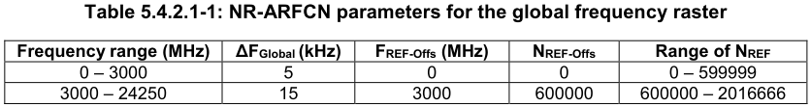
載波中心頻率 dlEarfcn 640256 = nDlCenterFreq 3603840,
SSB Subcarrier Offset =16, offsetToCarrier=0, offsetToPointA=17
Point A = nDlCenterFreq – carrierBw/2*12 sub*subCarrierSpacing – offsetToCarrier *12*15
SSB Freq = Point A + offsetToPointA*12*15 + SSB Subcarrier Offset *15 + 10RB*12*subCarrierSpacing
Ex:
Point A = 3603840 – 273/2*12 *30 – 0 *12*15 = 3554700
SSB Freq = 3554700 + 17*12*15 + 16*15 + 10*12*30 = 3563040 = 3000000+N*1440, N=391
(3000M以下) F = 0 + 0.005*(ARFCN-0)
(3000M以上) F = 3000 + 0.015*(ARFCN-600000)
Ex: F = 3563040 = 3563.04 MHz
3563.04 = 3000 + 0.015*(ARFCN-600000)
ARFCN = 637536
3563.04 = 3000+N*1.44, N=391, GSCN=7499+391=7890
<dlFreqInfo>
<absFreqPointA>3554700</absFreqPointA>
<absArfcnPointA>636980</absArfcnPointA>
<absFreqSsb>3563040</absFreqSsb>
<absArfcnSsb>637536</absArfcnSsb>
<nrFreqBand>78</nrFreqBand>
<subCarrierCfg>
<offsetToCarrier>0</offsetToCarrier>
<subCarrierSpacing>KHz30</subCarrierSpacing>
<carrierBw>273</carrierBw>
</subCarrierCfg>
<bSChannelBwDL>100MHZ</bSChannelBwDL>
<dlEarfcn>640256</dlEarfcn>
</dlFreqInfo>
<nDlCenterFreq>3603840</nDlCenterFreq>
<nUlCenterFreq>3603840</nUlCenterFreq>
1980/01/07 06:01:29.079 [0xB822] NR5G RRC MIB Info
DL Frequency = 504990
SSB Subcarrier Offset = 4
Subcarrier Spacing Common = SCSC30
[0xB821] BCCH_DL_SCH / SystemInformationBlockType1
frequencyInfoDL
{
frequencyBandList
{
{
freqBandIndicatorNR 41
}
},
offsetToPointA 26,
scs-SpecificCarrierList
{
{
offsetToCarrier 0,
subcarrierSpacing kHz30,
carrierBandwidth 273
}
}
},
initialDownlinkBWP
{
genericParameters
{
locationAndBandwidth 1099,
subcarrierSpacing kHz30
},
(3000M以下) F = 0 + 0.005*(ARFCN-0)
(3000M以上) F = 3000 + 0.015*(ARFCN-600000)
Ex: F = 3603840 = 3603.84 MHz
3603.84 = 3000 + 0.015*(ARFCN-600000)
ARFCN = 640256
Notes:
3554700|636980|3563040|637536|640256|3603840
<dlFreqInfo>
<absFreqPointA>3554700</absFreqPointA>
<absArfcnPointA>636980</absArfcnPointA>
<absFreqSsb>3563040</absFreqSsb>
<absArfcnSsb>637536</absArfcnSsb>●
<nrFreqBand>78</nrFreqBand>
<subCarrierCfg>
<offsetToCarrier>0</offsetToCarrier>
<subCarrierSpacing>KHz30</subCarrierSpacing>
<carrierBw>273</carrierBw>
</subCarrierCfg>
<bSChannelBwDL>100MHZ</bSChannelBwDL>
<dlEarfcn>640256</dlEarfcn>●
</dlFreqInfo>
<nDlCenterFreq>3603840</nDlCenterFreq>
=================================================
1980/01/06 08:11:18.743 [0xB950] NR5G ML1 DL Common Config
dl_cell_frequency = 637536
1980/01/06 08:11:19.127 [0xB825] NR5G RRC Configuration Info
NR5G Serving Cell Info[0] {
CC Id = 0
Cell Id = 1
DL Arfcn = 640256
UL Arfcn = 640256
SSB Arfcn = 637536
Band = 78
Band Type = SUB6
DL Carrier Bandwidth = BW_100MHz
UL Carrier Bandwidth = BW_100MHz
DL Max MIMO = 4
UL Max MIMO = NA
}
1980/01/06 08:11:19.478 [0xB822] NR5G RRC MIB Info
DL Frequency = 637536
1980/01/06 08:11:19.479 [0xB821] BCCH_DL_SCH / SystemInformationBlockType1
frequencyBandList
{
{
freqBandIndicatorNR 78
}
},
offsetToPointA 26,
=================================================
載波中心頻率 dlEarfcn 513150 = nDlCenterFreq 2565750
Point A = nDlCenterFreq – carrierBw/2*12 sub*subCarrierSpacing – offsetToCarrier *12*15
SSB Freq = Point A + offsetToPointA*12*15 + SSB Subcarrier Offset *15 + 10RB*12*subCarrierSpacing
Ex:
Point A = 2565750 – 273/2*12 *30 – 0 *12*15 = 2516610
SSB Freq = 2516610 + 26*12*15 + 4*15 + 10*12*30 = 2524950

Slide 10
載波中心頻率 dlEarfcn 640256 = nDlCenterFreq 3603840,
SSB Subcarrier Offset =4, offsetToCarrier=0, offsetToPointA=26
Point A = nDlCenterFreq – carrierBw/2*12 sub*subCarrierSpacing – offsetToCarrier *12*15
SSB Freq = Point A + offsetToPointA*12*15 + SSB Subcarrier Offset *15 + 10RB*12*subCarrierSpacing
Ex:
Point A = 3603840 – 273/2*12 *30 – 0 *12*15 = 3554700
SSB Freq = 3554700 + 26*12*15 +4 *15 + 10*12*30 = 3563040 = 3000000+N*1440, N=391
(3000M以下) F = 0 + 0.005*(ARFCN-0)
(3000M以上) F = 3000 + 0.015*(ARFCN-600000)
Ex: F = 3563040 = 3563.04 MHz
3563.04 = 3000 + 0.015*(ARFCN-600000)
ARFCN = 637536
3563.04 = 3000+N*1.44, N=391, GSCN=7499+391=7890
<dlFreqInfo>
<absFreqPointA>3554700</absFreqPointA>
<absArfcnPointA>636980</absArfcnPointA>
<absFreqSsb>3563040</absFreqSsb>
<absArfcnSsb>637536</absArfcnSsb>
<nrFreqBand>78</nrFreqBand>
<subCarrierCfg>
<offsetToCarrier>0</offsetToCarrier>
<subCarrierSpacing>KHz30</subCarrierSpacing>
<carrierBw>273</carrierBw>
</subCarrierCfg>
<bSChannelBwDL>100MHZ</bSChannelBwDL>
<dlEarfcn>640256</dlEarfcn>
</dlFreqInfo>
<nDlCenterFreq>3603840</nDlCenterFreq>
<nUlCenterFreq>3603840</nUlCenterFreq>
3652980
273/2*12 *30
3572340
1980/01/07 06:01:29.079 [0xB822] NR5G RRC MIB Info
DL Frequency = 504990
SSB Subcarrier Offset = 4
Subcarrier Spacing Common = SCSC30
3563040
3603840
10*12*30
273/2*12 *30
[0xB821] BCCH_DL_SCH / SystemInformationBlockType1
frequencyInfoDL
{
frequencyBandList
{
{
freqBandIndicatorNR 41
}
},
offsetToPointA 26,
scs-SpecificCarrierList
{
{
offsetToCarrier 0,
subcarrierSpacing kHz30,
carrierBandwidth 273
}
}
},
initialDownlinkBWP
{
genericParameters
{
locationAndBandwidth 1099,
subcarrierSpacing kHz30
},
3559440
Offset(RB)
48 RB*30 scs*12
273/2*12 *30
3563040
4 *15
CORESET 0(24 RB)
CS0 is within the bandwidth part
3603840
26*12*15
0
10*12*30
3554700
273/2*12 *30
4 *15
3559440
3559380
Offset(RB)
12RB*30 scs*12
3555060
Kssb=4*15=60
Kssb=16*15=240
26*12*15
3554700
0 *12*15
4740
OffsetToPointA
=27*12*15=4860
4860/360=13.5(非整)
OffsetToPointA
=26*12*15=4680
4680/360= 13
3554700
3554700
PointA
RB=30scs*12subcarrier=360
(3000M以下) F = 0 + 0.005*(ARFCN-0)
(3000M以上) F = 3000 + 0.015*(ARFCN-600000)
Ex: F = 3603840 = 3603.84 MHz
3603.84 = 3000 + 0.015*(ARFCN-600000)
ARFCN = 640256
Notes:
Code計算
abs_freq_of_ssb_rb_0 = dl_freq_info.abs_freq_ssb - (10 * 12 * scs_sspbch);
3559440 = 3563040 - (10 * 12 * 30);
if(abs_freq_of_ssb_rb_0 < dl_freq_info.abs_freq_point_a)
if(3559440 < 3554700)
{
DU_CELL_ERROR_ARG0(module_ids::DURRM, gnb_du_rrm_log_arg::CELL_ID, cell_info.cell_id,
gnb_du_rrm_log::RRM_INVALID_ABS_FREQ_CONFIG);
return ret_t::FAILURE;
}
ssb_offset_from_point_a_in_khz = abs_freq_of_ssb_rb_0 - dl_freq_info.abs_freq_point_a;
4740 = 3559440 - 3554700;
ssb_sub_carrier_offset_in_khz = ssb_offset_from_point_a_in_khz % (12 * scs_kssb);
60 = 4740 % (12 * 15);
offset_to_point_a_in_khz = ssb_offset_from_point_a_in_khz - ssb_sub_carrier_offset_in_khz;
4680 = 4740 - 60;
offset_to_point_a = offset_to_point_a_in_khz / (12 * scs_nssb_crb);
26 = 4680 / (12 * 15);
ss_pbch_cfg.n_ssb_prb_offset = offset_to_point_a;
ss_pbch_cfg.n_ssb_prb_offset = 26;
ss_pbch_cfg.ssb_sub_carr_offset = ssb_sub_carrier_offset_in_khz / scs_kssb;
4 = 60 / 15;
//26 = ((3563040 - 3554700) - (10 * 12 * 30))/(12 * 15);
DU_INFO_ARG4(module_ids::DURRM,
gnb_du_rrm_log::ABS_FREQ_SSB_ABS_FREQ_POINT_SCS_SSPDCH_15_INFO,
gnb_du_rrm_log_arg::ABS_FREQ_SSB,3563040,
gnb_du_rrm_log_arg::ABS_FREQ_POINT,3554700,
gnb_du_rrm_log_arg::SCS_SSPDCH, 30,
gnb_du_rrm_log_arg::15, 15);
DU_INFO_ARG2(module_ids::DURRM,
gnb_du_rrm_log::26_AND_SSB_SUBCARRIER_OFFSET_INFO,
gnb_du_rrm_log_arg::26,26,
gnb_du_rrm_log_arg::SSB_SUBCARRIER_OFFSET,4);
return ret_t::SUCCESS;
=============================
<dlFreqInfo>
<absFreqPointA>3554700</absFreqPointA>
<absArfcnPointA>636980</absArfcnPointA>
<absFreqSsb>3563040</absFreqSsb>
<absArfcnSsb>637536</absArfcnSsb>
<nrFreqBand>78</nrFreqBand>
<subCarrierCfg>
<offsetToCarrier>0</offsetToCarrier>
<subCarrierSpacing>KHz30</subCarrierSpacing>
<carrierBw>273</carrierBw>
</subCarrierCfg>
<bSChannelBwDL>100MHZ</bSChannelBwDL>
<dlEarfcn>640256</dlEarfcn>
abs_freq_of_ssb_rb_0 = dl_freq_info.abs_freq_ssb - (10 * 12 * scs_sspbch);
3559440 = 3563040 - (10 * 12 * 30);
if(abs_freq_of_ssb_rb_0 < dl_freq_info.abs_freq_point_a)
if(3559440 < 3554700)
{
DU_CELL_ERROR_ARG0(module_ids::DURRM, gnb_du_rrm_log_arg::CELL_ID, cell_info.cell_id,
gnb_du_rrm_log::RRM_INVALID_ABS_FREQ_CONFIG);
return ret_t::FAILURE;
}
ssb_offset_from_point_a_in_khz = abs_freq_of_ssb_rb_0 - dl_freq_info.abs_freq_point_a;
4740 = 3559440 - 3554700;
ssb_sub_carrier_offset_in_khz = ssb_offset_from_point_a_in_khz % (12 * scs_kssb);
60 = 4740 % (12 * 15);
offset_to_point_a_in_khz = ssb_offset_from_point_a_in_khz - ssb_sub_carrier_offset_in_khz;
4680 = 4740 - 60;
offset_to_point_a = offset_to_point_a_in_khz / (12 * scs_nssb_crb);
26 = 4680 / (12 * 15);
ss_pbch_cfg.n_ssb_prb_offset = offset_to_point_a;
ss_pbch_cfg.n_ssb_prb_offset = 26;
ss_pbch_cfg.ssb_sub_carr_offset = ssb_sub_carrier_offset_in_khz / scs_kssb;
4 = 60 / 15;
//26 = ((3563040 - 3554700) - (10 * 12 * 30))/(12 * 15);
DU_INFO_ARG4(module_ids::DURRM,
gnb_du_rrm_log::ABS_FREQ_SSB_ABS_FREQ_POINT_SCS_SSPDCH_15_INFO,
gnb_du_rrm_log_arg::ABS_FREQ_SSB,3563040,
gnb_du_rrm_log_arg::ABS_FREQ_POINT,3554700,
gnb_du_rrm_log_arg::SCS_SSPDCH, 30,
gnb_du_rrm_log_arg::15, 15);
DU_INFO_ARG2(module_ids::DURRM,
gnb_du_rrm_log::26_AND_SSB_SUBCARRIER_OFFSET_INFO,
gnb_du_rrm_log_arg::26,26,
gnb_du_rrm_log_arg::SSB_SUBCARRIER_OFFSET,4);
return ret_t::SUCCESS;
}
[19/05/2023 15:21:19.256952][DURRM][INF][gnb_du_rrm_cell.cpp:7963] ABS_FREQ_SSB_ABS_FREQ_POINT_SCS_SSPDCH_15_INFO:ABS_FREQ_SSB:3563040:ABS_FREQ_POINT:3554700:SCS_SSPDCH:30:15:15
[19/05/2023 15:21:19.256953][DURRM][INF][gnb_du_rrm_cell.cpp:7967] 26_AND_SSB_SUBCARRIER_OFFSET_INFO:26:26:SSB_SUBCARRIER_OFFSET:4
===============================================================
3554700|636980|3563040|637536|640256|3603840
<dlFreqInfo>
<absFreqPointA>3554700</absFreqPointA>
<absArfcnPointA>636980</absArfcnPointA>
<absFreqSsb>3563040</absFreqSsb>
<absArfcnSsb>637536</absArfcnSsb>●
<nrFreqBand>78</nrFreqBand>
<subCarrierCfg>
<offsetToCarrier>0</offsetToCarrier>
<subCarrierSpacing>KHz30</subCarrierSpacing>
<carrierBw>273</carrierBw>
</subCarrierCfg>
<bSChannelBwDL>100MHZ</bSChannelBwDL>
<dlEarfcn>640256</dlEarfcn>●
</dlFreqInfo>
<nDlCenterFreq>3603840</nDlCenterFreq>
=================================================
1980/01/06 08:11:18.743 [0xB950] NR5G ML1 DL Common Config
dl_cell_frequency = 637536
1980/01/06 08:11:19.127 [0xB825] NR5G RRC Configuration Info
NR5G Serving Cell Info[0] {
CC Id = 0
Cell Id = 1
DL Arfcn = 640256
UL Arfcn = 640256
SSB Arfcn = 637536
Band = 78
Band Type = SUB6
DL Carrier Bandwidth = BW_100MHz
UL Carrier Bandwidth = BW_100MHz
DL Max MIMO = 4
UL Max MIMO = NA
}
1980/01/06 08:11:19.478 [0xB822] NR5G RRC MIB Info
DL Frequency = 637536
1980/01/06 08:11:19.479 [0xB821] BCCH_DL_SCH / SystemInformationBlockType1
frequencyBandList
{
{
freqBandIndicatorNR 78
}
},
offsetToPointA 26,
=================================================
載波中心頻率 dlEarfcn 513150 = nDlCenterFreq 2565750
Point A = nDlCenterFreq – carrierBw/2*12 sub*subCarrierSpacing – offsetToCarrier *12*15
SSB Freq = Point A + offsetToPointA*12*15 + SSB Subcarrier Offset *15 + 10RB*12*subCarrierSpacing
Ex:
Point A = 2565750 – 273/2*12 *30 – 0 *12*15 = 2516610
SSB Freq = 2516610 + 26*12*15 + 4*15 + 10*12*30 = 2524950

Slide 11
載波中心頻率 dlEarfcn 640256 = nDlCenterFreq 3603840,
SSB Subcarrier Offset =4, offsetToCarrier=0, offsetToPointA=26
Point A = nDlCenterFreq – carrierBw/2*12 sub*subCarrierSpacing – offsetToCarrier *12*15
SSB Freq = Point A + offsetToPointA*12*15 + SSB Subcarrier Offset *15 + 10RB*12*subCarrierSpacing
Ex:
Point A = 3603840 – 273/2*12 *30 – 0 *12*15 = 3554700
SSB Freq = 3554700 + 26*12*15 +4 *15 + 10*12*30 = 3563040 = 3000000+N*1440, N=391
3652980
3572340
<dlFreqInfo>
<absFreqPointA>3554700</absFreqPointA>
<absArfcnPointA>636980</absArfcnPointA>
<absFreqSsb>3563040</absFreqSsb>
<absArfcnSsb>637536</absArfcnSsb>
<nrFreqBand>78</nrFreqBand>
<subCarrierCfg>
<offsetToCarrier>0</offsetToCarrier>
<subCarrierSpacing>KHz30</subCarrierSpacing>
<carrierBw>273</carrierBw>
</subCarrierCfg>
<bSChannelBwDL>100MHZ</bSChannelBwDL>
<dlEarfcn>640256</dlEarfcn>
</dlFreqInfo>
<nDlCenterFreq>3603840</nDlCenterFreq>
<nUlCenterFreq>3603840</nUlCenterFreq>
Offset(RB)
48 RB*30 scs*12
273/2*12 *30
3563040
CORESET 0(24 RB)
CS0 is within the bandwidth part
3603840
10*12*30
273/2*12 *30
4 *15
3559380
Offset(RB)
12RB*30 scs*12
3555060
26*12*15
3554700
0 *12*15
3554700

Slide 12
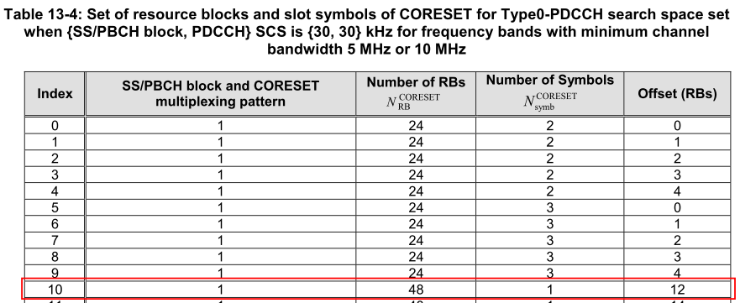
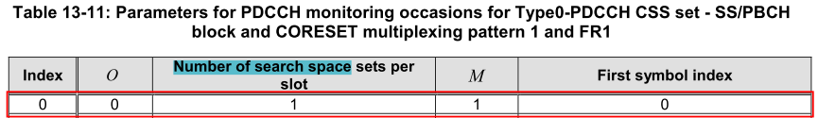
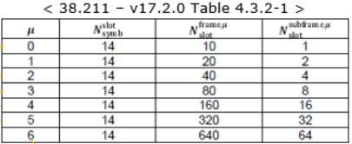
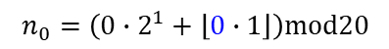
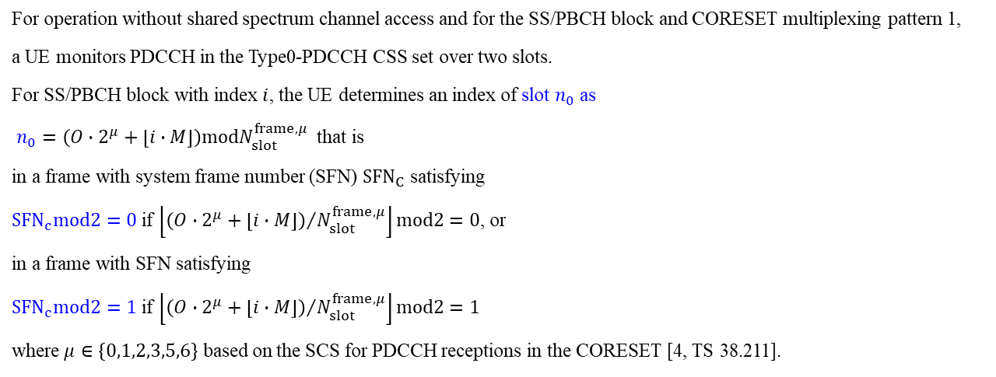
1980/01/07 05:29:22.389
1980/01/07 05:29:22.389 [0xB822] NR5G RRC MIB Info
Version = 3
Physical Cell ID = 1
DL Frequency = 637536
SFN = 760
Block Index = 0
Half Number = 0
Intra Freq Reselection = ALLOWED
Cell Barred = NOT_BARRED
PDCCH Config SIB1 = 160 // 1010 0000
DMRS TypeA Position = POS2
SSB Subcarrier Offset = 4
Subcarrier Spacing Common = SCSC30
For operation without shared spectrum channel access and for the SS/PBCH block and CORESET multiplexing pattern 1,
a UE monitors PDCCH in the Type0-PDCCH CSS set over two slots.
For SS/PBCH block with index $i$, the UE determines an index of slot $n_{0}$ as
$n_{0}=\left(O∙2^{μ}+\left\lfloor i∙M\right\rfloor \right)modN_{slot}^{frame,μ}$ that is
in a frame with system frame number (SFN) ${SFN}_{C}$ satisfying
${SFN}_{c}mod2=0$ if $\left\lfloor {\left(O∙2^{μ}+\left\lfloor i∙M\right\rfloor \right)}/{N_{slot}^{frame,μ}}\right\rfloor mod2=0$, or
in a frame with SFN satisfying
${SFN}_{c}mod2=1$ if $\left\lfloor {\left(O∙2^{μ}+\left\lfloor i∙M\right\rfloor \right)}/{N_{slot}^{frame,μ}}\right\rfloor mod2=1$
where $μ∈\left\{0,1,2,3,5,6\right\}$ based on the SCS for PDCCH receptions in the CORESET [4, TS 38.211].
$n_{0}=\left(0∙2^{1}+\left\lfloor 0∙1\right\rfloor \right)mod20$

Slide 13
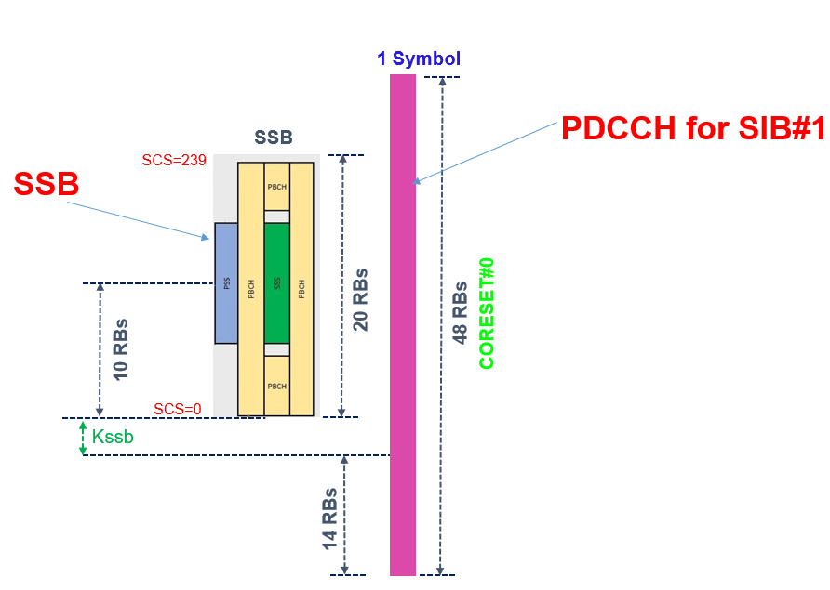
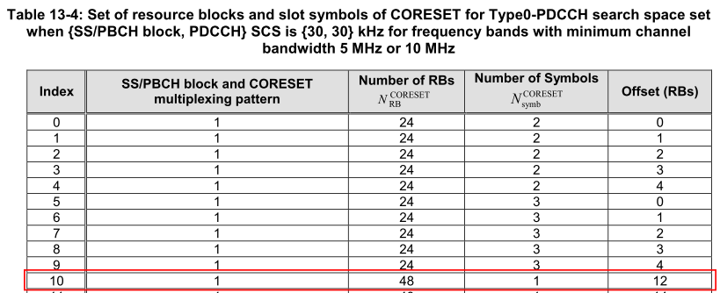
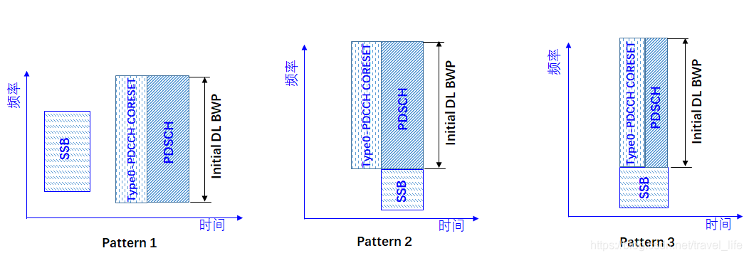
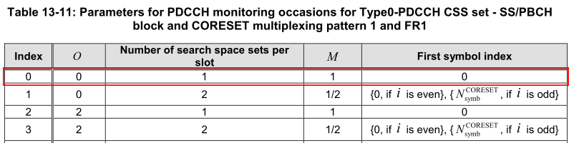
1980/01/07 05:29:22.644 [0xB822] NR5G RRC MIB Info
PDCCH Config SIB1 = 160 = 1010 0000
//Table 13-4, Index = 1010 = 10, Table 13-11 Index = 0000
DMRS TypeA Position = POS2
SSB Subcarrier Offset = 4
Subcarrier Spacing Common = SCSC30
[23/05/2023 09:47:24.590602][DURRM][TRC][gnb_du_rrm_dl_bwp.cpp:507] RRM_CALCULATED_CS_VALUES:CELL_ID:1:RRM_OFFSET_TO_POINT_A:27:RRM_CS0_RB_OFFSET:12:RRM_CS0_SIZE:48
[23/05/2023 09:47:24.590618][DURRM][TRC][gnb_du_rrm_dl_bwp.cpp:2289] RRM_CS0_CONFIGURED:CELL_ID:1:RRM_CS0_START_RB:1:RRM_CS0_NUM_RB:48:RRM_CS0_NUM_SYMBOLS:1
[23/05/2023 09:47:24.590620][DURRM][TRC][gnb_du_rrm_dl_bwp.cpp:2313] RRM_CS_CONFIGURED:CELL_ID:1:RRM_CS_ID:1:RRM_CS_START_RB:0:RRM_CS_NUM_RB:162
12 RBs
Notes:
<moduleId>OAMAG</moduleId> <logLevel>TRACE</logLevel>
<moduleId>DURRM</moduleId> <logLevel>TRACE</logLevel>
[19/05/2023 15:21:16.230623][OAMAG][INF][gnb_du_oam_app_intf_log.cpp:849] OAM_INTF_DL_BWP_CONFIGURATION:NUM_RB:273
[19/05/2023 15:21:16.230640][OAMAG][INF][gnb_du_oam_app_intf_log.cpp:773] OAM_INTF_UL_BWP_CFG:NUM_RB:273
[19/05/2023 15:21:16.230754][OAMAG][INF][gnb_du_oam_app_intf_log.cpp:567] OAM_INTF_SCS_LIST:CARRIER_BW:273
[19/05/2023 15:21:16.230769][OAMAG][INF][gnb_du_oam_app_intf_log.cpp:538] OAM_INTF_SCS_LIST:CARRIER_BW:273
[19/05/2023 15:21:19.257015][DURRM][TRC][gnb_du_rrm_dl_bwp.cpp:515] RRM_BWP_START_AND_NUM_PRB:CELL_ID:1:RRM_BWP0_START_PRB:0:RRM_BWP0_NUM_PRB:273
=======================================
https://www.sqimway.com/nr_rmsi.php
1980/01/07 05:29:22.644 LOG [0xB822] NR5G RRC MIB Info Length: 30
1980/01/07 05:29:22.644
1980/01/07 05:29:22.644 [0xB822] NR5G RRC MIB Info
Version = 3
Physical Cell ID = 1
DL Frequency = 637536
SFN = 818
Block Index = 0
Half Number = 0
Intra Freq Reselection = ALLOWED
Cell Barred = NOT_BARRED
PDCCH Config SIB1 = 160
DMRS TypeA Position = POS2
SSB Subcarrier Offset = 4
Subcarrier Spacing Common = SCSC30

Slide 14
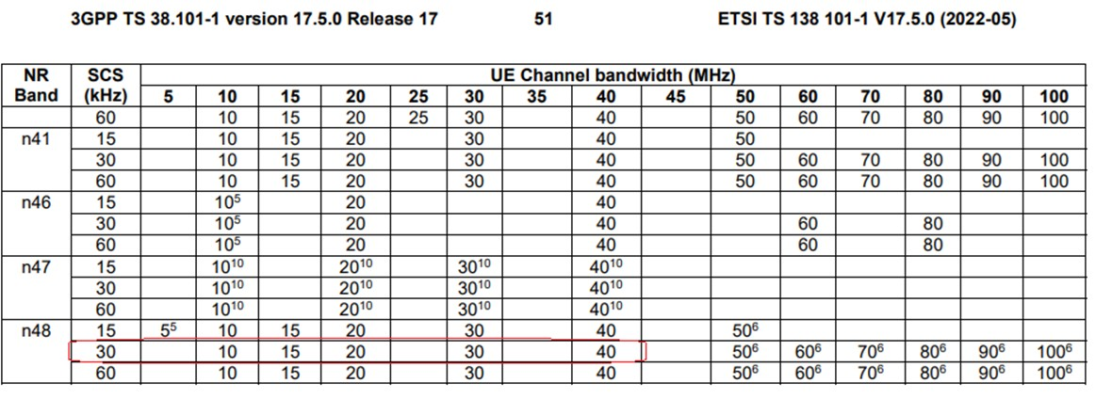
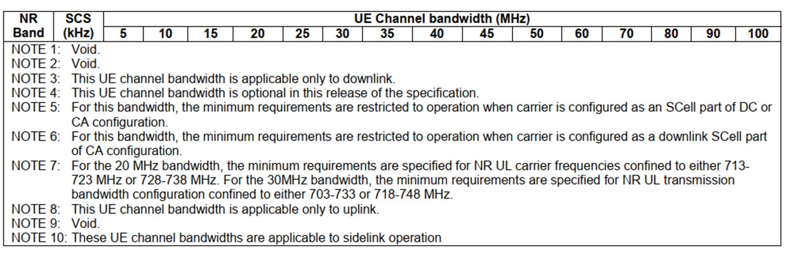
Note6
38.101 規定 n48 50MHz 以上都要做CA
不然不能用

Slide 15
載波中心頻率 dlEarfcn 640256 = nDlCenterFreq 3603840,
SSB Subcarrier Offset =4, offsetToCarrier=0, offsetToPointA=34
Point A = nDlCenterFreq – carrierBw/2*12 sub*subCarrierSpacing – offsetToCarrier *12*15
SSB Freq = Point A + offsetToPointA*12*15 + SSB Subcarrier Offset *15 + 10RB*12*subCarrierSpacing
Ex:
Point A = 3603840 – 273/2*12 *30 – 0 *12*15 = 3554700
SSB Freq = 3554700 + 34*12*15 + 4*15 + 10*12*30 = 3564480 = 3000000+N*1440, N=392
(3000M以下) F = 0 + 0.005*(ARFCN-0)
(3000M以上) F = 3000 + 0.015*(ARFCN-600000)
Ex: F = 3563040 = 3563.04 MHz
3564.48 = 3000 + 0.015*(ARFCN-600000)
ARFCN = 637536
3564.48 = 3000+N*1.44, N=392, GSCN=7499+392=7891
<dlFreqInfo>
<absFreqPointA>3554700</absFreqPointA>
<absArfcnPointA>636980</absArfcnPointA>
<absFreqSsb>3564480</absFreqSsb>
<absArfcnSsb>637632</absArfcnSsb>
<nrFreqBand>78</nrFreqBand>
<subCarrierCfg>
<offsetToCarrier>0</offsetToCarrier>
<subCarrierSpacing>KHz30</subCarrierSpacing>
<carrierBw>273</carrierBw>
</subCarrierCfg>
<bSChannelBwDL>100MHZ</bSChannelBwDL>
<dlEarfcn>640256</dlEarfcn>
</dlFreqInfo>
<nDlCenterFreq>3603840</nDlCenterFreq>
<nUlCenterFreq>3603840</nUlCenterFreq>
1980/01/07 06:01:29.079 [0xB822] NR5G RRC MIB Info
DL Frequency = 504990
SSB Subcarrier Offset = 4
Subcarrier Spacing Common = SCSC30
(3000M以下) F = 0 + 0.005*(ARFCN-0)
(3000M以上) F = 3000 + 0.015*(ARFCN-600000)
Ex: F = 3603840 = 3603.84 MHz
3603.84 = 3000 + 0.015*(ARFCN-600000)
ARFCN = 640256
[0xB821] BCCH_DL_SCH / SystemInformationBlockType1
frequencyInfoDL
{
frequencyBandList
{
{
freqBandIndicatorNR 41
}
},
offsetToPointA 26,
scs-SpecificCarrierList
{
{
offsetToCarrier 0,
subcarrierSpacing kHz30,
carrierBandwidth 273
}
}
},
initialDownlinkBWP
{
genericParameters
{
locationAndBandwidth 1099,
subcarrierSpacing kHz30
},
Notes:
3554700|636980|3563040|637536|640256|3603840
<dlFreqInfo>
<absFreqPointA>3554700</absFreqPointA>
<absArfcnPointA>636980</absArfcnPointA>
<absFreqSsb>3563040</absFreqSsb>
<absArfcnSsb>637536</absArfcnSsb>●
<nrFreqBand>78</nrFreqBand>
<subCarrierCfg>
<offsetToCarrier>0</offsetToCarrier>
<subCarrierSpacing>KHz30</subCarrierSpacing>
<carrierBw>273</carrierBw>
</subCarrierCfg>
<bSChannelBwDL>100MHZ</bSChannelBwDL>
<dlEarfcn>640256</dlEarfcn>●
</dlFreqInfo>
<nDlCenterFreq>3603840</nDlCenterFreq>
=================================================
1980/01/06 08:11:18.743 [0xB950] NR5G ML1 DL Common Config
dl_cell_frequency = 637536
1980/01/06 08:11:19.127 [0xB825] NR5G RRC Configuration Info
NR5G Serving Cell Info[0] {
CC Id = 0
Cell Id = 1
DL Arfcn = 640256
UL Arfcn = 640256
SSB Arfcn = 637536
Band = 78
Band Type = SUB6
DL Carrier Bandwidth = BW_100MHz
UL Carrier Bandwidth = BW_100MHz
DL Max MIMO = 4
UL Max MIMO = NA
}
1980/01/06 08:11:19.478 [0xB822] NR5G RRC MIB Info
DL Frequency = 637536
1980/01/06 08:11:19.479 [0xB821] BCCH_DL_SCH / SystemInformationBlockType1
frequencyBandList
{
{
freqBandIndicatorNR 78
}
},
offsetToPointA 26,
=================================================
載波中心頻率 dlEarfcn 513150 = nDlCenterFreq 2565750
Point A = nDlCenterFreq – carrierBw/2*12 sub*subCarrierSpacing – offsetToCarrier *12*15
SSB Freq = Point A + offsetToPointA*12*15 + SSB Subcarrier Offset *15 + 10RB*12*subCarrierSpacing
Ex:
Point A = 2565750 – 273/2*12 *30 – 0 *12*15 = 2516610
SSB Freq = 2516610 + 26*12*15 + 4*15 + 10*12*30 = 2524950

Slide 16
載波中心頻率 dlEarfcn 640256 = nDlCenterFreq 3603840,
SSB Subcarrier Offset =4, offsetToCarrier=0, offsetToPointA=42
Point A = nDlCenterFreq – carrierBw/2*12 sub*subCarrierSpacing – offsetToCarrier *12*15
SSB Freq = Point A + offsetToPointA*12*15 + SSB Subcarrier Offset *15 + 10RB*12*subCarrierSpacing
Ex:
Point A = 3603840 – 273/2*12 *30 – 0 *12*15 = 3554700
SSB Freq = 3554700 + 42*12*15 + 4*15 + 10*12*30 = 3565920 = 3000000+N*1440
(3000M以下) F = 0 + 0.005*(ARFCN-0)
(3000M以上) F = 3000 + 0.015*(ARFCN-600000)
Ex: F = 3563040 = 3563.04 MHz
3563.04 = 3000 + 0.015*(ARFCN-600000)
ARFCN = 637536
3563.04 = 3000+N*1.44, N=391, GSCN=7499+391=7890
<dlFreqInfo>
<absFreqPointA>3554700</absFreqPointA>
<absArfcnPointA>636980</absArfcnPointA>
<absFreqSsb>3565920</absFreqSsb>
<absArfcnSsb>637728</absArfcnSsb>
<nrFreqBand>78</nrFreqBand>
<subCarrierCfg>
<offsetToCarrier>0</offsetToCarrier>
<subCarrierSpacing>KHz30</subCarrierSpacing>
<carrierBw>273</carrierBw>
</subCarrierCfg>
<bSChannelBwDL>100MHZ</bSChannelBwDL>
<dlEarfcn>640256</dlEarfcn>
</dlFreqInfo>
<nDlCenterFreq>3603840</nDlCenterFreq>
<nUlCenterFreq>3603840</nUlCenterFreq>
1980/01/07 06:01:29.079 [0xB822] NR5G RRC MIB Info
DL Frequency = 504990
SSB Subcarrier Offset = 4
Subcarrier Spacing Common = SCSC30
(3000M以下) F = 0 + 0.005*(ARFCN-0)
(3000M以上) F = 3000 + 0.015*(ARFCN-600000)
Ex: F = 3603840 = 3603.84 MHz
3603.84 = 3000 + 0.015*(ARFCN-600000)
ARFCN = 640256
[0xB821] BCCH_DL_SCH / SystemInformationBlockType1
frequencyInfoDL
{
frequencyBandList
{
{
freqBandIndicatorNR 41
}
},
offsetToPointA 26,
scs-SpecificCarrierList
{
{
offsetToCarrier 0,
subcarrierSpacing kHz30,
carrierBandwidth 273
}
}
},
initialDownlinkBWP
{
genericParameters
{
locationAndBandwidth 1099,
subcarrierSpacing kHz30
},
Notes:
3554700|636980|3563040|637536|640256|3603840
<dlFreqInfo>
<absFreqPointA>3554700</absFreqPointA>
<absArfcnPointA>636980</absArfcnPointA>
<absFreqSsb>3563040</absFreqSsb>
<absArfcnSsb>637536</absArfcnSsb>●
<nrFreqBand>78</nrFreqBand>
<subCarrierCfg>
<offsetToCarrier>0</offsetToCarrier>
<subCarrierSpacing>KHz30</subCarrierSpacing>
<carrierBw>273</carrierBw>
</subCarrierCfg>
<bSChannelBwDL>100MHZ</bSChannelBwDL>
<dlEarfcn>640256</dlEarfcn>●
</dlFreqInfo>
<nDlCenterFreq>3603840</nDlCenterFreq>
=================================================
1980/01/06 08:11:18.743 [0xB950] NR5G ML1 DL Common Config
dl_cell_frequency = 637536
1980/01/06 08:11:19.127 [0xB825] NR5G RRC Configuration Info
NR5G Serving Cell Info[0] {
CC Id = 0
Cell Id = 1
DL Arfcn = 640256
UL Arfcn = 640256
SSB Arfcn = 637536
Band = 78
Band Type = SUB6
DL Carrier Bandwidth = BW_100MHz
UL Carrier Bandwidth = BW_100MHz
DL Max MIMO = 4
UL Max MIMO = NA
}
1980/01/06 08:11:19.478 [0xB822] NR5G RRC MIB Info
DL Frequency = 637536
1980/01/06 08:11:19.479 [0xB821] BCCH_DL_SCH / SystemInformationBlockType1
frequencyBandList
{
{
freqBandIndicatorNR 78
}
},
offsetToPointA 26,
=================================================
載波中心頻率 dlEarfcn 513150 = nDlCenterFreq 2565750
Point A = nDlCenterFreq – carrierBw/2*12 sub*subCarrierSpacing – offsetToCarrier *12*15
SSB Freq = Point A + offsetToPointA*12*15 + SSB Subcarrier Offset *15 + 10RB*12*subCarrierSpacing
Ex:
Point A = 2565750 – 273/2*12 *30 – 0 *12*15 = 2516610
SSB Freq = 2516610 + 26*12*15 + 4*15 + 10*12*30 = 2524950

Slide 17
載波中心頻率 dlEarfcn 640256 = nDlCenterFreq 3603840,
SSB Subcarrier Offset =4, offsetToCarrier=0, offsetToPointA=18
Point A = nDlCenterFreq – carrierBw/2*12 sub*subCarrierSpacing – offsetToCarrier *12*15
SSB Freq = Point A + offsetToPointA*12*15 + SSB Subcarrier Offset *15 + 10RB*12*subCarrierSpacing
Ex:
Point A = 3603840 – 273/2*12 *30 – 0 *12*15 = 3554700
SSB Freq = 3554700 + 18*12*15 + 4*15 + 10*12*30 = 3561600
(3000M以下) F = 0 + 0.005*(ARFCN-0)
(3000M以上) F = 3000 + 0.015*(ARFCN-600000)
Ex: F = 3563040 = 3563.04 MHz
3563.04 = 3000 + 0.015*(ARFCN-600000)
ARFCN = 637536
3563.04 = 3000+N*1.44, N=391, GSCN=7499+391=7890
<dlFreqInfo>
<absFreqPointA>3554700</absFreqPointA>
<absArfcnPointA>636980</absArfcnPointA>
<absFreqSsb>3561600</absFreqSsb>
<absArfcnSsb>637440</absArfcnSsb>
<nrFreqBand>78</nrFreqBand>
<subCarrierCfg>
<offsetToCarrier>0</offsetToCarrier>
<subCarrierSpacing>KHz30</subCarrierSpacing>
<carrierBw>273</carrierBw>
</subCarrierCfg>
<bSChannelBwDL>100MHZ</bSChannelBwDL>
<dlEarfcn>640256</dlEarfcn>
</dlFreqInfo>
<nDlCenterFreq>3603840</nDlCenterFreq>
<nUlCenterFreq>3603840</nUlCenterFreq>
1980/01/07 06:01:29.079 [0xB822] NR5G RRC MIB Info
DL Frequency = 504990
SSB Subcarrier Offset = 4
Subcarrier Spacing Common = SCSC30
(3000M以下) F = 0 + 0.005*(ARFCN-0)
(3000M以上) F = 3000 + 0.015*(ARFCN-600000)
Ex: F = 3603840 = 3603.84 MHz
3603.84 = 3000 + 0.015*(ARFCN-600000)
ARFCN = 640256
[0xB821] BCCH_DL_SCH / SystemInformationBlockType1
frequencyInfoDL
{
frequencyBandList
{
{
freqBandIndicatorNR 41
}
},
offsetToPointA 26,
scs-SpecificCarrierList
{
{
offsetToCarrier 0,
subcarrierSpacing kHz30,
carrierBandwidth 273
}
}
},
initialDownlinkBWP
{
genericParameters
{
locationAndBandwidth 1099,
subcarrierSpacing kHz30
},
Notes:
3554700|636980|3563040|637536|640256|3603840
<dlFreqInfo>
<absFreqPointA>3554700</absFreqPointA>
<absArfcnPointA>636980</absArfcnPointA>
<absFreqSsb>3563040</absFreqSsb>
<absArfcnSsb>637536</absArfcnSsb>●
<nrFreqBand>78</nrFreqBand>
<subCarrierCfg>
<offsetToCarrier>0</offsetToCarrier>
<subCarrierSpacing>KHz30</subCarrierSpacing>
<carrierBw>273</carrierBw>
</subCarrierCfg>
<bSChannelBwDL>100MHZ</bSChannelBwDL>
<dlEarfcn>640256</dlEarfcn>●
</dlFreqInfo>
<nDlCenterFreq>3603840</nDlCenterFreq>
=================================================
1980/01/06 08:11:18.743 [0xB950] NR5G ML1 DL Common Config
dl_cell_frequency = 637536
1980/01/06 08:11:19.127 [0xB825] NR5G RRC Configuration Info
NR5G Serving Cell Info[0] {
CC Id = 0
Cell Id = 1
DL Arfcn = 640256
UL Arfcn = 640256
SSB Arfcn = 637536
Band = 78
Band Type = SUB6
DL Carrier Bandwidth = BW_100MHz
UL Carrier Bandwidth = BW_100MHz
DL Max MIMO = 4
UL Max MIMO = NA
}
1980/01/06 08:11:19.478 [0xB822] NR5G RRC MIB Info
DL Frequency = 637536
1980/01/06 08:11:19.479 [0xB821] BCCH_DL_SCH / SystemInformationBlockType1
frequencyBandList
{
{
freqBandIndicatorNR 78
}
},
offsetToPointA 26,
=================================================
載波中心頻率 dlEarfcn 513150 = nDlCenterFreq 2565750
Point A = nDlCenterFreq – carrierBw/2*12 sub*subCarrierSpacing – offsetToCarrier *12*15
SSB Freq = Point A + offsetToPointA*12*15 + SSB Subcarrier Offset *15 + 10RB*12*subCarrierSpacing
Ex:
Point A = 2565750 – 273/2*12 *30 – 0 *12*15 = 2516610
SSB Freq = 2516610 + 26*12*15 + 4*15 + 10*12*30 = 2524950

Slide 18
載波中心頻率 dlEarfcn 640256 = nDlCenterFreq 3603840,
SSB Subcarrier Offset =4, offsetToCarrier=0, offsetToPointA=30
Point A = nDlCenterFreq – carrierBw/2*12 sub*subCarrierSpacing – offsetToCarrier *12*15
SSB Freq = Point A + offsetToPointA*12*15 + SSB Subcarrier Offset *15 + 10RB*12*subCarrierSpacing
Ex:
Point A = 3603840 – 245/2*12 *30 – 0 *12*15 = 3559740
SSB Freq = 3559740 + 30*12*15 + 4*15 + 10*12*30 = 3568800 = 3000000+N*1440, N=395
(3000M以下) F = 0 + 0.005*(ARFCN-0)
(3000M以上) F = 3000 + 0.015*(ARFCN-600000)
Ex: F = 3568800 = 3568.8 MHz
3568.8 = 3000 + 0.015*(ARFCN-600000)
ARFCN = 637920
3568.8 = 3000+N*1.44, N=395, GSCN=7499+395=7890
<dlFreqInfo>
<absFreqPointA>3559740</absFreqPointA>
<absArfcnPointA>637316</absArfcnPointA>
<absFreqSsb>3568800</absFreqSsb>
<absArfcnSsb>637920</absArfcnSsb>
<nrFreqBand>78</nrFreqBand>
<subCarrierCfg>
<offsetToCarrier>0</offsetToCarrier>
<subCarrierSpacing>KHz30</subCarrierSpacing>
<carrierBw>245</carrierBw>
</subCarrierCfg>
<bSChannelBwDL>90MHZ</bSChannelBwDL>
<dlEarfcn>640256</dlEarfcn>
</dlFreqInfo>
<nDlCenterFreq>3603840</nDlCenterFreq>
<nUlCenterFreq>3603840</nUlCenterFreq>
1980/01/07 06:01:29.079 [0xB822] NR5G RRC MIB Info
DL Frequency = 504990
SSB Subcarrier Offset = 4
Subcarrier Spacing Common = SCSC30
(3000M以下) F = 0 + 0.005*(ARFCN-0)
(3000M以上) F = 3000 + 0.015*(ARFCN-600000)
Ex: F = 3603840 = 3603.84 MHz
3603.84 = 3000 + 0.015*(ARFCN-600000)
ARFCN = 640256
[0xB821] BCCH_DL_SCH / SystemInformationBlockType1
frequencyInfoDL
{
frequencyBandList
{
{
freqBandIndicatorNR 41
}
},
offsetToPointA 26,
scs-SpecificCarrierList
{
{
offsetToCarrier 0,
subcarrierSpacing kHz30,
carrierBandwidth 273
}
}
},
initialDownlinkBWP
{
genericParameters
{
locationAndBandwidth 1099,
subcarrierSpacing kHz30
},
Notes:
載波中心頻率 dlEarfcn 513150 = nDlCenterFreq 2565750
Point A = nDlCenterFreq – carrierBw/2*12 sub*subCarrierSpacing – offsetToCarrier *12*15
SSB Freq = Point A + offsetToPointA*12*15 + SSB Subcarrier Offset *15 + 10RB*12*subCarrierSpacing
Ex:
Point A = 2565750 – 273/2*12 *30 – 0 *12*15 = 2516610
SSB Freq = 2516610 + 26*12*15 + 4*15 + 10*12*30 = 2524950

Slide 19
載波中心頻率 dlEarfcn 640256 = nDlCenterFreq 3603840,
SSB Subcarrier Offset =4, offsetToCarrier=0, offsetToPointA=26
Point A = nDlCenterFreq – carrierBw/2*12 sub*subCarrierSpacing – offsetToCarrier *12*15
SSB Freq = Point A + offsetToPointA*12*15 + SSB Subcarrier Offset *15 + 10RB*12*subCarrierSpacing
Ex:
Point A = 3603840 – 217/2*12 *30 – 0 *12*15 = 3564780
SSB Freq = 3564780 + 26*12*15 + 4*15 + 10*12*30 = 3573120 = 3000000+N*1440, N=398
(3000M以下) F = 0 + 0.005*(ARFCN-0)
(3000M以上) F = 3000 + 0.015*(ARFCN-600000)
Ex: F = 3573120 = 3573.120 MHz
3573.120= 3000 + 0.015*(ARFCN-600000)
ARFCN = 638208
3573.120 = 3000+N*1.44, N=398, GSCN=7499+398=7897
<dlFreqInfo>
<absFreqPointA>3564780</absFreqPointA>
<absArfcnPointA>637652</absArfcnPointA>
<absFreqSsb>3573120</absFreqSsb>
<absArfcnSsb>638208</absArfcnSsb>
<nrFreqBand>78</nrFreqBand>
<subCarrierCfg>
<offsetToCarrier>0</offsetToCarrier>
<subCarrierSpacing>KHz30</subCarrierSpacing>
<carrierBw>217</carrierBw>
</subCarrierCfg>
<bSChannelBwDL>80MHZ</bSChannelBwDL>
<dlEarfcn>640256</dlEarfcn>
</dlFreqInfo>
<nDlCenterFreq>3603840</nDlCenterFreq>
<nUlCenterFreq>3603840</nUlCenterFreq>
1980/01/07 06:01:29.079 [0xB822] NR5G RRC MIB Info
DL Frequency = 504990
SSB Subcarrier Offset = 4
Subcarrier Spacing Common = SCSC30
(3000M以下) F = 0 + 0.005*(ARFCN-0)
(3000M以上) F = 3000 + 0.015*(ARFCN-600000)
Ex: F = 3603840 = 3603.84 MHz
3603.84 = 3000 + 0.015*(ARFCN-600000)
ARFCN = 640256
[0xB821] BCCH_DL_SCH / SystemInformationBlockType1
frequencyInfoDL
{
frequencyBandList
{
{
freqBandIndicatorNR 41
}
},
offsetToPointA 26,
scs-SpecificCarrierList
{
{
offsetToCarrier 0,
subcarrierSpacing kHz30,
carrierBandwidth 273
}
}
},
initialDownlinkBWP
{
genericParameters
{
locationAndBandwidth 1099,
subcarrierSpacing kHz30
},
Notes:
載波中心頻率 dlEarfcn 513150 = nDlCenterFreq 2565750
Point A = nDlCenterFreq – carrierBw/2*12 sub*subCarrierSpacing – offsetToCarrier *12*15
SSB Freq = Point A + offsetToPointA*12*15 + SSB Subcarrier Offset *15 + 10RB*12*subCarrierSpacing
Ex:
Point A = 2565750 – 273/2*12 *30 – 0 *12*15 = 2516610
SSB Freq = 2516610 + 26*12*15 + 4*15 + 10*12*30 = 2524950

Slide 20
載波中心頻率 dlEarfcn 640256 = nDlCenterFreq 3603840,
SSB Subcarrier Offset =4, offsetToCarrier=0, offsetToPointA=30
Point A = nDlCenterFreq – carrierBw/2*12 sub*subCarrierSpacing – offsetToCarrier *12*15
SSB Freq = Point A + offsetToPointA*12*15 + SSB Subcarrier Offset *15 + 10RB*12*subCarrierSpacing
Ex:
Point A = 3603840 – 189/2*12 *30 – 0 *12*15 = 3569820
SSB Freq = 3569820 + 30*12*15 + 4*15 + 10*12*30 = 3578880 = 3000000+N*1440, N=402
(3000M以下) F = 0 + 0.005*(ARFCN-0)
(3000M以上) F = 3000 + 0.015*(ARFCN-600000)
Ex: F = 3573120 = 3573.120 MHz
3573.120= 3000 + 0.015*(ARFCN-600000)
ARFCN = 638208
3573.120 = 3000+N*1.44, N=398, GSCN=7499+398=7897
<dlFreqInfo>
<absFreqPointA>3569820</absFreqPointA>
<absArfcnPointA>637988</absArfcnPointA>
<absFreqSsb> 3578880</absFreqSsb>
<absArfcnSsb>638592</absArfcnSsb>
<nrFreqBand>78</nrFreqBand>
<subCarrierCfg>
<offsetToCarrier>0</offsetToCarrier>
<subCarrierSpacing>KHz30</subCarrierSpacing>
<carrierBw>217</carrierBw>
</subCarrierCfg>
<bSChannelBwDL>80MHZ</bSChannelBwDL>
<dlEarfcn>640256</dlEarfcn>
</dlFreqInfo>
<nDlCenterFreq>3603840</nDlCenterFreq>
<nUlCenterFreq>3603840</nUlCenterFreq>
1980/01/07 06:01:29.079 [0xB822] NR5G RRC MIB Info
DL Frequency = 504990
SSB Subcarrier Offset = 4
Subcarrier Spacing Common = SCSC30
(3000M以下) F = 0 + 0.005*(ARFCN-0)
(3000M以上) F = 3000 + 0.015*(ARFCN-600000)
Ex: F = 3603840 = 3603.84 MHz
3603.84 = 3000 + 0.015*(ARFCN-600000)
ARFCN = 640256
[0xB821] BCCH_DL_SCH / SystemInformationBlockType1
frequencyInfoDL
{
frequencyBandList
{
{
freqBandIndicatorNR 41
}
},
offsetToPointA 26,
scs-SpecificCarrierList
{
{
offsetToCarrier 0,
subcarrierSpacing kHz30,
carrierBandwidth 273
}
}
},
initialDownlinkBWP
{
genericParameters
{
locationAndBandwidth 1099,
subcarrierSpacing kHz30
},
Notes:
載波中心頻率 dlEarfcn 513150 = nDlCenterFreq 2565750
Point A = nDlCenterFreq – carrierBw/2*12 sub*subCarrierSpacing – offsetToCarrier *12*15
SSB Freq = Point A + offsetToPointA*12*15 + SSB Subcarrier Offset *15 + 10RB*12*subCarrierSpacing
Ex:
Point A = 2565750 – 273/2*12 *30 – 0 *12*15 = 2516610
SSB Freq = 2516610 + 26*12*15 + 4*15 + 10*12*30 = 2524950

Slide 21
載波中心頻率 dlEarfcn 640256 = nDlCenterFreq 3603840,
SSB Subcarrier Offset =4, offsetToCarrier=0, offsetToPointA=3
Point A = nDlCenterFreq – carrierBw/2*12 sub*subCarrierSpacing – offsetToCarrier *12*15
SSB Freq = Point A + offsetToPointA*12*15 + SSB Subcarrier Offset *15 + 10RB*12*subCarrierSpacing
Ex:
Point A = 3603840 – 162/2*12 *30 – 0 *12*15 = 3574680
SSB Freq = 3574680 + 3*12*15 + 4*15 + 10*12*30 = 3578880 = 3000000+N*1440, N=403
(3000M以下) F = 0 + 0.005*(ARFCN-0)
(3000M以上) F = 3000 + 0.015*(ARFCN-600000)
Ex: F = 3580320 = 3580.320 MHz
3580.320 = 3000 + 0.015*(ARFCN-600000)
ARFCN = 637536
3563.04 = 3000+N*1.44, N=403, GSCN=7499+391=7890
<dlFreqInfo>
<absFreqPointA>3574680</absFreqPointA>
<absArfcnPointA>638312</absArfcnPointA>
<absFreqSsb>3578880</absFreqSsb>
<absArfcnSsb>638592</absArfcnSsb>
<nrFreqBand>78</nrFreqBand>
<subCarrierCfg>
<offsetToCarrier>0</offsetToCarrier>
<subCarrierSpacing>KHz30</subCarrierSpacing>
<carrierBw>162</carrierBw>
</subCarrierCfg>
<bSChannelBwDL>60MHZ</bSChannelBwDL>
<dlEarfcn>640256</dlEarfcn>
</dlFreqInfo>
<nDlCenterFreq>3603840</nDlCenterFreq>
<nUlCenterFreq>3603840</nUlCenterFreq>
1980/01/07 06:01:29.079 [0xB822] NR5G RRC MIB Info
DL Frequency = 504990
SSB Subcarrier Offset = 4
Subcarrier Spacing Common = SCSC30
(3000M以下) F = 0 + 0.005*(ARFCN-0)
(3000M以上) F = 3000 + 0.015*(ARFCN-600000)
Ex: F = 3603840 = 3603.84 MHz
3603.84 = 3000 + 0.015*(ARFCN-600000)
ARFCN = 640256
[0xB821] BCCH_DL_SCH / SystemInformationBlockType1
frequencyInfoDL
{
frequencyBandList
{
{
freqBandIndicatorNR 41
}
},
offsetToPointA 26,
scs-SpecificCarrierList
{
{
offsetToCarrier 0,
subcarrierSpacing kHz30,
carrierBandwidth 273
}
}
},
initialDownlinkBWP
{
genericParameters
{
locationAndBandwidth 1099,
subcarrierSpacing kHz30
},
Notes:
載波中心頻率 dlEarfcn 513150 = nDlCenterFreq 2565750
Point A = nDlCenterFreq – carrierBw/2*12 sub*subCarrierSpacing – offsetToCarrier *12*15
SSB Freq = Point A + offsetToPointA*12*15 + SSB Subcarrier Offset *15 + 10RB*12*subCarrierSpacing
Ex:
Point A = 2565750 – 273/2*12 *30 – 0 *12*15 = 2516610
SSB Freq = 2516610 + 26*12*15 + 4*15 + 10*12*30 = 2524950

Slide 22
載波中心頻率 dlEarfcn 640256 = nDlCenterFreq 3603840,
SSB Subcarrier Offset =4, offsetToCarrier=0, offsetToPointA=11
Point A = nDlCenterFreq – carrierBw/2*12 sub*subCarrierSpacing – offsetToCarrier *12*15
SSB Freq = Point A + offsetToPointA*12*15 + SSB Subcarrier Offset *15 + 10RB*12*subCarrierSpacing
Ex:
Point A = 3603840 – 162/2*12 *30 – 0 *12*15 = 3574680
SSB Freq = 3574680 + 11*12*15 + 4*15 + 10*12*30 = 3580320 = 3000000+N*1440, N=403
(3000M以下) F = 0 + 0.005*(ARFCN-0)
(3000M以上) F = 3000 + 0.015*(ARFCN-600000)
Ex: F = 3580320 = 3580.320 MHz
3580.320 = 3000 + 0.015*(ARFCN-600000)
ARFCN = 637536
3563.04 = 3000+N*1.44, N=403, GSCN=7499+391=7890
<dlFreqInfo>
<absFreqPointA>3574680</absFreqPointA>
<absArfcnPointA>638312</absArfcnPointA>
<absFreqSsb>3580320</absFreqSsb>
<absArfcnSsb>638688</absArfcnSsb>
<nrFreqBand>78</nrFreqBand>
<subCarrierCfg>
<offsetToCarrier>0</offsetToCarrier>
<subCarrierSpacing>KHz30</subCarrierSpacing>
<carrierBw>162</carrierBw>
</subCarrierCfg>
<bSChannelBwDL>60MHZ</bSChannelBwDL>
<dlEarfcn>640256</dlEarfcn>
</dlFreqInfo>
<nDlCenterFreq>3603840</nDlCenterFreq>
<nUlCenterFreq>3603840</nUlCenterFreq>
1980/01/07 06:01:29.079 [0xB822] NR5G RRC MIB Info
DL Frequency = 504990
SSB Subcarrier Offset = 4
Subcarrier Spacing Common = SCSC30
(3000M以下) F = 0 + 0.005*(ARFCN-0)
(3000M以上) F = 3000 + 0.015*(ARFCN-600000)
Ex: F = 3603840 = 3603.84 MHz
3603.84 = 3000 + 0.015*(ARFCN-600000)
ARFCN = 640256
[0xB821] BCCH_DL_SCH / SystemInformationBlockType1
frequencyInfoDL
{
frequencyBandList
{
{
freqBandIndicatorNR 41
}
},
offsetToPointA 26,
scs-SpecificCarrierList
{
{
offsetToCarrier 0,
subcarrierSpacing kHz30,
carrierBandwidth 273
}
}
},
initialDownlinkBWP
{
genericParameters
{
locationAndBandwidth 1099,
subcarrierSpacing kHz30
},
Notes:
載波中心頻率 dlEarfcn 513150 = nDlCenterFreq 2565750
Point A = nDlCenterFreq – carrierBw/2*12 sub*subCarrierSpacing – offsetToCarrier *12*15
SSB Freq = Point A + offsetToPointA*12*15 + SSB Subcarrier Offset *15 + 10RB*12*subCarrierSpacing
Ex:
Point A = 2565750 – 273/2*12 *30 – 0 *12*15 = 2516610
SSB Freq = 2516610 + 26*12*15 + 4*15 + 10*12*30 = 2524950

Slide 23
載波中心頻率 dlEarfcn 640256 = nDlCenterFreq 3603840,
SSB Subcarrier Offset =4, offsetToCarrier=0, offsetToPointA=19
Point A = nDlCenterFreq – carrierBw/2*12 sub*subCarrierSpacing – offsetToCarrier *12*15
SSB Freq = Point A + offsetToPointA*12*15 + SSB Subcarrier Offset *15 + 10RB*12*subCarrierSpacing
Ex:
Point A = 3603840 – 162/2*12 *30 – 0 *12*15 = 3574680
SSB Freq = 3574680 + 19*12*15 + 4*15 + 10*12*30 = 3581760 = 3000000+N*1440, N=404
(3000M以下) F = 0 + 0.005*(ARFCN-0)
(3000M以上) F = 3000 + 0.015*(ARFCN-600000)
Ex: F = 3563040 = 3563.04 MHz
3563.04 = 3000 + 0.015*(ARFCN-600000)
ARFCN = 637536
3563.04 = 3000+N*1.44, N=404, GSCN=7499+404=7890
<dlFreqInfo>
<absFreqPointA>3574680</absFreqPointA>
<absArfcnPointA>638312</absArfcnPointA>
<absFreqSsb>3581760</absFreqSsb>
<absArfcnSsb>638784</absArfcnSsb>
<nrFreqBand>78</nrFreqBand>
<subCarrierCfg>
<offsetToCarrier>0</offsetToCarrier>
<subCarrierSpacing>KHz30</subCarrierSpacing>
<carrierBw>162</carrierBw>
</subCarrierCfg>
<bSChannelBwDL>60MHZ</bSChannelBwDL>
<dlEarfcn>640256</dlEarfcn>
</dlFreqInfo>
<nDlCenterFreq>3603840</nDlCenterFreq>
<nUlCenterFreq>3603840</nUlCenterFreq>
1980/01/07 06:01:29.079 [0xB822] NR5G RRC MIB Info
DL Frequency = 504990
SSB Subcarrier Offset = 4
Subcarrier Spacing Common = SCSC30
(3000M以下) F = 0 + 0.005*(ARFCN-0)
(3000M以上) F = 3000 + 0.015*(ARFCN-600000)
Ex: F = 3603840 = 3603.84 MHz
3603.84 = 3000 + 0.015*(ARFCN-600000)
ARFCN = 640256
[0xB821] BCCH_DL_SCH / SystemInformationBlockType1
frequencyInfoDL
{
frequencyBandList
{
{
freqBandIndicatorNR 41
}
},
offsetToPointA 26,
scs-SpecificCarrierList
{
{
offsetToCarrier 0,
subcarrierSpacing kHz30,
carrierBandwidth 273
}
}
},
initialDownlinkBWP
{
genericParameters
{
locationAndBandwidth 1099,
subcarrierSpacing kHz30
},
Notes:
載波中心頻率 dlEarfcn 513150 = nDlCenterFreq 2565750
Point A = nDlCenterFreq – carrierBw/2*12 sub*subCarrierSpacing – offsetToCarrier *12*15
SSB Freq = Point A + offsetToPointA*12*15 + SSB Subcarrier Offset *15 + 10RB*12*subCarrierSpacing
Ex:
Point A = 2565750 – 273/2*12 *30 – 0 *12*15 = 2516610
SSB Freq = 2516610 + 26*12*15 + 4*15 + 10*12*30 = 2524950

Slide 24
BW60, 載波中心頻率 dlEarfcn 640256 = nDlCenterFreq 3603840,
SSB Subcarrier Offset =4, offsetToCarrier=0, offsetToPointA=27
Point A = nDlCenterFreq – carrierBw/2*12 sub*subCarrierSpacing – offsetToCarrier *12*15
SSB Freq = Point A + offsetToPointA*12*15 + SSB Subcarrier Offset *15 + 10RB*12*subCarrierSpacing
Ex:
absFreqPointA = 3603840 – 162/2*12 *30 – 0 *12*15 = 3574680
absFreqSsb = 3574680 + 27*12*15 + 4*15 + 10*12*30 = 3583200 = 3000000+N*1440, N=405
(3000M以下) F = 0 + 0.005*(ARFCN-0)
(3000M以上) F = 3000 + 0.015*(ARFCN-600000)
Ex: F = 3563040 = 3563.04 MHz
3583.2 = 3000 + 0.015*(ARFCN-600000)
ARFCN = 638880
3583.2 = 3000+N*1.44, N=405 GSCN=7499+405=7904
<dlFreqInfo>
<absFreqPointA>3574680</absFreqPointA>
<absArfcnPointA>638312</absArfcnPointA>
<absFreqSsb>3583200</absFreqSsb>
<absArfcnSsb>638880</absArfcnSsb>
<nrFreqBand>78</nrFreqBand>
<subCarrierCfg>
<offsetToCarrier>0</offsetToCarrier>
<subCarrierSpacing>KHz30</subCarrierSpacing>
<carrierBw>162</carrierBw>
</subCarrierCfg>
<bSChannelBwDL>60MHZ</bSChannelBwDL>
<dlEarfcn>640256</dlEarfcn>
</dlFreqInfo>
<nDlCenterFreq>3603840</nDlCenterFreq>
<nUlCenterFreq>3603840</nUlCenterFreq>
1980/01/07 06:01:29.079 [0xB822] NR5G RRC MIB Info
DL Frequency = 504990
SSB Subcarrier Offset = 4
Subcarrier Spacing Common = SCSC30
(3000M以下) F = 0 + 0.005*(ARFCN-0)
(3000M以上) F = 3000 + 0.015*(ARFCN-600000)
Ex: F = 3603840 = 3603.84 MHz
3603.84 = 3000 + 0.015*(ARFCN-600000)
ARFCN = 640256
[0xB821] BCCH_DL_SCH / SystemInformationBlockType1
frequencyInfoDL
{
frequencyBandList
{
{
freqBandIndicatorNR 41
}
},
offsetToPointA 26,
scs-SpecificCarrierList
{
{
offsetToCarrier 0,
subcarrierSpacing kHz30,
carrierBandwidth 273
}
}
},
initialDownlinkBWP
{
genericParameters
{
locationAndBandwidth 1099,
subcarrierSpacing kHz30
},
Notes:
載波中心頻率 dlEarfcn 513150 = nDlCenterFreq 2565750
Point A = nDlCenterFreq – carrierBw/2*12 sub*subCarrierSpacing – offsetToCarrier *12*15
SSB Freq = Point A + offsetToPointA*12*15 + SSB Subcarrier Offset *15 + 10RB*12*subCarrierSpacing
Ex:
Point A = 2565750 – 273/2*12 *30 – 0 *12*15 = 2516610
SSB Freq = 2516610 + 26*12*15 + 4*15 + 10*12*30 = 2524950

Slide 25
BW60, 載波中心頻率 dlEarfcn 640256 = nDlCenterFreq 3603840,
SSB Subcarrier Offset =16, offsetToCarrier=0, offsetToPointA=26
Point A = nDlCenterFreq – carrierBw/2*12 sub*subCarrierSpacing – offsetToCarrier *12*15
SSB Freq = Point A + offsetToPointA*12*15 + SSB Subcarrier Offset *15 + 10RB*12*subCarrierSpacing
Ex:
absFreqPointA = 3603840 – 162/2*12 *30 – 0 *12*15 = 3574680
absFreqSsb = 3574680 + 26*12*15 + 16*15 + 10*12*30 = 3583200 = 3000000+N*1440, N=405
(3000M以下) F = 0 + 0.005*(ARFCN-0)
(3000M以上) F = 3000 + 0.015*(ARFCN-600000)
Ex: F = 3563040 = 3563.04 MHz
3583.2 = 3000 + 0.015*(ARFCN-600000)
ARFCN = 638880
3583.2 = 3000+N*1.44, N=405 GSCN=7499+405=7904
<dlFreqInfo>
<absFreqPointA>3574680</absFreqPointA>
<absArfcnPointA>638312</absArfcnPointA>
<absFreqSsb>3583200</absFreqSsb>
<absArfcnSsb>638880</absArfcnSsb>
<nrFreqBand>78</nrFreqBand>
<subCarrierCfg>
<offsetToCarrier>0</offsetToCarrier>
<subCarrierSpacing>KHz30</subCarrierSpacing>
<carrierBw>162</carrierBw>
</subCarrierCfg>
<bSChannelBwDL>60MHZ</bSChannelBwDL>
<dlEarfcn>640256</dlEarfcn>
</dlFreqInfo>
<nDlCenterFreq>3603840</nDlCenterFreq>
<nUlCenterFreq>3603840</nUlCenterFreq>
1980/01/07 06:01:29.079 [0xB822] NR5G RRC MIB Info
DL Frequency = 504990
SSB Subcarrier Offset = 4
Subcarrier Spacing Common = SCSC30
3583200
(3000M以下) F = 0 + 0.005*(ARFCN-0)
(3000M以上) F = 3000 + 0.015*(ARFCN-600000)
Ex: F = 3603840 = 3603.84 MHz
3603.84 = 3000 + 0.015*(ARFCN-600000)
ARFCN = 640256
10*12*30
3603840
[0xB821] BCCH_DL_SCH / SystemInformationBlockType1
frequencyInfoDL
{
frequencyBandList
{
{
freqBandIndicatorNR 41
}
},
offsetToPointA 26,
scs-SpecificCarrierList
{
{
offsetToCarrier 0,
subcarrierSpacing kHz30,
carrierBandwidth 273
}
}
},
initialDownlinkBWP
{
genericParameters
{
locationAndBandwidth 1099,
subcarrierSpacing kHz30
},
162/2*12 *30
3579600
16*15
26*12*15
0 *12*15
3574680
3579600
Kssb=4*15=60
Kssb=16*15=240
4920
OffsetToPointA
=27*12*15=4860
4860/360=13.5(非整)
OffsetToPointA
=26*12*15=4680
4680/360= 13
3574680
PointA
RB=30scs*12subcarrier=360
Notes:
載波中心頻率 dlEarfcn 513150 = nDlCenterFreq 2565750
Point A = nDlCenterFreq – carrierBw/2*12 sub*subCarrierSpacing – offsetToCarrier *12*15
SSB Freq = Point A + offsetToPointA*12*15 + SSB Subcarrier Offset *15 + 10RB*12*subCarrierSpacing
Ex:
Point A = 2565750 – 273/2*12 *30 – 0 *12*15 = 2516610
SSB Freq = 2516610 + 26*12*15 + 4*15 + 10*12*30 = 2524950

Slide 26
載波中心頻率 dlEarfcn 640256 = nDlCenterFreq 3603840,
SSB Subcarrier Offset =4, offsetToCarrier=0, offsetToPointA=35
Point A = nDlCenterFreq – carrierBw/2*12 sub*subCarrierSpacing – offsetToCarrier *12*15
SSB Freq = Point A + offsetToPointA*12*15 + SSB Subcarrier Offset *15 + 10RB*12*subCarrierSpacing
Ex:
Point A = 3603840 – 162/2*12 *30 – 0 *12*15 = 3574680
SSB Freq = 3574680 + 35*12*15 + 4*15 + 10*12*30 = 3584640 = 3000000+N*1440
(3000M以下) F = 0 + 0.005*(ARFCN-0)
(3000M以上) F = 3000 + 0.015*(ARFCN-600000)
Ex: F = 3563040 = 3563.04 MHz
3563.04 = 3000 + 0.015*(ARFCN-600000)
ARFCN = 637536
3563.04 = 3000+N*1.44, N=394.5, GSCN=7499+391=7890
<dlFreqInfo>
<absFreqPointA>3574680</absFreqPointA>
<absArfcnPointA>638312</absArfcnPointA>
<absFreqSsb>3584640</absFreqSsb>
<absArfcnSsb>638976</absArfcnSsb>
<nrFreqBand>78</nrFreqBand>
<subCarrierCfg>
<offsetToCarrier>0</offsetToCarrier>
<subCarrierSpacing>KHz30</subCarrierSpacing>
<carrierBw>162</carrierBw>
</subCarrierCfg>
<bSChannelBwDL>60MHZ</bSChannelBwDL>
<dlEarfcn>640256</dlEarfcn>
</dlFreqInfo>
<nDlCenterFreq>3603840</nDlCenterFreq>
<nUlCenterFreq>3603840</nUlCenterFreq>
1980/01/07 06:01:29.079 [0xB822] NR5G RRC MIB Info
DL Frequency = 504990
SSB Subcarrier Offset = 4
Subcarrier Spacing Common = SCSC30
(3000M以下) F = 0 + 0.005*(ARFCN-0)
(3000M以上) F = 3000 + 0.015*(ARFCN-600000)
Ex: F = 3603840 = 3603.84 MHz
3603.84 = 3000 + 0.015*(ARFCN-600000)
ARFCN = 640256
[0xB821] BCCH_DL_SCH / SystemInformationBlockType1
frequencyInfoDL
{
frequencyBandList
{
{
freqBandIndicatorNR 41
}
},
offsetToPointA 26,
scs-SpecificCarrierList
{
{
offsetToCarrier 0,
subcarrierSpacing kHz30,
carrierBandwidth 273
}
}
},
initialDownlinkBWP
{
genericParameters
{
locationAndBandwidth 1099,
subcarrierSpacing kHz30
},
Notes:
載波中心頻率 dlEarfcn 513150 = nDlCenterFreq 2565750
Point A = nDlCenterFreq – carrierBw/2*12 sub*subCarrierSpacing – offsetToCarrier *12*15
SSB Freq = Point A + offsetToPointA*12*15 + SSB Subcarrier Offset *15 + 10RB*12*subCarrierSpacing
Ex:
Point A = 2565750 – 273/2*12 *30 – 0 *12*15 = 2516610
SSB Freq = 2516610 + 26*12*15 + 4*15 + 10*12*30 = 2524950

Slide 27
載波中心頻率 dlEarfcn 640256 = nDlCenterFreq 3603840,
SSB Subcarrier Offset =4, offsetToCarrier=0, offsetToPointA=43
Point A = nDlCenterFreq – carrierBw/2*12 sub*subCarrierSpacing – offsetToCarrier *12*15
SSB Freq = Point A + offsetToPointA*12*15 + SSB Subcarrier Offset *15 + 10RB*12*subCarrierSpacing
Ex:
Point A = 3603840 – 162/2*12 *30 – 0 *12*15 = 3574680
SSB Freq = 3574680 + 43*12*15 + 4*15 + 10*12*30 = 3586080 = 3000000+N*1440, N=407
(3000M以下) F = 0 + 0.005*(ARFCN-0)
(3000M以上) F = 3000 + 0.015*(ARFCN-600000)
Ex: F = 3563040 = 3563.04 MHz
3563.04 = 3000 + 0.015*(ARFCN-600000)
ARFCN = 637536
3563.04 = 3000+N*1.44, N=394.5, GSCN=7499+391=7890
<dlFreqInfo>
<absFreqPointA>3574680</absFreqPointA>
<absArfcnPointA>638312</absArfcnPointA>
<absFreqSsb>3586080</absFreqSsb>
<absArfcnSsb>639072</absArfcnSsb>
<nrFreqBand>78</nrFreqBand>
<subCarrierCfg>
<offsetToCarrier>0</offsetToCarrier>
<subCarrierSpacing>KHz30</subCarrierSpacing>
<carrierBw>162</carrierBw>
</subCarrierCfg>
<bSChannelBwDL>60MHZ</bSChannelBwDL>
<dlEarfcn>640256</dlEarfcn>
</dlFreqInfo>
<nDlCenterFreq>3603840</nDlCenterFreq>
<nUlCenterFreq>3603840</nUlCenterFreq>
1980/01/07 06:01:29.079 [0xB822] NR5G RRC MIB Info
DL Frequency = 504990
SSB Subcarrier Offset = 4
Subcarrier Spacing Common = SCSC30
(3000M以下) F = 0 + 0.005*(ARFCN-0)
(3000M以上) F = 3000 + 0.015*(ARFCN-600000)
Ex: F = 3603840 = 3603.84 MHz
3603.84 = 3000 + 0.015*(ARFCN-600000)
ARFCN = 640256
[0xB821] BCCH_DL_SCH / SystemInformationBlockType1
frequencyInfoDL
{
frequencyBandList
{
{
freqBandIndicatorNR 41
}
},
offsetToPointA 26,
scs-SpecificCarrierList
{
{
offsetToCarrier 0,
subcarrierSpacing kHz30,
carrierBandwidth 273
}
}
},
initialDownlinkBWP
{
genericParameters
{
locationAndBandwidth 1099,
subcarrierSpacing kHz30
},
Notes:
載波中心頻率 dlEarfcn 513150 = nDlCenterFreq 2565750
Point A = nDlCenterFreq – carrierBw/2*12 sub*subCarrierSpacing – offsetToCarrier *12*15
SSB Freq = Point A + offsetToPointA*12*15 + SSB Subcarrier Offset *15 + 10RB*12*subCarrierSpacing
Ex:
Point A = 2565750 – 273/2*12 *30 – 0 *12*15 = 2516610
SSB Freq = 2516610 + 26*12*15 + 4*15 + 10*12*30 = 2524950

Slide 28
載波中心頻率 dlEarfcn 640256 = nDlCenterFreq 3603840,
SSB Subcarrier Offset =4, offsetToCarrier=0, offsetToPointA=51
Point A = nDlCenterFreq – carrierBw/2*12 sub*subCarrierSpacing – offsetToCarrier *12*15
SSB Freq = Point A + offsetToPointA*12*15 + SSB Subcarrier Offset *15 + 10RB*12*subCarrierSpacing
Ex:
Point A = 3603840 – 162/2*12 *30 – 0 *12*15 = 3574680
SSB Freq = 3574680 + 51*12*15 + 4*15 + 10*12*30 = 3587520 = 3000000+N*1440, N=408
(3000M以下) F = 0 + 0.005*(ARFCN-0)
(3000M以上) F = 3000 + 0.015*(ARFCN-600000)
Ex: F = 3563040 = 3563.04 MHz
3563.04 = 3000 + 0.015*(ARFCN-600000)
ARFCN = 637536
3563.04 = 3000+N*1.44, N=394.5, GSCN=7499+391=7890
<dlFreqInfo>
<absFreqPointA>3574680</absFreqPointA>
<absArfcnPointA>638312</absArfcnPointA>
<absFreqSsb>3587520</absFreqSsb>
<absArfcnSsb>639168</absArfcnSsb>
<nrFreqBand>78</nrFreqBand>
<subCarrierCfg>
<offsetToCarrier>0</offsetToCarrier>
<subCarrierSpacing>KHz30</subCarrierSpacing>
<carrierBw>162</carrierBw>
</subCarrierCfg>
<bSChannelBwDL>60MHZ</bSChannelBwDL>
<dlEarfcn>640256</dlEarfcn>
</dlFreqInfo>
<nDlCenterFreq>3603840</nDlCenterFreq>
<nUlCenterFreq>3603840</nUlCenterFreq>
1980/01/07 06:01:29.079 [0xB822] NR5G RRC MIB Info
DL Frequency = 504990
SSB Subcarrier Offset = 4
Subcarrier Spacing Common = SCSC30
(3000M以下) F = 0 + 0.005*(ARFCN-0)
(3000M以上) F = 3000 + 0.015*(ARFCN-600000)
Ex: F = 3603840 = 3603.84 MHz
3603.84 = 3000 + 0.015*(ARFCN-600000)
ARFCN = 640256
[0xB821] BCCH_DL_SCH / SystemInformationBlockType1
frequencyInfoDL
{
frequencyBandList
{
{
freqBandIndicatorNR 41
}
},
offsetToPointA 26,
scs-SpecificCarrierList
{
{
offsetToCarrier 0,
subcarrierSpacing kHz30,
carrierBandwidth 273
}
}
},
initialDownlinkBWP
{
genericParameters
{
locationAndBandwidth 1099,
subcarrierSpacing kHz30
},
Notes:
載波中心頻率 dlEarfcn 513150 = nDlCenterFreq 2565750
Point A = nDlCenterFreq – carrierBw/2*12 sub*subCarrierSpacing – offsetToCarrier *12*15
SSB Freq = Point A + offsetToPointA*12*15 + SSB Subcarrier Offset *15 + 10RB*12*subCarrierSpacing
Ex:
Point A = 2565750 – 273/2*12 *30 – 0 *12*15 = 2516610
SSB Freq = 2516610 + 26*12*15 + 4*15 + 10*12*30 = 2524950

Slide 29
載波中心頻率 dlEarfcn 640256 = nDlCenterFreq 3603840,
SSB Subcarrier Offset =4, offsetToCarrier=0, offsetToPointA=59
Point A = nDlCenterFreq – carrierBw/2*12 sub*subCarrierSpacing – offsetToCarrier *12*15
SSB Freq = Point A + offsetToPointA*12*15 + SSB Subcarrier Offset *15 + 10RB*12*subCarrierSpacing
Ex:
Point A = 3603840 – 162/2*12 *30 – 0 *12*15 = 3574680
SSB Freq = 3574680 + 59*12*15 + 4*15 + 10*12*30 = 3588960 = 3000000+N*1440, N=409
(3000M以下) F = 0 + 0.005*(ARFCN-0)
(3000M以上) F = 3000 + 0.015*(ARFCN-600000)
Ex: F = 3563040 = 3563.04 MHz
3588.960 = 3000 + 0.015*(ARFCN-600000)
ARFCN = 637536
3563.04 = 3000+N*1.44, N=394.5, GSCN=7499+391=7890
<dlFreqInfo>
<absFreqPointA>3574680</absFreqPointA>
<absArfcnPointA>638312</absArfcnPointA>
<absFreqSsb>3588960</absFreqSsb>
<absArfcnSsb>639264</absArfcnSsb>
<nrFreqBand>78</nrFreqBand>
<subCarrierCfg>
<offsetToCarrier>0</offsetToCarrier>
<subCarrierSpacing>KHz30</subCarrierSpacing>
<carrierBw>162</carrierBw>
</subCarrierCfg>
<bSChannelBwDL>60MHZ</bSChannelBwDL>
<dlEarfcn>640256</dlEarfcn>
</dlFreqInfo>
<nDlCenterFreq>3603840</nDlCenterFreq>
<nUlCenterFreq>3603840</nUlCenterFreq>
1980/01/07 06:01:29.079 [0xB822] NR5G RRC MIB Info
DL Frequency = 504990
SSB Subcarrier Offset = 4
Subcarrier Spacing Common = SCSC30
(3000M以下) F = 0 + 0.005*(ARFCN-0)
(3000M以上) F = 3000 + 0.015*(ARFCN-600000)
Ex: F = 3603840 = 3603.84 MHz
3603.84 = 3000 + 0.015*(ARFCN-600000)
ARFCN = 640256
[0xB821] BCCH_DL_SCH / SystemInformationBlockType1
frequencyInfoDL
{
frequencyBandList
{
{
freqBandIndicatorNR 41
}
},
offsetToPointA 26,
scs-SpecificCarrierList
{
{
offsetToCarrier 0,
subcarrierSpacing kHz30,
carrierBandwidth 273
}
}
},
initialDownlinkBWP
{
genericParameters
{
locationAndBandwidth 1099,
subcarrierSpacing kHz30
},
Notes:
載波中心頻率 dlEarfcn 513150 = nDlCenterFreq 2565750
Point A = nDlCenterFreq – carrierBw/2*12 sub*subCarrierSpacing – offsetToCarrier *12*15
SSB Freq = Point A + offsetToPointA*12*15 + SSB Subcarrier Offset *15 + 10RB*12*subCarrierSpacing
Ex:
Point A = 2565750 – 273/2*12 *30 – 0 *12*15 = 2516610
SSB Freq = 2516610 + 26*12*15 + 4*15 + 10*12*30 = 2524950

Slide 30
載波中心頻率 dlEarfcn 640256 = nDlCenterFreq 3603840,
SSB Subcarrier Offset =4, offsetToCarrier=0, offsetToPointA=22
Point A = nDlCenterFreq – carrierBw/2*12 sub*subCarrierSpacing – offsetToCarrier *12*15
SSB Freq = Point A + offsetToPointA*12*15 + SSB Subcarrier Offset *15 + 10RB*12*subCarrierSpacing
Ex:
Point A = 3603840 – 133/2*12 *30 – 0 *12*15 = 3579900
SSB Freq = 3579900 + 22*12*15 + 4*15 + 10*12*30 = 3587520 = 3000000+N*1440, N=409
(3000M以下) F = 0 + 0.005*(ARFCN-0)
(3000M以上) F = 3000 + 0.015*(ARFCN-600000)
Ex: F = 3588960 = 3588.960 MHz
3588.960 = 3000 + 0.015*(ARFCN-600000)
ARFCN = 639264
3588.960 = 3000+N*1.44, N=409, GSCN=7499+409=7908
<dlFreqInfo>
<absFreqPointA>3579900</absFreqPointA>
<absArfcnPointA>638660</absArfcnPointA>
<absFreqSsb>3587520</absFreqSsb>
<absArfcnSsb>639168</absArfcnSsb>
<nrFreqBand>78</nrFreqBand>
<subCarrierCfg>
<offsetToCarrier>0</offsetToCarrier>
<subCarrierSpacing>KHz30</subCarrierSpacing>
<carrierBw>133</carrierBw>
</subCarrierCfg>
<bSChannelBwDL>50MHZ</bSChannelBwDL>
<dlEarfcn>640256</dlEarfcn>
</dlFreqInfo>
<nDlCenterFreq>3603840</nDlCenterFreq>
<nUlCenterFreq>3603840</nUlCenterFreq>
1980/01/07 06:01:29.079 [0xB822] NR5G RRC MIB Info
DL Frequency = 504990
SSB Subcarrier Offset = 4
Subcarrier Spacing Common = SCSC30
(3000M以下) F = 0 + 0.005*(ARFCN-0)
(3000M以上) F = 3000 + 0.015*(ARFCN-600000)
Ex: F = 3603840 = 3603.84 MHz
3603.84 = 3000 + 0.015*(ARFCN-600000)
ARFCN = 640256
[0xB821] BCCH_DL_SCH / SystemInformationBlockType1
frequencyInfoDL
{
frequencyBandList
{
{
freqBandIndicatorNR 41
}
},
offsetToPointA 26,
scs-SpecificCarrierList
{
{
offsetToCarrier 0,
subcarrierSpacing kHz30,
carrierBandwidth 273
}
}
},
initialDownlinkBWP
{
genericParameters
{
locationAndBandwidth 1099,
subcarrierSpacing kHz30
},
Notes:
3554700|636980|3563040|637536|640256|3603840
<dlFreqInfo>
<absFreqPointA>3554700</absFreqPointA>
<absArfcnPointA>636980</absArfcnPointA>
<absFreqSsb>3563040</absFreqSsb>
<absArfcnSsb>637536</absArfcnSsb>●
<nrFreqBand>78</nrFreqBand>
<subCarrierCfg>
<offsetToCarrier>0</offsetToCarrier>
<subCarrierSpacing>KHz30</subCarrierSpacing>
<carrierBw>273</carrierBw>
</subCarrierCfg>
<bSChannelBwDL>100MHZ</bSChannelBwDL>
<dlEarfcn>640256</dlEarfcn>●
</dlFreqInfo>
<nDlCenterFreq>3603840</nDlCenterFreq>
=================================================
1980/01/06 08:11:18.743 [0xB950] NR5G ML1 DL Common Config
dl_cell_frequency = 637536
1980/01/06 08:11:19.127 [0xB825] NR5G RRC Configuration Info
NR5G Serving Cell Info[0] {
CC Id = 0
Cell Id = 1
DL Arfcn = 640256
UL Arfcn = 640256
SSB Arfcn = 637536
Band = 78
Band Type = SUB6
DL Carrier Bandwidth = BW_100MHz
UL Carrier Bandwidth = BW_100MHz
DL Max MIMO = 4
UL Max MIMO = NA
}
1980/01/06 08:11:19.478 [0xB822] NR5G RRC MIB Info
DL Frequency = 637536
1980/01/06 08:11:19.479 [0xB821] BCCH_DL_SCH / SystemInformationBlockType1
frequencyBandList
{
{
freqBandIndicatorNR 78
}
},
offsetToPointA 26,
=================================================
載波中心頻率 dlEarfcn 513150 = nDlCenterFreq 2565750
Point A = nDlCenterFreq – carrierBw/2*12 sub*subCarrierSpacing – offsetToCarrier *12*15
SSB Freq = Point A + offsetToPointA*12*15 + SSB Subcarrier Offset *15 + 10RB*12*subCarrierSpacing
Ex:
Point A = 2565750 – 273/2*12 *30 – 0 *12*15 = 2516610
SSB Freq = 2516610 + 26*12*15 + 4*15 + 10*12*30 = 2524950

Slide 31
載波中心頻率 dlEarfcn 640256 = nDlCenterFreq 3603840,
SSB Subcarrier Offset =4, offsetToCarrier=0, offsetToPointA=30
Point A = nDlCenterFreq – carrierBw/2*12 sub*subCarrierSpacing – offsetToCarrier *12*15
SSB Freq = Point A + offsetToPointA*12*15 + SSB Subcarrier Offset *15 + 10RB*12*subCarrierSpacing
Ex:
Point A = 3603840 – 133/2*12 *30 – 0 *12*15 = 3579900
SSB Freq = 3579900 + 30*12*15 + 4*15 + 10*12*30 = 3588960 = 3000000+N*1440, N=409
(3000M以下) F = 0 + 0.005*(ARFCN-0)
(3000M以上) F = 3000 + 0.015*(ARFCN-600000)
Ex: F = 3588960 = 3588.960 MHz
3588.960 = 3000 + 0.015*(ARFCN-600000)
ARFCN = 639264
3588.960 = 3000+N*1.44, N=409, GSCN=7499+409=7908
<dlFreqInfo>
<absFreqPointA>3579900</absFreqPointA>
<absArfcnPointA>638660</absArfcnPointA>
<absFreqSsb>3588960</absFreqSsb>
<absArfcnSsb>639264</absArfcnSsb>
<nrFreqBand>78</nrFreqBand>
<subCarrierCfg>
<offsetToCarrier>0</offsetToCarrier>
<subCarrierSpacing>KHz30</subCarrierSpacing>
<carrierBw>133</carrierBw>
</subCarrierCfg>
<bSChannelBwDL>50MHZ</bSChannelBwDL>
<dlEarfcn>640256</dlEarfcn>
</dlFreqInfo>
<nDlCenterFreq>3603840</nDlCenterFreq>
<nUlCenterFreq>3603840</nUlCenterFreq>
1980/01/07 06:01:29.079 [0xB822] NR5G RRC MIB Info
DL Frequency = 504990
SSB Subcarrier Offset = 4
Subcarrier Spacing Common = SCSC30
(3000M以下) F = 0 + 0.005*(ARFCN-0)
(3000M以上) F = 3000 + 0.015*(ARFCN-600000)
Ex: F = 3603840 = 3603.84 MHz
3603.84 = 3000 + 0.015*(ARFCN-600000)
ARFCN = 640256
[0xB821] BCCH_DL_SCH / SystemInformationBlockType1
frequencyInfoDL
{
frequencyBandList
{
{
freqBandIndicatorNR 41
}
},
offsetToPointA 26,
scs-SpecificCarrierList
{
{
offsetToCarrier 0,
subcarrierSpacing kHz30,
carrierBandwidth 273
}
}
},
initialDownlinkBWP
{
genericParameters
{
locationAndBandwidth 1099,
subcarrierSpacing kHz30
},
Notes:
3554700|636980|3563040|637536|640256|3603840
<dlFreqInfo>
<absFreqPointA>3554700</absFreqPointA>
<absArfcnPointA>636980</absArfcnPointA>
<absFreqSsb>3563040</absFreqSsb>
<absArfcnSsb>637536</absArfcnSsb>●
<nrFreqBand>78</nrFreqBand>
<subCarrierCfg>
<offsetToCarrier>0</offsetToCarrier>
<subCarrierSpacing>KHz30</subCarrierSpacing>
<carrierBw>273</carrierBw>
</subCarrierCfg>
<bSChannelBwDL>100MHZ</bSChannelBwDL>
<dlEarfcn>640256</dlEarfcn>●
</dlFreqInfo>
<nDlCenterFreq>3603840</nDlCenterFreq>
=================================================
1980/01/06 08:11:18.743 [0xB950] NR5G ML1 DL Common Config
dl_cell_frequency = 637536
1980/01/06 08:11:19.127 [0xB825] NR5G RRC Configuration Info
NR5G Serving Cell Info[0] {
CC Id = 0
Cell Id = 1
DL Arfcn = 640256
UL Arfcn = 640256
SSB Arfcn = 637536
Band = 78
Band Type = SUB6
DL Carrier Bandwidth = BW_100MHz
UL Carrier Bandwidth = BW_100MHz
DL Max MIMO = 4
UL Max MIMO = NA
}
1980/01/06 08:11:19.478 [0xB822] NR5G RRC MIB Info
DL Frequency = 637536
1980/01/06 08:11:19.479 [0xB821] BCCH_DL_SCH / SystemInformationBlockType1
frequencyBandList
{
{
freqBandIndicatorNR 78
}
},
offsetToPointA 26,
=================================================
載波中心頻率 dlEarfcn 513150 = nDlCenterFreq 2565750
Point A = nDlCenterFreq – carrierBw/2*12 sub*subCarrierSpacing – offsetToCarrier *12*15
SSB Freq = Point A + offsetToPointA*12*15 + SSB Subcarrier Offset *15 + 10RB*12*subCarrierSpacing
Ex:
Point A = 2565750 – 273/2*12 *30 – 0 *12*15 = 2516610
SSB Freq = 2516610 + 26*12*15 + 4*15 + 10*12*30 = 2524950

Slide 32
載波中心頻率 dlEarfcn 640256 = nDlCenterFreq 3603840,
SSB Subcarrier Offset =4, offsetToCarrier=0, offsetToPointA=38
Point A = nDlCenterFreq – carrierBw/2*12 sub*subCarrierSpacing – offsetToCarrier *12*15
SSB Freq = Point A + offsetToPointA*12*15 + SSB Subcarrier Offset *15 + 10RB*12*subCarrierSpacing
Ex:
Point A = 3603840 – 133/2*12 *30 – 0 *12*15 = 3579900
SSB Freq = 3579900 + 38*12*15 + 4*15 + 10*12*30 = 3590400 = 3000000+N*1440, N=409
(3000M以下) F = 0 + 0.005*(ARFCN-0)
(3000M以上) F = 3000 + 0.015*(ARFCN-600000)
Ex: F = 3588960 = 3588.960 MHz
3588.960 = 3000 + 0.015*(ARFCN-600000)
ARFCN = 639264
3588.960 = 3000+N*1.44, N=409, GSCN=7499+409=7908
<dlFreqInfo>
<absFreqPointA>3579900</absFreqPointA>
<absArfcnPointA>638660</absArfcnPointA>
<absFreqSsb> 3590400</absFreqSsb>
<absArfcnSsb>639360</absArfcnSsb>
<nrFreqBand>78</nrFreqBand>
<subCarrierCfg>
<offsetToCarrier>0</offsetToCarrier>
<subCarrierSpacing>KHz30</subCarrierSpacing>
<carrierBw>133</carrierBw>
</subCarrierCfg>
<bSChannelBwDL>50MHZ</bSChannelBwDL>
<dlEarfcn>640256</dlEarfcn>
</dlFreqInfo>
<nDlCenterFreq>3603840</nDlCenterFreq>
<nUlCenterFreq>3603840</nUlCenterFreq>
1980/01/07 06:01:29.079 [0xB822] NR5G RRC MIB Info
DL Frequency = 504990
SSB Subcarrier Offset = 4
Subcarrier Spacing Common = SCSC30
(3000M以下) F = 0 + 0.005*(ARFCN-0)
(3000M以上) F = 3000 + 0.015*(ARFCN-600000)
Ex: F = 3603840 = 3603.84 MHz
3603.84 = 3000 + 0.015*(ARFCN-600000)
ARFCN = 640256
[0xB821] BCCH_DL_SCH / SystemInformationBlockType1
frequencyInfoDL
{
frequencyBandList
{
{
freqBandIndicatorNR 41
}
},
offsetToPointA 26,
scs-SpecificCarrierList
{
{
offsetToCarrier 0,
subcarrierSpacing kHz30,
carrierBandwidth 273
}
}
},
initialDownlinkBWP
{
genericParameters
{
locationAndBandwidth 1099,
subcarrierSpacing kHz30
},
Notes:
3554700|636980|3563040|637536|640256|3603840
<dlFreqInfo>
<absFreqPointA>3554700</absFreqPointA>
<absArfcnPointA>636980</absArfcnPointA>
<absFreqSsb>3563040</absFreqSsb>
<absArfcnSsb>637536</absArfcnSsb>●
<nrFreqBand>78</nrFreqBand>
<subCarrierCfg>
<offsetToCarrier>0</offsetToCarrier>
<subCarrierSpacing>KHz30</subCarrierSpacing>
<carrierBw>273</carrierBw>
</subCarrierCfg>
<bSChannelBwDL>100MHZ</bSChannelBwDL>
<dlEarfcn>640256</dlEarfcn>●
</dlFreqInfo>
<nDlCenterFreq>3603840</nDlCenterFreq>
=================================================
1980/01/06 08:11:18.743 [0xB950] NR5G ML1 DL Common Config
dl_cell_frequency = 637536
1980/01/06 08:11:19.127 [0xB825] NR5G RRC Configuration Info
NR5G Serving Cell Info[0] {
CC Id = 0
Cell Id = 1
DL Arfcn = 640256
UL Arfcn = 640256
SSB Arfcn = 637536
Band = 78
Band Type = SUB6
DL Carrier Bandwidth = BW_100MHz
UL Carrier Bandwidth = BW_100MHz
DL Max MIMO = 4
UL Max MIMO = NA
}
1980/01/06 08:11:19.478 [0xB822] NR5G RRC MIB Info
DL Frequency = 637536
1980/01/06 08:11:19.479 [0xB821] BCCH_DL_SCH / SystemInformationBlockType1
frequencyBandList
{
{
freqBandIndicatorNR 78
}
},
offsetToPointA 26,
=================================================
載波中心頻率 dlEarfcn 513150 = nDlCenterFreq 2565750
Point A = nDlCenterFreq – carrierBw/2*12 sub*subCarrierSpacing – offsetToCarrier *12*15
SSB Freq = Point A + offsetToPointA*12*15 + SSB Subcarrier Offset *15 + 10RB*12*subCarrierSpacing
Ex:
Point A = 2565750 – 273/2*12 *30 – 0 *12*15 = 2516610
SSB Freq = 2516610 + 26*12*15 + 4*15 + 10*12*30 = 2524950

Slide 33
載波中心頻率 dlEarfcn 640256 = nDlCenterFreq 3603840,
SSB Subcarrier Offset =4, offsetToCarrier=0, offsetToPointA=46
Point A = nDlCenterFreq – carrierBw/2*12 sub*subCarrierSpacing – offsetToCarrier *12*15
SSB Freq = Point A + offsetToPointA*12*15 + SSB Subcarrier Offset *15 + 10RB*12*subCarrierSpacing
Ex:
Point A = 3603840 – 133/2*12 *30 – 0 *12*15 = 3579900
SSB Freq = 3579900 + 46*12*15 + 4*15 + 10*12*30 = 3591840 = 3000000+N*1440, N=409
(3000M以下) F = 0 + 0.005*(ARFCN-0)
(3000M以上) F = 3000 + 0.015*(ARFCN-600000)
Ex: F = 3588960 = 3588.960 MHz
3588.960 = 3000 + 0.015*(ARFCN-600000)
ARFCN = 639264
3588.960 = 3000+N*1.44, N=409, GSCN=7499+409=7908
<dlFreqInfo>
<absFreqPointA>3579900</absFreqPointA>
<absArfcnPointA>638660</absArfcnPointA>
<absFreqSsb> 3591840</absFreqSsb>
<absArfcnSsb> 639456</absArfcnSsb>
<nrFreqBand>78</nrFreqBand>
<subCarrierCfg>
<offsetToCarrier>0</offsetToCarrier>
<subCarrierSpacing>KHz30</subCarrierSpacing>
<carrierBw>133</carrierBw>
</subCarrierCfg>
<bSChannelBwDL>50MHZ</bSChannelBwDL>
<dlEarfcn>640256</dlEarfcn>
</dlFreqInfo>
<nDlCenterFreq>3603840</nDlCenterFreq>
<nUlCenterFreq>3603840</nUlCenterFreq>
<nDlBw>50</nDlBw> <nUlBw>50</nUlBw>
1980/01/07 06:01:29.079 [0xB822] NR5G RRC MIB Info
DL Frequency = 504990
SSB Subcarrier Offset = 4
Subcarrier Spacing Common = SCSC30
(3000M以下) F = 0 + 0.005*(ARFCN-0)
(3000M以上) F = 3000 + 0.015*(ARFCN-600000)
Ex: F = 3603840 = 3603.84 MHz
3603.84 = 3000 + 0.015*(ARFCN-600000)
ARFCN = 640256
[0xB821] BCCH_DL_SCH / SystemInformationBlockType1
frequencyInfoDL
{
frequencyBandList
{
{
freqBandIndicatorNR 41
}
},
offsetToPointA 26,
scs-SpecificCarrierList
{
{
offsetToCarrier 0,
subcarrierSpacing kHz30,
carrierBandwidth 273
}
}
},
initialDownlinkBWP
{
genericParameters
{
locationAndBandwidth 1099,
subcarrierSpacing kHz30
},
Notes:
3554700|636980|3563040|637536|640256|3603840
<dlFreqInfo>
<absFreqPointA>3554700</absFreqPointA>
<absArfcnPointA>636980</absArfcnPointA>
<absFreqSsb>3563040</absFreqSsb>
<absArfcnSsb>637536</absArfcnSsb>●
<nrFreqBand>78</nrFreqBand>
<subCarrierCfg>
<offsetToCarrier>0</offsetToCarrier>
<subCarrierSpacing>KHz30</subCarrierSpacing>
<carrierBw>273</carrierBw>
</subCarrierCfg>
<bSChannelBwDL>100MHZ</bSChannelBwDL>
<dlEarfcn>640256</dlEarfcn>●
</dlFreqInfo>
<nDlCenterFreq>3603840</nDlCenterFreq>
=================================================
1980/01/06 08:11:18.743 [0xB950] NR5G ML1 DL Common Config
dl_cell_frequency = 637536
1980/01/06 08:11:19.127 [0xB825] NR5G RRC Configuration Info
NR5G Serving Cell Info[0] {
CC Id = 0
Cell Id = 1
DL Arfcn = 640256
UL Arfcn = 640256
SSB Arfcn = 637536
Band = 78
Band Type = SUB6
DL Carrier Bandwidth = BW_100MHz
UL Carrier Bandwidth = BW_100MHz
DL Max MIMO = 4
UL Max MIMO = NA
}
1980/01/06 08:11:19.478 [0xB822] NR5G RRC MIB Info
DL Frequency = 637536
1980/01/06 08:11:19.479 [0xB821] BCCH_DL_SCH / SystemInformationBlockType1
frequencyBandList
{
{
freqBandIndicatorNR 78
}
},
offsetToPointA 26,
=================================================
載波中心頻率 dlEarfcn 513150 = nDlCenterFreq 2565750
Point A = nDlCenterFreq – carrierBw/2*12 sub*subCarrierSpacing – offsetToCarrier *12*15
SSB Freq = Point A + offsetToPointA*12*15 + SSB Subcarrier Offset *15 + 10RB*12*subCarrierSpacing
Ex:
Point A = 2565750 – 273/2*12 *30 – 0 *12*15 = 2516610
SSB Freq = 2516610 + 26*12*15 + 4*15 + 10*12*30 = 2524950

Slide 34
載波中心頻率 dlEarfcn 640256 = nDlCenterFreq 3603840,
SSB Subcarrier Offset =4, offsetToCarrier=0, offsetToPointA=54
Point A = nDlCenterFreq – carrierBw/2*12 sub*subCarrierSpacing – offsetToCarrier *12*15
SSB Freq = Point A + offsetToPointA*12*15 + SSB Subcarrier Offset *15 + 10RB*12*subCarrierSpacing
Ex:
Point A = 3603840 – 133/2*12 *30 – 0 *12*15 = 3579900
SSB Freq = 3579900 + 54*12*15 + 4*15 + 10*12*30 = 3591840 = 3000000+N*1440, N=409
(3000M以下) F = 0 + 0.005*(ARFCN-0)
(3000M以上) F = 3000 + 0.015*(ARFCN-600000)
Ex: F = 3588960 = 3588.960 MHz
3588.960 = 3000 + 0.015*(ARFCN-600000)
ARFCN = 639264
3588.960 = 3000+N*1.44, N=409, GSCN=7499+409=7908
<dlFreqInfo>
<absFreqPointA>3579900</absFreqPointA>
<absArfcnPointA>638660</absArfcnPointA>
<absFreqSsb> 3593280</absFreqSsb>
<absArfcnSsb> 639552</absArfcnSsb>
<nrFreqBand>78</nrFreqBand>
<subCarrierCfg>
<offsetToCarrier>0</offsetToCarrier>
<subCarrierSpacing>KHz30</subCarrierSpacing>
<carrierBw>133</carrierBw>
</subCarrierCfg>
<bSChannelBwDL>50MHZ</bSChannelBwDL>
<dlEarfcn>640256</dlEarfcn>
</dlFreqInfo>
<nDlCenterFreq>3603840</nDlCenterFreq>
<nUlCenterFreq>3603840</nUlCenterFreq>
<nDlBw>50</nDlBw> <nUlBw>50</nUlBw>
1980/01/07 06:01:29.079 [0xB822] NR5G RRC MIB Info
DL Frequency = 504990
SSB Subcarrier Offset = 4
Subcarrier Spacing Common = SCSC30
(3000M以下) F = 0 + 0.005*(ARFCN-0)
(3000M以上) F = 3000 + 0.015*(ARFCN-600000)
Ex: F = 3603840 = 3603.84 MHz
3603.84 = 3000 + 0.015*(ARFCN-600000)
ARFCN = 640256
[0xB821] BCCH_DL_SCH / SystemInformationBlockType1
frequencyInfoDL
{
frequencyBandList
{
{
freqBandIndicatorNR 41
}
},
offsetToPointA 26,
scs-SpecificCarrierList
{
{
offsetToCarrier 0,
subcarrierSpacing kHz30,
carrierBandwidth 273
}
}
},
initialDownlinkBWP
{
genericParameters
{
locationAndBandwidth 1099,
subcarrierSpacing kHz30
},
Notes:
3554700|636980|3563040|637536|640256|3603840
<dlFreqInfo>
<absFreqPointA>3554700</absFreqPointA>
<absArfcnPointA>636980</absArfcnPointA>
<absFreqSsb>3563040</absFreqSsb>
<absArfcnSsb>637536</absArfcnSsb>●
<nrFreqBand>78</nrFreqBand>
<subCarrierCfg>
<offsetToCarrier>0</offsetToCarrier>
<subCarrierSpacing>KHz30</subCarrierSpacing>
<carrierBw>273</carrierBw>
</subCarrierCfg>
<bSChannelBwDL>100MHZ</bSChannelBwDL>
<dlEarfcn>640256</dlEarfcn>●
</dlFreqInfo>
<nDlCenterFreq>3603840</nDlCenterFreq>
=================================================
1980/01/06 08:11:18.743 [0xB950] NR5G ML1 DL Common Config
dl_cell_frequency = 637536
1980/01/06 08:11:19.127 [0xB825] NR5G RRC Configuration Info
NR5G Serving Cell Info[0] {
CC Id = 0
Cell Id = 1
DL Arfcn = 640256
UL Arfcn = 640256
SSB Arfcn = 637536
Band = 78
Band Type = SUB6
DL Carrier Bandwidth = BW_100MHz
UL Carrier Bandwidth = BW_100MHz
DL Max MIMO = 4
UL Max MIMO = NA
}
1980/01/06 08:11:19.478 [0xB822] NR5G RRC MIB Info
DL Frequency = 637536
1980/01/06 08:11:19.479 [0xB821] BCCH_DL_SCH / SystemInformationBlockType1
frequencyBandList
{
{
freqBandIndicatorNR 78
}
},
offsetToPointA 26,
=================================================
載波中心頻率 dlEarfcn 513150 = nDlCenterFreq 2565750
Point A = nDlCenterFreq – carrierBw/2*12 sub*subCarrierSpacing – offsetToCarrier *12*15
SSB Freq = Point A + offsetToPointA*12*15 + SSB Subcarrier Offset *15 + 10RB*12*subCarrierSpacing
Ex:
Point A = 2565750 – 273/2*12 *30 – 0 *12*15 = 2516610
SSB Freq = 2516610 + 26*12*15 + 4*15 + 10*12*30 = 2524950

Slide 35
載波中心頻率 dlEarfcn 640256 = nDlCenterFreq 3603840,
SSB Subcarrier Offset =4, offsetToCarrier=0, offsetToPointA=62
Point A = nDlCenterFreq – carrierBw/2*12 sub*subCarrierSpacing – offsetToCarrier *12*15
SSB Freq = Point A + offsetToPointA*12*15 + SSB Subcarrier Offset *15 + 10RB*12*subCarrierSpacing
Ex:
Point A = 3603840 – 133/2*12 *30 – 0 *12*15 = 3579900
SSB Freq = 3579900 + 62*12*15 + 4*15 + 10*12*30 = 3594720 = 3000000+N*1440, N=409
(3000M以下) F = 0 + 0.005*(ARFCN-0)
(3000M以上) F = 3000 + 0.015*(ARFCN-600000)
Ex: F = 3588960 = 3588.960 MHz
3588.960 = 3000 + 0.015*(ARFCN-600000)
ARFCN = 639264
3588.960 = 3000+N*1.44, N=409, GSCN=7499+409=7908
<dlFreqInfo>
<absFreqPointA>3579900</absFreqPointA>
<absArfcnPointA>638660</absArfcnPointA>
<absFreqSsb> 3594720</absFreqSsb>
<absArfcnSsb> 639648</absArfcnSsb>
<nrFreqBand>78</nrFreqBand>
<subCarrierCfg>
<offsetToCarrier>0</offsetToCarrier>
<subCarrierSpacing>KHz30</subCarrierSpacing>
<carrierBw>133</carrierBw>
</subCarrierCfg>
<bSChannelBwDL>50MHZ</bSChannelBwDL>
<dlEarfcn>640256</dlEarfcn>
</dlFreqInfo>
<nDlCenterFreq>3603840</nDlCenterFreq>
<nUlCenterFreq>3603840</nUlCenterFreq>
<nDlBw>50</nDlBw> <nUlBw>50</nUlBw>
1980/01/07 06:01:29.079 [0xB822] NR5G RRC MIB Info
DL Frequency = 504990
SSB Subcarrier Offset = 4
Subcarrier Spacing Common = SCSC30
(3000M以下) F = 0 + 0.005*(ARFCN-0)
(3000M以上) F = 3000 + 0.015*(ARFCN-600000)
Ex: F = 3603840 = 3603.84 MHz
3603.84 = 3000 + 0.015*(ARFCN-600000)
ARFCN = 640256
[0xB821] BCCH_DL_SCH / SystemInformationBlockType1
frequencyInfoDL
{
frequencyBandList
{
{
freqBandIndicatorNR 41
}
},
offsetToPointA 26,
scs-SpecificCarrierList
{
{
offsetToCarrier 0,
subcarrierSpacing kHz30,
carrierBandwidth 273
}
}
},
initialDownlinkBWP
{
genericParameters
{
locationAndBandwidth 1099,
subcarrierSpacing kHz30
},
Notes:
3554700|636980|3563040|637536|640256|3603840
<dlFreqInfo>
<absFreqPointA>3554700</absFreqPointA>
<absArfcnPointA>636980</absArfcnPointA>
<absFreqSsb>3563040</absFreqSsb>
<absArfcnSsb>637536</absArfcnSsb>●
<nrFreqBand>78</nrFreqBand>
<subCarrierCfg>
<offsetToCarrier>0</offsetToCarrier>
<subCarrierSpacing>KHz30</subCarrierSpacing>
<carrierBw>273</carrierBw>
</subCarrierCfg>
<bSChannelBwDL>100MHZ</bSChannelBwDL>
<dlEarfcn>640256</dlEarfcn>●
</dlFreqInfo>
<nDlCenterFreq>3603840</nDlCenterFreq>
=================================================
1980/01/06 08:11:18.743 [0xB950] NR5G ML1 DL Common Config
dl_cell_frequency = 637536
1980/01/06 08:11:19.127 [0xB825] NR5G RRC Configuration Info
NR5G Serving Cell Info[0] {
CC Id = 0
Cell Id = 1
DL Arfcn = 640256
UL Arfcn = 640256
SSB Arfcn = 637536
Band = 78
Band Type = SUB6
DL Carrier Bandwidth = BW_100MHz
UL Carrier Bandwidth = BW_100MHz
DL Max MIMO = 4
UL Max MIMO = NA
}
1980/01/06 08:11:19.478 [0xB822] NR5G RRC MIB Info
DL Frequency = 637536
1980/01/06 08:11:19.479 [0xB821] BCCH_DL_SCH / SystemInformationBlockType1
frequencyBandList
{
{
freqBandIndicatorNR 78
}
},
offsetToPointA 26,
=================================================
載波中心頻率 dlEarfcn 513150 = nDlCenterFreq 2565750
Point A = nDlCenterFreq – carrierBw/2*12 sub*subCarrierSpacing – offsetToCarrier *12*15
SSB Freq = Point A + offsetToPointA*12*15 + SSB Subcarrier Offset *15 + 10RB*12*subCarrierSpacing
Ex:
Point A = 2565750 – 273/2*12 *30 – 0 *12*15 = 2516610
SSB Freq = 2516610 + 26*12*15 + 4*15 + 10*12*30 = 2524950

Slide 36
載波中心頻率 dlEarfcn 640256 = nDlCenterFreq 3603840,
SSB Subcarrier Offset =4, offsetToCarrier=0, offsetToPointA=19
Point A = nDlCenterFreq – carrierBw/2*12 sub*subCarrierSpacing – offsetToCarrier *12*15
SSB Freq = Point A + offsetToPointA*12*15 + SSB Subcarrier Offset *15 + 10RB*12*subCarrierSpacing
Ex:
Point A = 3603840 – 106/2*12 *30 – 0 *12*15 = 3584760
SSB Freq = 3584760 + 19*12*15 + 4*15 + 10*12*30 = 3591840 = 3000000+N*1440, N=411
(3000M以下) F = 0 + 0.005*(ARFCN-0)
(3000M以上) F = 3000 + 0.015*(ARFCN-600000)
Ex: F = 3563040 = 3563.04 MHz
3563.04 = 3000 + 0.015*(ARFCN-600000)
ARFCN = 637536
3563.04 = 3000+N*1.44, N=391, GSCN=7499+391=7890
<dlFreqInfo>
<absFreqPointA>3584760</absFreqPointA>
<absArfcnPointA>638984</absArfcnPointA>
<absFreqSsb>3591840</absFreqSsb>
<absArfcnSsb>639456</absArfcnSsb>
<nrFreqBand>78</nrFreqBand>
<subCarrierCfg>
<offsetToCarrier>0</offsetToCarrier>
<subCarrierSpacing>KHz30</subCarrierSpacing>
<carrierBw>106</carrierBw>
</subCarrierCfg>
<bSChannelBwDL>40MHZ</bSChannelBwDL>
<dlEarfcn>640256</dlEarfcn>
</dlFreqInfo>
<nDlCenterFreq>3603840</nDlCenterFreq>
<nUlCenterFreq>3603840</nUlCenterFreq>
1980/01/07 06:01:29.079 [0xB822] NR5G RRC MIB Info
DL Frequency = 504990
SSB Subcarrier Offset = 4
Subcarrier Spacing Common = SCSC30
(3000M以下) F = 0 + 0.005*(ARFCN-0)
(3000M以上) F = 3000 + 0.015*(ARFCN-600000)
Ex: F = 3603840 = 3603.84 MHz
3603.84 = 3000 + 0.015*(ARFCN-600000)
ARFCN = 640256
[0xB821] BCCH_DL_SCH / SystemInformationBlockType1
frequencyInfoDL
{
frequencyBandList
{
{
freqBandIndicatorNR 41
}
},
offsetToPointA 26,
scs-SpecificCarrierList
{
{
offsetToCarrier 0,
subcarrierSpacing kHz30,
carrierBandwidth 273
}
}
},
initialDownlinkBWP
{
genericParameters
{
locationAndBandwidth 1099,
subcarrierSpacing kHz30
},
Notes:
3554700|636980|3563040|637536|640256|3603840
<dlFreqInfo>
<absFreqPointA>3554700</absFreqPointA>
<absArfcnPointA>636980</absArfcnPointA>
<absFreqSsb>3563040</absFreqSsb>
<absArfcnSsb>637536</absArfcnSsb>●
<nrFreqBand>78</nrFreqBand>
<subCarrierCfg>
<offsetToCarrier>0</offsetToCarrier>
<subCarrierSpacing>KHz30</subCarrierSpacing>
<carrierBw>273</carrierBw>
</subCarrierCfg>
<bSChannelBwDL>100MHZ</bSChannelBwDL>
<dlEarfcn>640256</dlEarfcn>●
</dlFreqInfo>
<nDlCenterFreq>3603840</nDlCenterFreq>
=================================================
1980/01/06 08:11:18.743 [0xB950] NR5G ML1 DL Common Config
dl_cell_frequency = 637536
1980/01/06 08:11:19.127 [0xB825] NR5G RRC Configuration Info
NR5G Serving Cell Info[0] {
CC Id = 0
Cell Id = 1
DL Arfcn = 640256
UL Arfcn = 640256
SSB Arfcn = 637536
Band = 78
Band Type = SUB6
DL Carrier Bandwidth = BW_100MHz
UL Carrier Bandwidth = BW_100MHz
DL Max MIMO = 4
UL Max MIMO = NA
}
1980/01/06 08:11:19.478 [0xB822] NR5G RRC MIB Info
DL Frequency = 637536
1980/01/06 08:11:19.479 [0xB821] BCCH_DL_SCH / SystemInformationBlockType1
frequencyBandList
{
{
freqBandIndicatorNR 78
}
},
offsetToPointA 26,
=================================================
載波中心頻率 dlEarfcn 513150 = nDlCenterFreq 2565750
Point A = nDlCenterFreq – carrierBw/2*12 sub*subCarrierSpacing – offsetToCarrier *12*15
SSB Freq = Point A + offsetToPointA*12*15 + SSB Subcarrier Offset *15 + 10RB*12*subCarrierSpacing
Ex:
Point A = 2565750 – 273/2*12 *30 – 0 *12*15 = 2516610
SSB Freq = 2516610 + 26*12*15 + 4*15 + 10*12*30 = 2524950

Slide 37
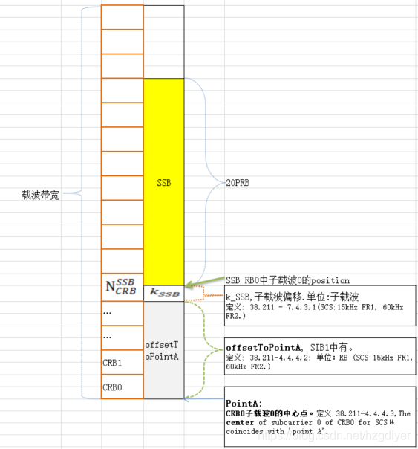
載波中心頻率 dlEarfcn 640256 = nDlCenterFreq 3603840,
SSB Subcarrier Offset =4, offsetToCarrier=0, offsetToPointA=27
Point A = nDlCenterFreq – carrierBw/2*12 sub*subCarrierSpacing – offsetToCarrier *12*15
SSB Freq = Point A + offsetToPointA*12*15 + SSB Subcarrier Offset *15 + 10RB*12*subCarrierSpacing
Ex:
absFreqPointA = 3603840 – 106/2*12 *30 – 0 *12*15 = 3584760
absFreqSsb = 3584760 + 27*12*15 + 4*15 + 10*12*30 = 3593280 = 3000000+N*1440, N=412
(3000M以下) F = 0 + 0.005*(ARFCN-0)
(3000M以上) F = 3000 + 0.015*(ARFCN-600000)
Ex: F = 3563040 = 3563.04 MHz
3563.04 = 3000 + 0.015*(ARFCN-600000)
ARFCN = 637536
3563.04 = 3000+N*1.44, N=391, GSCN=7499+391=7890
<dlFreqInfo>
<absFreqPointA>3584760</absFreqPointA>
<absArfcnPointA>638984</absArfcnPointA>
<absFreqSsb>3593280</absFreqSsb>
<absArfcnSsb>639552</absArfcnSsb>
<nrFreqBand>78</nrFreqBand>
<subCarrierCfg>
<offsetToCarrier>0</offsetToCarrier>
<subCarrierSpacing>KHz30</subCarrierSpacing>
<carrierBw>106</carrierBw>
</subCarrierCfg>
<bSChannelBwDL>40MHZ</bSChannelBwDL>
<dlEarfcn>640256</dlEarfcn>
</dlFreqInfo>
<nDlCenterFreq>3603840</nDlCenterFreq>
<nUlCenterFreq>3603840</nUlCenterFreq>
3603840
1980/01/07 06:01:29.079 [0xB822] NR5G RRC MIB Info
DL Frequency = 504990
SSB Subcarrier Offset = 4
Subcarrier Spacing Common = SCSC30
3593280
(3000M以下) F = 0 + 0.005*(ARFCN-0)
(3000M以上) F = 3000 + 0.015*(ARFCN-600000)
Ex: F = 3603840 = 3603.84 MHz
3603.84 = 3000 + 0.015*(ARFCN-600000)
ARFCN = 640256
10RB*12sub*30scs
[0xB821] BCCH_DL_SCH / SystemInformationBlockType1
frequencyInfoDL
{
frequencyBandList
{
{
freqBandIndicatorNR 41
}
},
offsetToPointA 26,
scs-SpecificCarrierList
{
{
offsetToCarrier 0,
subcarrierSpacing kHz30,
carrierBandwidth 273
}
}
},
initialDownlinkBWP
{
genericParameters
{
locationAndBandwidth 1099,
subcarrierSpacing kHz30
},
106/2*12 *30
4*15=60
16*15=240
27*12*15=4860
4860/360=13.5
26*12*15=4680
4680/360= 13
0 *12*15
3584760
K*30*12=360k
一個CRB=30scs*12subcarrier=360
4920 mod 360=13…240
Start of CRBssb必須是整數
Kssb=4*15=60
Kssb=16*15=240
Kssb=16*15=240
4920
OffsetToPointA
=27*12*15=4860
4860/360=13.5
OffsetToPointA
=26*12*15=4680
4680/360= 13
OffsetToPointA
=34*12*15=6120
6120/360= 17
PointA
RB=30scs*12subcarrier=360
Notes:
3554700|636980|3563040|637536|640256|3603840
<dlFreqInfo>
<absFreqPointA>3554700</absFreqPointA>
<absArfcnPointA>636980</absArfcnPointA>
<absFreqSsb>3563040</absFreqSsb>
<absArfcnSsb>637536</absArfcnSsb>●
<nrFreqBand>78</nrFreqBand>
<subCarrierCfg>
<offsetToCarrier>0</offsetToCarrier>
<subCarrierSpacing>KHz30</subCarrierSpacing>
<carrierBw>273</carrierBw>
</subCarrierCfg>
<bSChannelBwDL>100MHZ</bSChannelBwDL>
<dlEarfcn>640256</dlEarfcn>●
</dlFreqInfo>
<nDlCenterFreq>3603840</nDlCenterFreq>
=================================================
1980/01/06 08:11:18.743 [0xB950] NR5G ML1 DL Common Config
dl_cell_frequency = 637536
1980/01/06 08:11:19.127 [0xB825] NR5G RRC Configuration Info
NR5G Serving Cell Info[0] {
CC Id = 0
Cell Id = 1
DL Arfcn = 640256
UL Arfcn = 640256
SSB Arfcn = 637536
Band = 78
Band Type = SUB6
DL Carrier Bandwidth = BW_100MHz
UL Carrier Bandwidth = BW_100MHz
DL Max MIMO = 4
UL Max MIMO = NA
}
1980/01/06 08:11:19.478 [0xB822] NR5G RRC MIB Info
DL Frequency = 637536
1980/01/06 08:11:19.479 [0xB821] BCCH_DL_SCH / SystemInformationBlockType1
frequencyBandList
{
{
freqBandIndicatorNR 78
}
},
offsetToPointA 26,
=================================================
載波中心頻率 dlEarfcn 513150 = nDlCenterFreq 2565750
Point A = nDlCenterFreq – carrierBw/2*12 sub*subCarrierSpacing – offsetToCarrier *12*15
SSB Freq = Point A + offsetToPointA*12*15 + SSB Subcarrier Offset *15 + 10RB*12*subCarrierSpacing
Ex:
Point A = 2565750 – 273/2*12 *30 – 0 *12*15 = 2516610
SSB Freq = 2516610 + 26*12*15 + 4*15 + 10*12*30 = 2524950

Slide 38
載波中心頻率 dlEarfcn 640256 = nDlCenterFreq 3603840,
SSB Subcarrier Offset =16, offsetToCarrier=0, offsetToPointA=26
Point A = nDlCenterFreq – carrierBw/2*12 sub*subCarrierSpacing – offsetToCarrier *12*15
SSB Freq = Point A + offsetToPointA*12*15 + SSB Subcarrier Offset *15 + 10RB*12*subCarrierSpacing
Ex:
absFreqPointA = 3603840 – 106/2*12 *30 – 0 *12*15 = 3584760
absFreqSsb = 3584760 + 27*12*15 + 4*15 + 10*12*30 = 3593280 = 3000000+N*1440, N=412
(3000M以下) F = 0 + 0.005*(ARFCN-0)
(3000M以上) F = 3000 + 0.015*(ARFCN-600000)
Ex: F = 3563040 = 3563.04 MHz
3563.04 = 3000 + 0.015*(ARFCN-600000)
ARFCN = 637536
3563.04 = 3000+N*1.44, N=391, GSCN=7499+391=7890
<dlFreqInfo>
<absFreqPointA>3584760</absFreqPointA>
<absArfcnPointA>638984</absArfcnPointA>
<absFreqSsb>3593280</absFreqSsb>
<absArfcnSsb>639552</absArfcnSsb>
<nrFreqBand>78</nrFreqBand>
<subCarrierCfg>
<offsetToCarrier>0</offsetToCarrier>
<subCarrierSpacing>KHz30</subCarrierSpacing>
<carrierBw>106</carrierBw>
</subCarrierCfg>
<bSChannelBwDL>40MHZ</bSChannelBwDL>
<dlEarfcn>640256</dlEarfcn>
</dlFreqInfo>
<nDlCenterFreq>3603840</nDlCenterFreq>
<nUlCenterFreq>3603840</nUlCenterFreq>
3603840
1980/01/07 06:01:29.079 [0xB822] NR5G RRC MIB Info
DL Frequency = 504990
SSB Subcarrier Offset = 4
Subcarrier Spacing Common = SCSC30
3593280
(3000M以下) F = 0 + 0.005*(ARFCN-0)
(3000M以上) F = 3000 + 0.015*(ARFCN-600000)
Ex: F = 3603840 = 3603.84 MHz
3603.84 = 3000 + 0.015*(ARFCN-600000)
ARFCN = 640256
10RB*12sub*30scs
[0xB821] BCCH_DL_SCH / SystemInformationBlockType1
frequencyInfoDL
{
frequencyBandList
{
{
freqBandIndicatorNR 41
}
},
offsetToPointA 26,
scs-SpecificCarrierList
{
{
offsetToCarrier 0,
subcarrierSpacing kHz30,
carrierBandwidth 273
}
}
},
initialDownlinkBWP
{
genericParameters
{
locationAndBandwidth 1099,
subcarrierSpacing kHz30
},
106/2*12 *30
4*15=60
16*15=240
27*12*15=4860
4860/360=13.5
26*12*15=4680
4680/360= 13
0 *12*15
3584760
3593280-3584760-10*12*30=4920
K*30*12=360k
一個CRB=30scs*12subcarrier=360
4920 mod 360=13…240
Start of CRBssb必須是整數
Kssb=4*15=60
Kssb=16*15=240
Kssb=16*15=240
4920
OffsetToPointA
=27*12*15=4860
4860/360=13.5
OffsetToPointA
=26*12*15=4680
4680/360= 13
OffsetToPointA
=34*12*15=6120
6120/360= 17
PointA
RB=30scs*12subcarrier=360
Notes:
3554700|636980|3563040|637536|640256|3603840
<dlFreqInfo>
<absFreqPointA>3554700</absFreqPointA>
<absArfcnPointA>636980</absArfcnPointA>
<absFreqSsb>3563040</absFreqSsb>
<absArfcnSsb>637536</absArfcnSsb>●
<nrFreqBand>78</nrFreqBand>
<subCarrierCfg>
<offsetToCarrier>0</offsetToCarrier>
<subCarrierSpacing>KHz30</subCarrierSpacing>
<carrierBw>273</carrierBw>
</subCarrierCfg>
<bSChannelBwDL>100MHZ</bSChannelBwDL>
<dlEarfcn>640256</dlEarfcn>●
</dlFreqInfo>
<nDlCenterFreq>3603840</nDlCenterFreq>
=================================================
1980/01/06 08:11:18.743 [0xB950] NR5G ML1 DL Common Config
dl_cell_frequency = 637536
1980/01/06 08:11:19.127 [0xB825] NR5G RRC Configuration Info
NR5G Serving Cell Info[0] {
CC Id = 0
Cell Id = 1
DL Arfcn = 640256
UL Arfcn = 640256
SSB Arfcn = 637536
Band = 78
Band Type = SUB6
DL Carrier Bandwidth = BW_100MHz
UL Carrier Bandwidth = BW_100MHz
DL Max MIMO = 4
UL Max MIMO = NA
}
1980/01/06 08:11:19.478 [0xB822] NR5G RRC MIB Info
DL Frequency = 637536
1980/01/06 08:11:19.479 [0xB821] BCCH_DL_SCH / SystemInformationBlockType1
frequencyBandList
{
{
freqBandIndicatorNR 78
}
},
offsetToPointA 26,
=================================================
載波中心頻率 dlEarfcn 513150 = nDlCenterFreq 2565750
Point A = nDlCenterFreq – carrierBw/2*12 sub*subCarrierSpacing – offsetToCarrier *12*15
SSB Freq = Point A + offsetToPointA*12*15 + SSB Subcarrier Offset *15 + 10RB*12*subCarrierSpacing
Ex:
Point A = 2565750 – 273/2*12 *30 – 0 *12*15 = 2516610
SSB Freq = 2516610 + 26*12*15 + 4*15 + 10*12*30 = 2524950

Slide 39
載波中心頻率 dlEarfcn 640256 = nDlCenterFreq 3603840,
SSB Subcarrier Offset =4, offsetToCarrier=0, offsetToPointA=35
Point A = nDlCenterFreq – carrierBw/2*12 sub*subCarrierSpacing – offsetToCarrier *12*15
SSB Freq = Point A + offsetToPointA*12*15 + SSB Subcarrier Offset *15 + 10RB*12*subCarrierSpacing
Ex:
Point A = 3603840 – 106/2*12 *30 – 0 *12*15 = 3584760
SSB Freq = 3584760 + 35*12*15 + 4*15 + 10*12*30 = 3594720 = 3000000+N*1440, N=413
(3000M以下) F = 0 + 0.005*(ARFCN-0)
(3000M以上) F = 3000 + 0.015*(ARFCN-600000)
Ex: F = 3563040 = 3563.04 MHz
3563.04 = 3000 + 0.015*(ARFCN-600000)
ARFCN = 637536
3563.04 = 3000+N*1.44, N=391, GSCN=7499+391=7890
<dlFreqInfo>
<absFreqPointA>3584760</absFreqPointA>
<absArfcnPointA>638984</absArfcnPointA>
<absFreqSsb>3594720</absFreqSsb>
<absArfcnSsb>639648</absArfcnSsb>
<nrFreqBand>78</nrFreqBand>
<subCarrierCfg>
<offsetToCarrier>0</offsetToCarrier>
<subCarrierSpacing>KHz30</subCarrierSpacing>
<carrierBw>106</carrierBw>
</subCarrierCfg>
<bSChannelBwDL>40MHZ</bSChannelBwDL>
<dlEarfcn>640256</dlEarfcn>
</dlFreqInfo>
<nDlCenterFreq>3603840</nDlCenterFreq>
<nUlCenterFreq>3603840</nUlCenterFreq>
1980/01/07 06:01:29.079 [0xB822] NR5G RRC MIB Info
DL Frequency = 504990
SSB Subcarrier Offset = 4
Subcarrier Spacing Common = SCSC30
(3000M以下) F = 0 + 0.005*(ARFCN-0)
(3000M以上) F = 3000 + 0.015*(ARFCN-600000)
Ex: F = 3603840 = 3603.84 MHz
3603.84 = 3000 + 0.015*(ARFCN-600000)
ARFCN = 640256
[0xB821] BCCH_DL_SCH / SystemInformationBlockType1
frequencyInfoDL
{
frequencyBandList
{
{
freqBandIndicatorNR 41
}
},
offsetToPointA 26,
scs-SpecificCarrierList
{
{
offsetToCarrier 0,
subcarrierSpacing kHz30,
carrierBandwidth 273
}
}
},
initialDownlinkBWP
{
genericParameters
{
locationAndBandwidth 1099,
subcarrierSpacing kHz30
},
Notes:
3554700|636980|3563040|637536|640256|3603840
<dlFreqInfo>
<absFreqPointA>3554700</absFreqPointA>
<absArfcnPointA>636980</absArfcnPointA>
<absFreqSsb>3563040</absFreqSsb>
<absArfcnSsb>637536</absArfcnSsb>●
<nrFreqBand>78</nrFreqBand>
<subCarrierCfg>
<offsetToCarrier>0</offsetToCarrier>
<subCarrierSpacing>KHz30</subCarrierSpacing>
<carrierBw>273</carrierBw>
</subCarrierCfg>
<bSChannelBwDL>100MHZ</bSChannelBwDL>
<dlEarfcn>640256</dlEarfcn>●
</dlFreqInfo>
<nDlCenterFreq>3603840</nDlCenterFreq>
=================================================
1980/01/06 08:11:18.743 [0xB950] NR5G ML1 DL Common Config
dl_cell_frequency = 637536
1980/01/06 08:11:19.127 [0xB825] NR5G RRC Configuration Info
NR5G Serving Cell Info[0] {
CC Id = 0
Cell Id = 1
DL Arfcn = 640256
UL Arfcn = 640256
SSB Arfcn = 637536
Band = 78
Band Type = SUB6
DL Carrier Bandwidth = BW_100MHz
UL Carrier Bandwidth = BW_100MHz
DL Max MIMO = 4
UL Max MIMO = NA
}
1980/01/06 08:11:19.478 [0xB822] NR5G RRC MIB Info
DL Frequency = 637536
1980/01/06 08:11:19.479 [0xB821] BCCH_DL_SCH / SystemInformationBlockType1
frequencyBandList
{
{
freqBandIndicatorNR 78
}
},
offsetToPointA 26,
=================================================
載波中心頻率 dlEarfcn 513150 = nDlCenterFreq 2565750
Point A = nDlCenterFreq – carrierBw/2*12 sub*subCarrierSpacing – offsetToCarrier *12*15
SSB Freq = Point A + offsetToPointA*12*15 + SSB Subcarrier Offset *15 + 10RB*12*subCarrierSpacing
Ex:
Point A = 2565750 – 273/2*12 *30 – 0 *12*15 = 2516610
SSB Freq = 2516610 + 26*12*15 + 4*15 + 10*12*30 = 2524950

Slide 40
載波中心頻率 dlEarfcn 640256 = nDlCenterFreq 3603840,
SSB Subcarrier Offset =4, offsetToCarrier=0, offsetToPointA=43
Point A = nDlCenterFreq – carrierBw/2*12 sub*subCarrierSpacing – offsetToCarrier *12*15
SSB Freq = Point A + offsetToPointA*12*15 + SSB Subcarrier Offset *15 + 10RB*12*subCarrierSpacing
Ex:
Point A = 3603840 – 106/2*12 *30 – 0 *12*15 = 3584760
SSB Freq = 3584760 + 43*12*15 + 4*15 + 10*12*30 = 3596160 = 3000000+N*1440, N=414
(3000M以下) F = 0 + 0.005*(ARFCN-0)
(3000M以上) F = 3000 + 0.015*(ARFCN-600000)
Ex: F = 3596160 = 3563.04 MHz
3596.160 = 3000 + 0.015*(ARFCN-600000)
ARFCN = 637536
3563.04 = 3000+N*1.44, N=391, GSCN=7499+391=7890
<dlFreqInfo>
<absFreqPointA>3584760</absFreqPointA>
<absArfcnPointA>638984</absArfcnPointA>
<absFreqSsb>3596160</absFreqSsb>
<absArfcnSsb>639744</absArfcnSsb>
<nrFreqBand>78</nrFreqBand>
<subCarrierCfg>
<offsetToCarrier>0</offsetToCarrier>
<subCarrierSpacing>KHz30</subCarrierSpacing>
<carrierBw>106</carrierBw>
</subCarrierCfg>
<bSChannelBwDL>40MHZ</bSChannelBwDL>
<dlEarfcn>640256</dlEarfcn>
</dlFreqInfo>
<nDlCenterFreq>3603840</nDlCenterFreq>
<nUlCenterFreq>3603840</nUlCenterFreq>
1980/01/07 06:01:29.079 [0xB822] NR5G RRC MIB Info
DL Frequency = 504990
SSB Subcarrier Offset = 4
Subcarrier Spacing Common = SCSC30
(3000M以下) F = 0 + 0.005*(ARFCN-0)
(3000M以上) F = 3000 + 0.015*(ARFCN-600000)
Ex: F = 3603840 = 3603.84 MHz
3603.84 = 3000 + 0.015*(ARFCN-600000)
ARFCN = 640256
[0xB821] BCCH_DL_SCH / SystemInformationBlockType1
frequencyInfoDL
{
frequencyBandList
{
{
freqBandIndicatorNR 41
}
},
offsetToPointA 26,
scs-SpecificCarrierList
{
{
offsetToCarrier 0,
subcarrierSpacing kHz30,
carrierBandwidth 273
}
}
},
initialDownlinkBWP
{
genericParameters
{
locationAndBandwidth 1099,
subcarrierSpacing kHz30
},
Notes:
3554700|636980|3563040|637536|640256|3603840
<dlFreqInfo>
<absFreqPointA>3554700</absFreqPointA>
<absArfcnPointA>636980</absArfcnPointA>
<absFreqSsb>3563040</absFreqSsb>
<absArfcnSsb>637536</absArfcnSsb>●
<nrFreqBand>78</nrFreqBand>
<subCarrierCfg>
<offsetToCarrier>0</offsetToCarrier>
<subCarrierSpacing>KHz30</subCarrierSpacing>
<carrierBw>273</carrierBw>
</subCarrierCfg>
<bSChannelBwDL>100MHZ</bSChannelBwDL>
<dlEarfcn>640256</dlEarfcn>●
</dlFreqInfo>
<nDlCenterFreq>3603840</nDlCenterFreq>
=================================================
1980/01/06 08:11:18.743 [0xB950] NR5G ML1 DL Common Config
dl_cell_frequency = 637536
1980/01/06 08:11:19.127 [0xB825] NR5G RRC Configuration Info
NR5G Serving Cell Info[0] {
CC Id = 0
Cell Id = 1
DL Arfcn = 640256
UL Arfcn = 640256
SSB Arfcn = 637536
Band = 78
Band Type = SUB6
DL Carrier Bandwidth = BW_100MHz
UL Carrier Bandwidth = BW_100MHz
DL Max MIMO = 4
UL Max MIMO = NA
}
1980/01/06 08:11:19.478 [0xB822] NR5G RRC MIB Info
DL Frequency = 637536
1980/01/06 08:11:19.479 [0xB821] BCCH_DL_SCH / SystemInformationBlockType1
frequencyBandList
{
{
freqBandIndicatorNR 78
}
},
offsetToPointA 26,
=================================================
載波中心頻率 dlEarfcn 513150 = nDlCenterFreq 2565750
Point A = nDlCenterFreq – carrierBw/2*12 sub*subCarrierSpacing – offsetToCarrier *12*15
SSB Freq = Point A + offsetToPointA*12*15 + SSB Subcarrier Offset *15 + 10RB*12*subCarrierSpacing
Ex:
Point A = 2565750 – 273/2*12 *30 – 0 *12*15 = 2516610
SSB Freq = 2516610 + 26*12*15 + 4*15 + 10*12*30 = 2524950

Slide 41
載波中心頻率 dlEarfcn 640256 = nDlCenterFreq 3603840,
SSB Subcarrier Offset =4, offsetToCarrier=0, offsetToPointA=51
Point A = nDlCenterFreq – carrierBw/2*12 sub*subCarrierSpacing – offsetToCarrier *12*15
SSB Freq = Point A + offsetToPointA*12*15 + SSB Subcarrier Offset *15 + 10RB*12*subCarrierSpacing
Ex:
Point A = 3603840 – 106/2*12 *30 – 0 *12*15 = 3584760
SSB Freq = 3584760 + 51*12*15 + 4*15 + 10*12*30 = 3597600 = 3000000+N*1440, N=414
(3000M以下) F = 0 + 0.005*(ARFCN-0)
(3000M以上) F = 3000 + 0.015*(ARFCN-600000)
Ex: F = 3596160 = 3563.04 MHz
3596.160 = 3000 + 0.015*(ARFCN-600000)
ARFCN = 637536
3563.04 = 3000+N*1.44, N=391, GSCN=7499+391=7890
<dlFreqInfo>
<absFreqPointA>3584760</absFreqPointA>
<absArfcnPointA>638984</absArfcnPointA>
<absFreqSsb>3597600</absFreqSsb>
<absArfcnSsb>639840</absArfcnSsb>
<nrFreqBand>78</nrFreqBand>
<subCarrierCfg>
<offsetToCarrier>0</offsetToCarrier>
<subCarrierSpacing>KHz30</subCarrierSpacing>
<carrierBw>106</carrierBw>
</subCarrierCfg>
<bSChannelBwDL>40MHZ</bSChannelBwDL>
<dlEarfcn>640256</dlEarfcn>
</dlFreqInfo>
<nDlCenterFreq>3603840</nDlCenterFreq>
<nUlCenterFreq>3603840</nUlCenterFreq>
1980/01/07 06:01:29.079 [0xB822] NR5G RRC MIB Info
DL Frequency = 504990
SSB Subcarrier Offset = 4
Subcarrier Spacing Common = SCSC30
(3000M以下) F = 0 + 0.005*(ARFCN-0)
(3000M以上) F = 3000 + 0.015*(ARFCN-600000)
Ex: F = 3603840 = 3603.84 MHz
3603.84 = 3000 + 0.015*(ARFCN-600000)
ARFCN = 640256
[0xB821] BCCH_DL_SCH / SystemInformationBlockType1
frequencyInfoDL
{
frequencyBandList
{
{
freqBandIndicatorNR 41
}
},
offsetToPointA 26,
scs-SpecificCarrierList
{
{
offsetToCarrier 0,
subcarrierSpacing kHz30,
carrierBandwidth 273
}
}
},
initialDownlinkBWP
{
genericParameters
{
locationAndBandwidth 1099,
subcarrierSpacing kHz30
},
Notes:
3554700|636980|3563040|637536|640256|3603840
<dlFreqInfo>
<absFreqPointA>3554700</absFreqPointA>
<absArfcnPointA>636980</absArfcnPointA>
<absFreqSsb>3563040</absFreqSsb>
<absArfcnSsb>637536</absArfcnSsb>●
<nrFreqBand>78</nrFreqBand>
<subCarrierCfg>
<offsetToCarrier>0</offsetToCarrier>
<subCarrierSpacing>KHz30</subCarrierSpacing>
<carrierBw>273</carrierBw>
</subCarrierCfg>
<bSChannelBwDL>100MHZ</bSChannelBwDL>
<dlEarfcn>640256</dlEarfcn>●
</dlFreqInfo>
<nDlCenterFreq>3603840</nDlCenterFreq>
=================================================
1980/01/06 08:11:18.743 [0xB950] NR5G ML1 DL Common Config
dl_cell_frequency = 637536
1980/01/06 08:11:19.127 [0xB825] NR5G RRC Configuration Info
NR5G Serving Cell Info[0] {
CC Id = 0
Cell Id = 1
DL Arfcn = 640256
UL Arfcn = 640256
SSB Arfcn = 637536
Band = 78
Band Type = SUB6
DL Carrier Bandwidth = BW_100MHz
UL Carrier Bandwidth = BW_100MHz
DL Max MIMO = 4
UL Max MIMO = NA
}
1980/01/06 08:11:19.478 [0xB822] NR5G RRC MIB Info
DL Frequency = 637536
1980/01/06 08:11:19.479 [0xB821] BCCH_DL_SCH / SystemInformationBlockType1
frequencyBandList
{
{
freqBandIndicatorNR 78
}
},
offsetToPointA 26,
=================================================
載波中心頻率 dlEarfcn 513150 = nDlCenterFreq 2565750
Point A = nDlCenterFreq – carrierBw/2*12 sub*subCarrierSpacing – offsetToCarrier *12*15
SSB Freq = Point A + offsetToPointA*12*15 + SSB Subcarrier Offset *15 + 10RB*12*subCarrierSpacing
Ex:
Point A = 2565750 – 273/2*12 *30 – 0 *12*15 = 2516610
SSB Freq = 2516610 + 26*12*15 + 4*15 + 10*12*30 = 2524950

Slide 42
載波中心頻率 dlEarfcn 640256 = nDlCenterFreq 3603840,
SSB Subcarrier Offset =4, offsetToCarrier=0, offsetToPointA=59
Point A = nDlCenterFreq – carrierBw/2*12 sub*subCarrierSpacing – offsetToCarrier *12*15
SSB Freq = Point A + offsetToPointA*12*15 + SSB Subcarrier Offset *15 + 10RB*12*subCarrierSpacing
Ex:
Point A = 3603840 – 106/2*12 *30 – 0 *12*15 = 3584760
SSB Freq = 3584760 + 59*12*15 + 4*15 + 10*12*30 = 3599040 = 3000000+N*1440, N=414
(3000M以下) F = 0 + 0.005*(ARFCN-0)
(3000M以上) F = 3000 + 0.015*(ARFCN-600000)
Ex: F = 3596160 = 3563.04 MHz
3596.160 = 3000 + 0.015*(ARFCN-600000)
ARFCN = 637536
3563.04 = 3000+N*1.44, N=391, GSCN=7499+391=7890
<dlFreqInfo>
<absFreqPointA>3584760</absFreqPointA>
<absArfcnPointA>638984</absArfcnPointA>
<absFreqSsb>3599040</absFreqSsb>
<absArfcnSsb>639936</absArfcnSsb>
<nrFreqBand>78</nrFreqBand>
<subCarrierCfg>
<offsetToCarrier>0</offsetToCarrier>
<subCarrierSpacing>KHz30</subCarrierSpacing>
<carrierBw>106</carrierBw>
</subCarrierCfg>
<bSChannelBwDL>40MHZ</bSChannelBwDL>
<dlEarfcn>640256</dlEarfcn>
</dlFreqInfo>
<nDlCenterFreq>3603840</nDlCenterFreq>
<nUlCenterFreq>3603840</nUlCenterFreq>
1980/01/07 06:01:29.079 [0xB822] NR5G RRC MIB Info
DL Frequency = 504990
SSB Subcarrier Offset = 4
Subcarrier Spacing Common = SCSC30
(3000M以下) F = 0 + 0.005*(ARFCN-0)
(3000M以上) F = 3000 + 0.015*(ARFCN-600000)
Ex: F = 3603840 = 3603.84 MHz
3603.84 = 3000 + 0.015*(ARFCN-600000)
ARFCN = 640256
[0xB821] BCCH_DL_SCH / SystemInformationBlockType1
frequencyInfoDL
{
frequencyBandList
{
{
freqBandIndicatorNR 41
}
},
offsetToPointA 26,
scs-SpecificCarrierList
{
{
offsetToCarrier 0,
subcarrierSpacing kHz30,
carrierBandwidth 273
}
}
},
initialDownlinkBWP
{
genericParameters
{
locationAndBandwidth 1099,
subcarrierSpacing kHz30
},
Notes:
3554700|636980|3563040|637536|640256|3603840
<dlFreqInfo>
<absFreqPointA>3554700</absFreqPointA>
<absArfcnPointA>636980</absArfcnPointA>
<absFreqSsb>3563040</absFreqSsb>
<absArfcnSsb>637536</absArfcnSsb>●
<nrFreqBand>78</nrFreqBand>
<subCarrierCfg>
<offsetToCarrier>0</offsetToCarrier>
<subCarrierSpacing>KHz30</subCarrierSpacing>
<carrierBw>273</carrierBw>
</subCarrierCfg>
<bSChannelBwDL>100MHZ</bSChannelBwDL>
<dlEarfcn>640256</dlEarfcn>●
</dlFreqInfo>
<nDlCenterFreq>3603840</nDlCenterFreq>
=================================================
1980/01/06 08:11:18.743 [0xB950] NR5G ML1 DL Common Config
dl_cell_frequency = 637536
1980/01/06 08:11:19.127 [0xB825] NR5G RRC Configuration Info
NR5G Serving Cell Info[0] {
CC Id = 0
Cell Id = 1
DL Arfcn = 640256
UL Arfcn = 640256
SSB Arfcn = 637536
Band = 78
Band Type = SUB6
DL Carrier Bandwidth = BW_100MHz
UL Carrier Bandwidth = BW_100MHz
DL Max MIMO = 4
UL Max MIMO = NA
}
1980/01/06 08:11:19.478 [0xB822] NR5G RRC MIB Info
DL Frequency = 637536
1980/01/06 08:11:19.479 [0xB821] BCCH_DL_SCH / SystemInformationBlockType1
frequencyBandList
{
{
freqBandIndicatorNR 78
}
},
offsetToPointA 26,
=================================================
載波中心頻率 dlEarfcn 513150 = nDlCenterFreq 2565750
Point A = nDlCenterFreq – carrierBw/2*12 sub*subCarrierSpacing – offsetToCarrier *12*15
SSB Freq = Point A + offsetToPointA*12*15 + SSB Subcarrier Offset *15 + 10RB*12*subCarrierSpacing
Ex:
Point A = 2565750 – 273/2*12 *30 – 0 *12*15 = 2516610
SSB Freq = 2516610 + 26*12*15 + 4*15 + 10*12*30 = 2524950

Slide 43
載波中心頻率 dlEarfcn 640256 = nDlCenterFreq 3603840,
SSB Subcarrier Offset =4, offsetToCarrier=0, offsetToPointA=31
Point A = nDlCenterFreq – carrierBw/2*12 sub*subCarrierSpacing – offsetToCarrier *12*15
SSB Freq = Point A + offsetToPointA*12*15 + SSB Subcarrier Offset *15 + 10RB*12*subCarrierSpacing
Ex:
Point A = 3603840 – 78/2*12 *30 – 0 *12*15 = 3589800
SSB Freq = 3589800 + 31*12*15 + 4*15 + 10*12*30 = 3599040 = 3000000+N*1440, N=409
(3000M以下) F = 0 + 0.005*(ARFCN-0)
(3000M以上) F = 3000 + 0.015*(ARFCN-600000)
Ex: F = 3563040 = 3563.04 MHz
3563.04 = 3000 + 0.015*(ARFCN-600000)
ARFCN = 637536
3563.04 = 3000+N*1.44, N=391, GSCN=7499+391=7890
<dlFreqInfo>
<absFreqPointA>3589800</absFreqPointA>
<absArfcnPointA>639320</absArfcnPointA>
<absFreqSsb>3599040</absFreqSsb>
<absArfcnSsb>639936</absArfcnSsb>
<nrFreqBand>78</nrFreqBand>
<subCarrierCfg>
<offsetToCarrier>0</offsetToCarrier>
<subCarrierSpacing>KHz30</subCarrierSpacing>
<carrierBw>78</carrierBw>
</subCarrierCfg>
<bSChannelBwDL>30MHZ</bSChannelBwDL>
<dlEarfcn>640256</dlEarfcn>
</dlFreqInfo>
<nDlCenterFreq>3603840</nDlCenterFreq>
<nUlCenterFreq>3603840</nUlCenterFreq>
1980/01/07 06:01:29.079 [0xB822] NR5G RRC MIB Info
DL Frequency = 504990
SSB Subcarrier Offset = 4
Subcarrier Spacing Common = SCSC30
(3000M以下) F = 0 + 0.005*(ARFCN-0)
(3000M以上) F = 3000 + 0.015*(ARFCN-600000)
Ex: F = 3603840 = 3603.84 MHz
3603.84 = 3000 + 0.015*(ARFCN-600000)
ARFCN = 640256
[0xB821] BCCH_DL_SCH / SystemInformationBlockType1
frequencyInfoDL
{
frequencyBandList
{
{
freqBandIndicatorNR 41
}
},
offsetToPointA 26,
scs-SpecificCarrierList
{
{
offsetToCarrier 0,
subcarrierSpacing kHz30,
carrierBandwidth 273
}
}
},
initialDownlinkBWP
{
genericParameters
{
locationAndBandwidth 1099,
subcarrierSpacing kHz30
},
Notes:
3554700|636980|3563040|637536|640256|3603840
<dlFreqInfo>
<absFreqPointA>3554700</absFreqPointA>
<absArfcnPointA>636980</absArfcnPointA>
<absFreqSsb>3563040</absFreqSsb>
<absArfcnSsb>637536</absArfcnSsb>●
<nrFreqBand>78</nrFreqBand>
<subCarrierCfg>
<offsetToCarrier>0</offsetToCarrier>
<subCarrierSpacing>KHz30</subCarrierSpacing>
<carrierBw>273</carrierBw>
</subCarrierCfg>
<bSChannelBwDL>100MHZ</bSChannelBwDL>
<dlEarfcn>640256</dlEarfcn>●
</dlFreqInfo>
<nDlCenterFreq>3603840</nDlCenterFreq>
=================================================
1980/01/06 08:11:18.743 [0xB950] NR5G ML1 DL Common Config
dl_cell_frequency = 637536
1980/01/06 08:11:19.127 [0xB825] NR5G RRC Configuration Info
NR5G Serving Cell Info[0] {
CC Id = 0
Cell Id = 1
DL Arfcn = 640256
UL Arfcn = 640256
SSB Arfcn = 637536
Band = 78
Band Type = SUB6
DL Carrier Bandwidth = BW_100MHz
UL Carrier Bandwidth = BW_100MHz
DL Max MIMO = 4
UL Max MIMO = NA
}
1980/01/06 08:11:19.478 [0xB822] NR5G RRC MIB Info
DL Frequency = 637536
1980/01/06 08:11:19.479 [0xB821] BCCH_DL_SCH / SystemInformationBlockType1
frequencyBandList
{
{
freqBandIndicatorNR 78
}
},
offsetToPointA 26,
=================================================
載波中心頻率 dlEarfcn 513150 = nDlCenterFreq 2565750
Point A = nDlCenterFreq – carrierBw/2*12 sub*subCarrierSpacing – offsetToCarrier *12*15
SSB Freq = Point A + offsetToPointA*12*15 + SSB Subcarrier Offset *15 + 10RB*12*subCarrierSpacing
Ex:
Point A = 2565750 – 273/2*12 *30 – 0 *12*15 = 2516610
SSB Freq = 2516610 + 26*12*15 + 4*15 + 10*12*30 = 2524950

Slide 44
載波中心頻率 dlEarfcn 640256 = nDlCenterFreq 3603840,
SSB Subcarrier Offset =16, offsetToCarrier=0, offsetToPointA=30
Point A = nDlCenterFreq – carrierBw/2*12 sub*subCarrierSpacing – offsetToCarrier *12*15
SSB Freq = Point A + offsetToPointA*12*15 + SSB Subcarrier Offset *15 + 10RB*12*subCarrierSpacing
Ex:
Point A = 3603840 – 78/2*12 *30 – 0 *12*15 = 3589800
SSB Freq = 3589800 + 30*12*15 + 16*15 + 10*12*30 = 3599040 = 3000000+N*1440, N=409
(3000M以下) F = 0 + 0.005*(ARFCN-0)
(3000M以上) F = 3000 + 0.015*(ARFCN-600000)
Ex: F = 3563040 = 3563.04 MHz
3563.04 = 3000 + 0.015*(ARFCN-600000)
ARFCN = 637536
3563.04 = 3000+N*1.44, N=391, GSCN=7499+391=7890
<dlFreqInfo>
<absFreqPointA>3589800</absFreqPointA>
<absArfcnPointA>639320</absArfcnPointA>
<absFreqSsb>3599040</absFreqSsb>
<absArfcnSsb>639936</absArfcnSsb>
<nrFreqBand>78</nrFreqBand>
<subCarrierCfg>
<offsetToCarrier>0</offsetToCarrier>
<subCarrierSpacing>KHz30</subCarrierSpacing>
<carrierBw>78</carrierBw>
</subCarrierCfg>
<bSChannelBwDL>30MHZ</bSChannelBwDL>
<dlEarfcn>640256</dlEarfcn>
</dlFreqInfo>
<nDlCenterFreq>3603840</nDlCenterFreq>
<nUlCenterFreq>3603840</nUlCenterFreq>
1980/01/07 06:01:29.079 [0xB822] NR5G RRC MIB Info
DL Frequency = 504990
SSB Subcarrier Offset = 4
Subcarrier Spacing Common = SCSC30
(3000M以下) F = 0 + 0.005*(ARFCN-0)
(3000M以上) F = 3000 + 0.015*(ARFCN-600000)
Ex: F = 3603840 = 3603.84 MHz
3603.84 = 3000 + 0.015*(ARFCN-600000)
ARFCN = 640256
[0xB821] BCCH_DL_SCH / SystemInformationBlockType1
frequencyInfoDL
{
frequencyBandList
{
{
freqBandIndicatorNR 41
}
},
offsetToPointA 26,
scs-SpecificCarrierList
{
{
offsetToCarrier 0,
subcarrierSpacing kHz30,
carrierBandwidth 273
}
}
},
initialDownlinkBWP
{
genericParameters
{
locationAndBandwidth 1099,
subcarrierSpacing kHz30
},
Notes:
3554700|636980|3563040|637536|640256|3603840
<dlFreqInfo>
<absFreqPointA>3554700</absFreqPointA>
<absArfcnPointA>636980</absArfcnPointA>
<absFreqSsb>3563040</absFreqSsb>
<absArfcnSsb>637536</absArfcnSsb>●
<nrFreqBand>78</nrFreqBand>
<subCarrierCfg>
<offsetToCarrier>0</offsetToCarrier>
<subCarrierSpacing>KHz30</subCarrierSpacing>
<carrierBw>273</carrierBw>
</subCarrierCfg>
<bSChannelBwDL>100MHZ</bSChannelBwDL>
<dlEarfcn>640256</dlEarfcn>●
</dlFreqInfo>
<nDlCenterFreq>3603840</nDlCenterFreq>
=================================================
1980/01/06 08:11:18.743 [0xB950] NR5G ML1 DL Common Config
dl_cell_frequency = 637536
1980/01/06 08:11:19.127 [0xB825] NR5G RRC Configuration Info
NR5G Serving Cell Info[0] {
CC Id = 0
Cell Id = 1
DL Arfcn = 640256
UL Arfcn = 640256
SSB Arfcn = 637536
Band = 78
Band Type = SUB6
DL Carrier Bandwidth = BW_100MHz
UL Carrier Bandwidth = BW_100MHz
DL Max MIMO = 4
UL Max MIMO = NA
}
1980/01/06 08:11:19.478 [0xB822] NR5G RRC MIB Info
DL Frequency = 637536
1980/01/06 08:11:19.479 [0xB821] BCCH_DL_SCH / SystemInformationBlockType1
frequencyBandList
{
{
freqBandIndicatorNR 78
}
},
offsetToPointA 26,
=================================================
載波中心頻率 dlEarfcn 513150 = nDlCenterFreq 2565750
Point A = nDlCenterFreq – carrierBw/2*12 sub*subCarrierSpacing – offsetToCarrier *12*15
SSB Freq = Point A + offsetToPointA*12*15 + SSB Subcarrier Offset *15 + 10RB*12*subCarrierSpacing
Ex:
Point A = 2565750 – 273/2*12 *30 – 0 *12*15 = 2516610
SSB Freq = 2516610 + 26*12*15 + 4*15 + 10*12*30 = 2524950

Slide 45
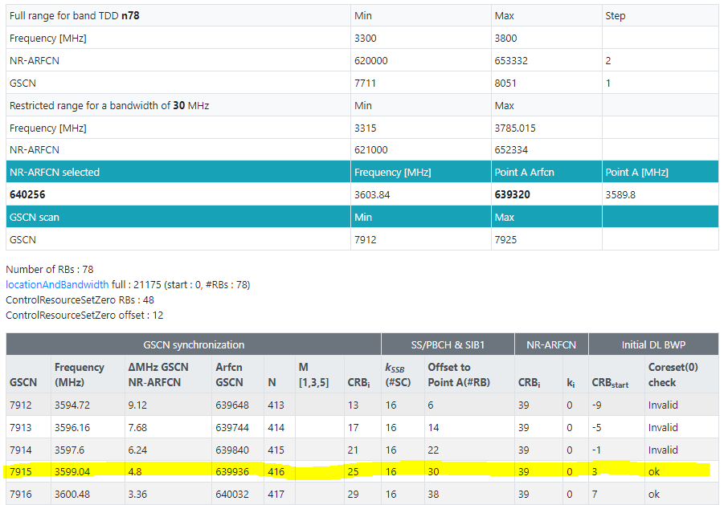
載波中心頻率 dlEarfcn 640256 = nDlCenterFreq 3603840,
SSB Subcarrier Offset =16, offsetToCarrier=0, offsetToPointA=30
Point A = nDlCenterFreq – carrierBw/2*12 sub*subCarrierSpacing – offsetToCarrier *12*15
SSB Freq = Point A + offsetToPointA*12*15 + SSB Subcarrier Offset *15 + 10RB*12*subCarrierSpacing
Ex:
Point A = 3603840 – 78/2*12 *30 – 0 *12*15 = 3589800
SSB Freq = 3589800 + 30*12*15 + 16*15 + 10*12*30 = 3599040 = 3000000+N*1440, N=409
3617880
3608160
<dlFreqInfo>
<absFreqPointA>3589800</absFreqPointA>
<absArfcnPointA>639320</absArfcnPointA>
<absFreqSsb>3599040</absFreqSsb>
<absArfcnSsb>639936</absArfcnSsb>
<nrFreqBand>78</nrFreqBand>
<subCarrierCfg>
<offsetToCarrier>0</offsetToCarrier>
<subCarrierSpacing>KHz30</subCarrierSpacing>
<carrierBw>78</carrierBw>
</subCarrierCfg>
<bSChannelBwDL>30MHZ</bSChannelBwDL>
<dlEarfcn>640256</dlEarfcn>
</dlFreqInfo>
<nDlCenterFreq>3603840</nDlCenterFreq>
<nUlCenterFreq>3603840</nUlCenterFreq>
78/2*12 *30
Offset(RB)
48 RB*30 scs*12
3599040
CS0 is within the bandwidth part
3603840
10*12*30
78/2*12 *30
3595440
16*15
3590880
3595200
Offset(RB)
12RB*30 scs*12
3589800
30*12*15
0 *12*15
3589800

Slide 46
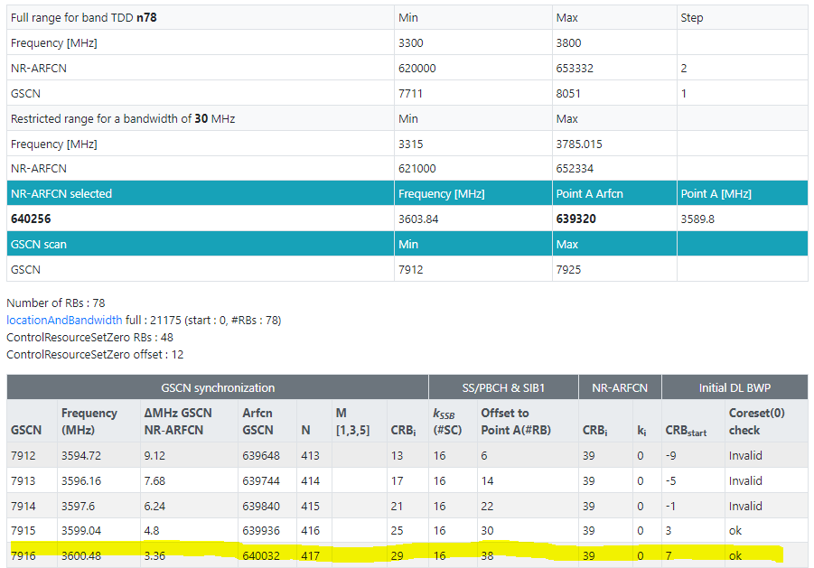
Kssb=4*15=60
Kssb=16*15=240
Kssb=16*15=240
4920
OffsetToPointA
=27*12*15=4860
4860/360=13.5
OffsetToPointA
=26*12*15=4680
4680/360= 13
OffsetToPointA
=34*12*15=6120
6120/360= 17
PointA
RB=30scs*12subcarrier=360
載波中心頻率 dlEarfcn 640256 = nDlCenterFreq 3603840,
SSB Subcarrier Offset =16, offsetToCarrier=0, offsetToPointA=38
Point A = nDlCenterFreq – carrierBw/2*12 sub*subCarrierSpacing – offsetToCarrier *12*15
SSB Freq = Point A + offsetToPointA*12*15 + SSB Subcarrier Offset *15 + 10RB*12*subCarrierSpacing
Ex:
Point A = 3603840 – 78/2*12 *30 – 0 *12*15 = 3589800
SSB Freq = 3589800 + 30*12*15 + 16*15 + 10*12*30 = 3599040 = 3000000+N*1440, N=409
nrBand = {'band' : 78,
'lowest_freq' : 3300000, 'highest_freq' : 3800000,
'lowerset_n_ref' : 620000, 'highest_n_ref' : 653332, 'n_ref_step' : 2, 'lowerest_gscn' : 7711, 'highest_gscn' : 8051, 'gscn_step' : 1}
(3000M以上) F = 3000 + 0.015*(ARFCN-600000)
// 每次加30
(620000-600000) *15+3000000 = 3300000
(620002-600000) *15+3000000 = 3300030
(7711-7499)*1440+3000000=3305280
3617880
(3000M以下) F = 0 + 0.005*(ARFCN-0)
(3000M以上) F = 3000 + 0.015*(ARFCN-600000)
Ex: F = 3563040 = 3563.04 MHz
3563.04 = 3000 + 0.015*(ARFCN-600000)
ARFCN = 637536
3563.04 = 3000+N*1.44, N=391, GSCN=7499+391=7890
3609600
<dlFreqInfo>
<absFreqPointA>3589800</absFreqPointA>
<absArfcnPointA>639320</absArfcnPointA>
<absFreqSsb>3600480</absFreqSsb>
<absArfcnSsb>640032</absArfcnSsb>
<nrFreqBand>78</nrFreqBand>
<subCarrierCfg>
<offsetToCarrier>0</offsetToCarrier>
<subCarrierSpacing>KHz30</subCarrierSpacing>
<carrierBw>78</carrierBw>
</subCarrierCfg>
<bSChannelBwDL>30MHZ</bSChannelBwDL>
<dlEarfcn>640256</dlEarfcn>
</dlFreqInfo>
<nDlCenterFreq>3603840</nDlCenterFreq>
<nUlCenterFreq>3603840</nUlCenterFreq>
78/2*12 *30
coreset0RB
48 RB*30 scs*12
absFreqSsb = 3600480
CS0 is within the bandwidth part
nDlCenterFreq
3603840
10*12*30
78/2*12 *30
3596880
16*15
coreset0freq =3592320
3596640
coreset0offset
12RB*30 scs*12
3589800
38*12*15
0 *12*15
3700000
3699990
absFreqPointA = 3589800
3695520
3695010
3580000
n48
freq
n_ref(2)
Gscn(1)
BW
3570000
3555000
3550020
3554400
3550000
Notes:
absoluteFrequencySSB ARFCN-ValueNR OPTIONAL, -- Cond SpCellAdd
frequencyBandList MultiFrequencyBandListNR,
absoluteFrequencyPointA ARFCN-ValueNR,
Kssb is INTEGER (0..15)
offsetToPointA is INTEGER (0..2199)
absoluteFrequencyPointA is INTEGER (0..3279165)
nDlCenterFreq+carrierBw*12*subCarrierSpacing/2 > absFreqSsb – 10*12*subCarrierSpacing – Kssb*15-coreset0offset*12*subCarrierSpacing+coreset0RB*12*subCarrierSpacing

Slide 47
Kssb=4*15=60
Kssb=16*15=240
Kssb=16*15=240
4920
OffsetToPointA
=27*12*15=4860
4860/360=13.5
OffsetToPointA
=26*12*15=4680
4680/360= 13
OffsetToPointA
=34*12*15=6120
6120/360= 17
PointA
RB=30scs*12subcarrier=360
載波中心頻率 dlEarfcn 640256 = nDlCenterFreq 3603840,
SSB Subcarrier Offset =16, offsetToCarrier=0, offsetToPointA=46
Point A = nDlCenterFreq – carrierBw/2*12 sub*subCarrierSpacing – offsetToCarrier *12*15
SSB Freq = Point A + offsetToPointA*12*15 + SSB Subcarrier Offset *15 + 10RB*12*subCarrierSpacing
Ex:
Point A = 3603840 – 78/2*12 *30 – 0 *12*15 = 3589800
SSB Freq = 3589800 + 46*12*15 + 16*15 + 10*12*30 = 3601920 = 3000000+N*1440, N=409
nrBand = {'band' : 78,
'lowest_freq' : 3300000, 'highest_freq' : 3800000,
'lowerset_n_ref' : 620000, 'highest_n_ref' : 653332, 'n_ref_step' : 2, 'lowerest_gscn' : 7711, 'highest_gscn' : 8051, 'gscn_step' : 1}
(3000M以上) F = 3000 + 0.015*(ARFCN-600000)
// 每次加30
(620000-600000) *15+3000000 = 3300000
(620002-600000) *15+3000000 = 3300030
(7711-7499)*1440+3000000=3305280
3617880
(3000M以下) F = 0 + 0.005*(ARFCN-0)
(3000M以上) F = 3000 + 0.015*(ARFCN-600000)
Ex: F = 3563040 = 3563.04 MHz
3563.04 = 3000 + 0.015*(ARFCN-600000)
ARFCN = 637536
3563.04 = 3000+N*1.44, N=391, GSCN=7499+391=7890
3609600
<dlFreqInfo>
<absFreqPointA>3589800</absFreqPointA>
<absArfcnPointA>639320</absArfcnPointA>
<absFreqSsb>3601920</absFreqSsb>
<absArfcnSsb>640128</absArfcnSsb>
<nrFreqBand>78</nrFreqBand>
<subCarrierCfg>
<offsetToCarrier>0</offsetToCarrier>
<subCarrierSpacing>KHz30</subCarrierSpacing>
<carrierBw>78</carrierBw>
</subCarrierCfg>
<bSChannelBwDL>30MHZ</bSChannelBwDL>
<dlEarfcn>640256</dlEarfcn>
</dlFreqInfo>
<nDlCenterFreq>3603840</nDlCenterFreq>
<nUlCenterFreq>3603840</nUlCenterFreq>
78/2*12 *30
coreset0RB
48 RB*30 scs*12
absFreqSsb = 3600480
CS0 is within the bandwidth part
nDlCenterFreq
3603840
10*12*30
78/2*12 *30
3596880
16*15
coreset0freq =3592320
3596640
coreset0offset
12RB*30 scs*12
3589800
38*12*15
0 *12*15
3700000
3699990
absFreqPointA = 3589800
3695520
3695010
3580000
n48
freq
n_ref(2)
Gscn(1)
BW
3570000
3555000
3550020
3554400
3550000
Notes:
absoluteFrequencySSB ARFCN-ValueNR OPTIONAL, -- Cond SpCellAdd
frequencyBandList MultiFrequencyBandListNR,
absoluteFrequencyPointA ARFCN-ValueNR,
Kssb is INTEGER (0..15)
offsetToPointA is INTEGER (0..2199)
absoluteFrequencyPointA is INTEGER (0..3279165)
nDlCenterFreq+carrierBw*12*subCarrierSpacing/2 > absFreqSsb – 10*12*subCarrierSpacing – Kssb*15-coreset0offset*12*subCarrierSpacing+coreset0RB*12*subCarrierSpacing

Slide 48
載波中心頻率 dlEarfcn 640256 = nDlCenterFreq 3603840,
SSB Subcarrier Offset =4, offsetToCarrier=0, offsetToPointA=12
Point A = nDlCenterFreq – carrierBw/2*12 sub*subCarrierSpacing – offsetToCarrier *12*15
SSB Freq = Point A + offsetToPointA*12*15 + SSB Subcarrier Offset *15 + 10RB*12*subCarrierSpacing
Ex:
Point A = 3603840 – 51/2*12 *30 – 0 *12*15 = 3594660
SSB Freq = 3594660 + 12*12*15 + 4*15 + 10*12*30 = 3600480 = 3000000+N*1440
(3000M以下) F = 0 + 0.005*(ARFCN-0)
(3000M以上) F = 3000 + 0.015*(ARFCN-600000)
Ex: F = 3563040 = 3563.04 MHz
3563.04 = 3000 + 0.015*(ARFCN-600000)
ARFCN = 637536
3563.04 = 3000+N*1.44, N=391, GSCN=7499+391=7890
<dlFreqInfo>
<absFreqPointA>3594660</absFreqPointA>
<absArfcnPointA>639644</absArfcnPointA>
<absFreqSsb>3600480</absFreqSsb>
<absArfcnSsb>640032</absArfcnSsb>
<nrFreqBand>78</nrFreqBand>
<subCarrierCfg>
<offsetToCarrier>0</offsetToCarrier>
<subCarrierSpacing>KHz30</subCarrierSpacing>
<carrierBw>51</carrierBw>
</subCarrierCfg>
<bSChannelBwDL>100MHZ</bSChannelBwDL>
<dlEarfcn>640256</dlEarfcn>
</dlFreqInfo>
<nDlCenterFreq>3603840</nDlCenterFreq>
<nUlCenterFreq>3603840</nUlCenterFreq>
1980/01/07 06:01:29.079 [0xB822] NR5G RRC MIB Info
DL Frequency = 504990
SSB Subcarrier Offset = 4
Subcarrier Spacing Common = SCSC30
(3000M以下) F = 0 + 0.005*(ARFCN-0)
(3000M以上) F = 3000 + 0.015*(ARFCN-600000)
Ex: F = 3603840 = 3603.84 MHz
3603.84 = 3000 + 0.015*(ARFCN-600000)
ARFCN = 640256
[0xB821] BCCH_DL_SCH / SystemInformationBlockType1
frequencyInfoDL
{
frequencyBandList
{
{
freqBandIndicatorNR 41
}
},
offsetToPointA 26,
scs-SpecificCarrierList
{
{
offsetToCarrier 0,
subcarrierSpacing kHz30,
carrierBandwidth 273
}
}
},
initialDownlinkBWP
{
genericParameters
{
locationAndBandwidth 1099,
subcarrierSpacing kHz30
},
Notes:
3554700|636980|3563040|637536|640256|3603840
<dlFreqInfo>
<absFreqPointA>3554700</absFreqPointA>
<absArfcnPointA>636980</absArfcnPointA>
<absFreqSsb>3563040</absFreqSsb>
<absArfcnSsb>637536</absArfcnSsb>●
<nrFreqBand>78</nrFreqBand>
<subCarrierCfg>
<offsetToCarrier>0</offsetToCarrier>
<subCarrierSpacing>KHz30</subCarrierSpacing>
<carrierBw>273</carrierBw>
</subCarrierCfg>
<bSChannelBwDL>100MHZ</bSChannelBwDL>
<dlEarfcn>640256</dlEarfcn>●
</dlFreqInfo>
<nDlCenterFreq>3603840</nDlCenterFreq>
=================================================
1980/01/06 08:11:18.743 [0xB950] NR5G ML1 DL Common Config
dl_cell_frequency = 637536
1980/01/06 08:11:19.127 [0xB825] NR5G RRC Configuration Info
NR5G Serving Cell Info[0] {
CC Id = 0
Cell Id = 1
DL Arfcn = 640256
UL Arfcn = 640256
SSB Arfcn = 637536
Band = 78
Band Type = SUB6
DL Carrier Bandwidth = BW_100MHz
UL Carrier Bandwidth = BW_100MHz
DL Max MIMO = 4
UL Max MIMO = NA
}
1980/01/06 08:11:19.478 [0xB822] NR5G RRC MIB Info
DL Frequency = 637536
1980/01/06 08:11:19.479 [0xB821] BCCH_DL_SCH / SystemInformationBlockType1
frequencyBandList
{
{
freqBandIndicatorNR 78
}
},
offsetToPointA 26,
=================================================
載波中心頻率 dlEarfcn 513150 = nDlCenterFreq 2565750
Point A = nDlCenterFreq – carrierBw/2*12 sub*subCarrierSpacing – offsetToCarrier *12*15
SSB Freq = Point A + offsetToPointA*12*15 + SSB Subcarrier Offset *15 + 10RB*12*subCarrierSpacing
Ex:
Point A = 2565750 – 273/2*12 *30 – 0 *12*15 = 2516610
SSB Freq = 2516610 + 26*12*15 + 4*15 + 10*12*30 = 2524950

Slide 49
載波中心頻率 dlEarfcn 640256 = nDlCenterFreq 3603840,
SSB Subcarrier Offset =4, offsetToCarrier=0, offsetToPointA=20
Point A = nDlCenterFreq – carrierBw/2*12 sub*subCarrierSpacing – offsetToCarrier *12*15
SSB Freq = Point A + offsetToPointA*12*15 + SSB Subcarrier Offset *15 + 10RB*12*subCarrierSpacing
Ex:
Point A = 3603840 – 51/2*12 *30 – 0 *12*15 = 3594660
SSB Freq = 3594660 + 20*12*15 + 4*15 + 10*12*30 = 3601920 = 3000000+N*1440
(3000M以下) F = 0 + 0.005*(ARFCN-0)
(3000M以上) F = 3000 + 0.015*(ARFCN-600000)
Ex: F = 3563040 = 3563.04 MHz
3563.04 = 3000 + 0.015*(ARFCN-600000)
ARFCN = 637536
3563.04 = 3000+N*1.44, N=391, GSCN=7499+391=7890
<dlFreqInfo>
<absFreqPointA>3594660</absFreqPointA>
<absArfcnPointA>639644</absArfcnPointA>
<absFreqSsb>3601920</absFreqSsb>
<absArfcnSsb>640128</absArfcnSsb>
<nrFreqBand>78</nrFreqBand>
<subCarrierCfg>
<offsetToCarrier>0</offsetToCarrier>
<subCarrierSpacing>KHz30</subCarrierSpacing>
<carrierBw>51</carrierBw>
</subCarrierCfg>
<bSChannelBwDL>100MHZ</bSChannelBwDL>
<dlEarfcn>640256</dlEarfcn>
</dlFreqInfo>
<nDlCenterFreq>3603840</nDlCenterFreq>
<nUlCenterFreq>3603840</nUlCenterFreq>
1980/01/07 06:01:29.079 [0xB822] NR5G RRC MIB Info
DL Frequency = 504990
SSB Subcarrier Offset = 4
Subcarrier Spacing Common = SCSC30
(3000M以下) F = 0 + 0.005*(ARFCN-0)
(3000M以上) F = 3000 + 0.015*(ARFCN-600000)
Ex: F = 3603840 = 3603.84 MHz
3603.84 = 3000 + 0.015*(ARFCN-600000)
ARFCN = 640256
[0xB821] BCCH_DL_SCH / SystemInformationBlockType1
frequencyInfoDL
{
frequencyBandList
{
{
freqBandIndicatorNR 41
}
},
offsetToPointA 26,
scs-SpecificCarrierList
{
{
offsetToCarrier 0,
subcarrierSpacing kHz30,
carrierBandwidth 273
}
}
},
initialDownlinkBWP
{
genericParameters
{
locationAndBandwidth 1099,
subcarrierSpacing kHz30
},
Notes:
3554700|636980|3563040|637536|640256|3603840
<dlFreqInfo>
<absFreqPointA>3554700</absFreqPointA>
<absArfcnPointA>636980</absArfcnPointA>
<absFreqSsb>3563040</absFreqSsb>
<absArfcnSsb>637536</absArfcnSsb>●
<nrFreqBand>78</nrFreqBand>
<subCarrierCfg>
<offsetToCarrier>0</offsetToCarrier>
<subCarrierSpacing>KHz30</subCarrierSpacing>
<carrierBw>273</carrierBw>
</subCarrierCfg>
<bSChannelBwDL>100MHZ</bSChannelBwDL>
<dlEarfcn>640256</dlEarfcn>●
</dlFreqInfo>
<nDlCenterFreq>3603840</nDlCenterFreq>
=================================================
1980/01/06 08:11:18.743 [0xB950] NR5G ML1 DL Common Config
dl_cell_frequency = 637536
1980/01/06 08:11:19.127 [0xB825] NR5G RRC Configuration Info
NR5G Serving Cell Info[0] {
CC Id = 0
Cell Id = 1
DL Arfcn = 640256
UL Arfcn = 640256
SSB Arfcn = 637536
Band = 78
Band Type = SUB6
DL Carrier Bandwidth = BW_100MHz
UL Carrier Bandwidth = BW_100MHz
DL Max MIMO = 4
UL Max MIMO = NA
}
1980/01/06 08:11:19.478 [0xB822] NR5G RRC MIB Info
DL Frequency = 637536
1980/01/06 08:11:19.479 [0xB821] BCCH_DL_SCH / SystemInformationBlockType1
frequencyBandList
{
{
freqBandIndicatorNR 78
}
},
offsetToPointA 26,
=================================================
載波中心頻率 dlEarfcn 513150 = nDlCenterFreq 2565750
Point A = nDlCenterFreq – carrierBw/2*12 sub*subCarrierSpacing – offsetToCarrier *12*15
SSB Freq = Point A + offsetToPointA*12*15 + SSB Subcarrier Offset *15 + 10RB*12*subCarrierSpacing
Ex:
Point A = 2565750 – 273/2*12 *30 – 0 *12*15 = 2516610
SSB Freq = 2516610 + 26*12*15 + 4*15 + 10*12*30 = 2524950

Slide 50
載波中心頻率 dlEarfcn 640256 = nDlCenterFreq 3603840,
SSB Subcarrier Offset =4, offsetToCarrier=0, offsetToPointA=28
Point A = nDlCenterFreq – carrierBw/2*12 sub*subCarrierSpacing – offsetToCarrier *12*15
SSB Freq = Point A + offsetToPointA*12*15 + SSB Subcarrier Offset *15 + 10RB*12*subCarrierSpacing
Ex:
Point A = 3603840 – 51/2*12 *30 – 0 *12*15 = 3594660
SSB Freq = 3594660 + 28*12*15 + 4*15 + 10*12*30 = 3603360 = 3000000+N*1440, N=419
(3000M以下) F = 0 + 0.005*(ARFCN-0)
(3000M以上) F = 3000 + 0.015*(ARFCN-600000)
Ex: F = 3563040 = 3563.04 MHz
3563.04 = 3000 + 0.015*(ARFCN-600000)
ARFCN = 637536
3563.04 = 3000+N*1.44, N=391, GSCN=7499+391=7890
<dlFreqInfo>
<absFreqPointA>3594660</absFreqPointA>
<absArfcnPointA>639644</absArfcnPointA>
<absFreqSsb>3603360</absFreqSsb>
<absArfcnSsb>640224</absArfcnSsb>
<nrFreqBand>78</nrFreqBand>
<subCarrierCfg>
<offsetToCarrier>0</offsetToCarrier>
<subCarrierSpacing>KHz30</subCarrierSpacing>
<carrierBw>51</carrierBw>
</subCarrierCfg>
<bSChannelBwDL>100MHZ</bSChannelBwDL>
<dlEarfcn>640256</dlEarfcn>
</dlFreqInfo>
<nDlCenterFreq>3603840</nDlCenterFreq>
<nUlCenterFreq>3603840</nUlCenterFreq>
1980/01/07 06:01:29.079 [0xB822] NR5G RRC MIB Info
DL Frequency = 504990
SSB Subcarrier Offset = 4
Subcarrier Spacing Common = SCSC30
(3000M以下) F = 0 + 0.005*(ARFCN-0)
(3000M以上) F = 3000 + 0.015*(ARFCN-600000)
Ex: F = 3603840 = 3603.84 MHz
3603.84 = 3000 + 0.015*(ARFCN-600000)
ARFCN = 640256
[0xB821] BCCH_DL_SCH / SystemInformationBlockType1
frequencyInfoDL
{
frequencyBandList
{
{
freqBandIndicatorNR 41
}
},
offsetToPointA 26,
scs-SpecificCarrierList
{
{
offsetToCarrier 0,
subcarrierSpacing kHz30,
carrierBandwidth 273
}
}
},
initialDownlinkBWP
{
genericParameters
{
locationAndBandwidth 1099,
subcarrierSpacing kHz30
},
Notes:
3554700|636980|3563040|637536|640256|3603840
<dlFreqInfo>
<absFreqPointA>3554700</absFreqPointA>
<absArfcnPointA>636980</absArfcnPointA>
<absFreqSsb>3563040</absFreqSsb>
<absArfcnSsb>637536</absArfcnSsb>●
<nrFreqBand>78</nrFreqBand>
<subCarrierCfg>
<offsetToCarrier>0</offsetToCarrier>
<subCarrierSpacing>KHz30</subCarrierSpacing>
<carrierBw>273</carrierBw>
</subCarrierCfg>
<bSChannelBwDL>100MHZ</bSChannelBwDL>
<dlEarfcn>640256</dlEarfcn>●
</dlFreqInfo>
<nDlCenterFreq>3603840</nDlCenterFreq>
=================================================
1980/01/06 08:11:18.743 [0xB950] NR5G ML1 DL Common Config
dl_cell_frequency = 637536
1980/01/06 08:11:19.127 [0xB825] NR5G RRC Configuration Info
NR5G Serving Cell Info[0] {
CC Id = 0
Cell Id = 1
DL Arfcn = 640256
UL Arfcn = 640256
SSB Arfcn = 637536
Band = 78
Band Type = SUB6
DL Carrier Bandwidth = BW_100MHz
UL Carrier Bandwidth = BW_100MHz
DL Max MIMO = 4
UL Max MIMO = NA
}
1980/01/06 08:11:19.478 [0xB822] NR5G RRC MIB Info
DL Frequency = 637536
1980/01/06 08:11:19.479 [0xB821] BCCH_DL_SCH / SystemInformationBlockType1
frequencyBandList
{
{
freqBandIndicatorNR 78
}
},
offsetToPointA 26,
=================================================
載波中心頻率 dlEarfcn 513150 = nDlCenterFreq 2565750
Point A = nDlCenterFreq – carrierBw/2*12 sub*subCarrierSpacing – offsetToCarrier *12*15
SSB Freq = Point A + offsetToPointA*12*15 + SSB Subcarrier Offset *15 + 10RB*12*subCarrierSpacing
Ex:
Point A = 2565750 – 273/2*12 *30 – 0 *12*15 = 2516610
SSB Freq = 2516610 + 26*12*15 + 4*15 + 10*12*30 = 2524950

Slide 51
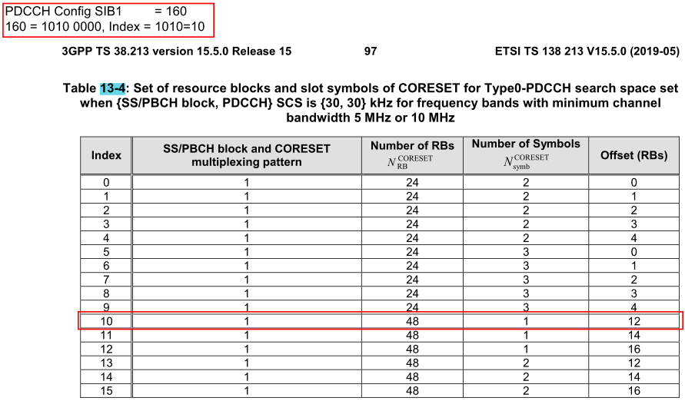
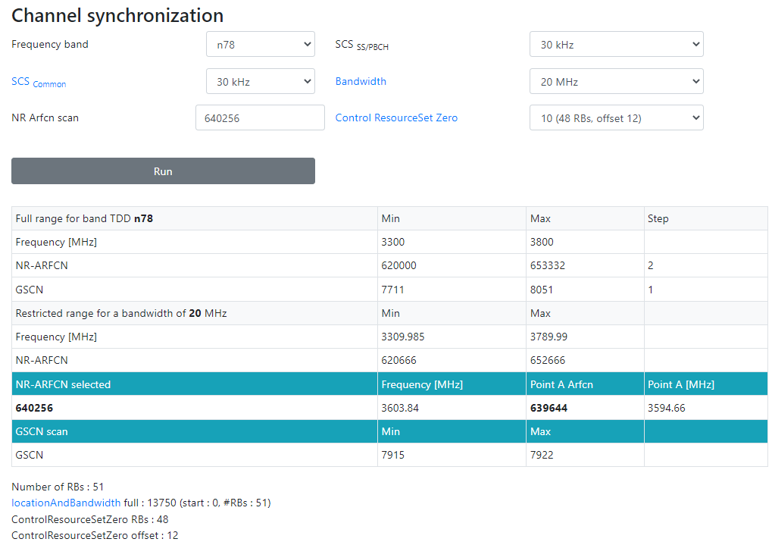
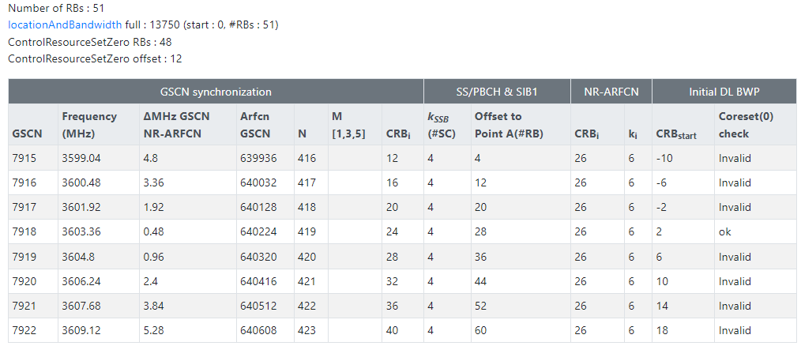
3613020
3613020
3612720
3611280
3601920
3603360
CORESET 0(48 RB)
CS0 is within the bandwidth part
Offset(RB)
48 RB*30 scs*12
Offset(RB)
48 RB*30 scs*12
10*12*30
3603840
10*12*30
3603840
CORESET 0(48 RB)
CS0 is within the bandwidth part
51/2*12 *30
51/2*12 *30
4*15
3598320
4*15
3599760
Offset(RB)
12RB*30 scs*12
Offset(RB)
12RB*30 scs*12
3594660
20*12*15
3594660
28*12*15
0 *12*15
3595440
3594000
0 *12*15
3594660
3594660
載波中心頻率 dlEarfcn 640256 = nDlCenterFreq 3603840,
SSB Subcarrier Offset =4, offsetToCarrier=0, offsetToPointA=28
Point A = nDlCenterFreq – carrierBw/2*12 sub*subCarrierSpacing – offsetToCarrier *12*15
SSB Freq = Point A + offsetToPointA*12*15 + SSB Subcarrier Offset *15 + 10RB*12*subCarrierSpacing
Ex:
Point A = 3603840 – 51/2*12 *30 – 0 *12*15 = 3594660
SSB Freq = 3594660 + 28*12*15 + 4*15 + 10*12*30 = 3603360 = 3000000+N*1440, N=419
載波中心頻率 dlEarfcn 640256 = nDlCenterFreq 3603840,
SSB Subcarrier Offset =4, offsetToCarrier=0, offsetToPointA=20
Point A = nDlCenterFreq – carrierBw/2*12 sub*subCarrierSpacing – offsetToCarrier *12*15
SSB Freq = Point A + offsetToPointA*12*15 + SSB Subcarrier Offset *15 + 10RB*12*subCarrierSpacing
Ex:
Point A = 3603840 – 51/2*12 *30 – 0 *12*15 = 3594660
SSB Freq = 3594660 + 20*12*15 + 4*15 + 10*12*30 = 3601920 = 3000000+N*1440, N=419

Slide 52
載波中心頻率 dlEarfcn 640256 = nDlCenterFreq 3603840,
SSB Subcarrier Offset =4, offsetToCarrier=0, offsetToPointA=9
Point A = nDlCenterFreq – carrierBw/2*12 sub*subCarrierSpacing – offsetToCarrier *12*15
SSB Freq = Point A + offsetToPointA*12*15 + SSB Subcarrier Offset *15 + 10RB*12*subCarrierSpacing
Ex:
Point A = 3603840 – 24/2*12 *30 – 0 *12*15 = 3599520
SSB Freq = 3599520+ 9*12*15 + 4*15 + 10*12*30 = 3604800 = 3000000+N*1440
(3000M以下) F = 0 + 0.005*(ARFCN-0)
(3000M以上) F = 3000 + 0.015*(ARFCN-600000)
Ex: F = 3603360 = 3603.36 MHz
3603.36 = 3000 + 0.015*(ARFCN-600000)
ARFCN = 640224
3563.04 = 3000+N*1.44, N=419, GSCN=7499+419=7918
<dlFreqInfo>
<absFreqPointA>3599520</absFreqPointA>
<absArfcnPointA>639968</absArfcnPointA>
<absFreqSsb> 3604800 </absFreqSsb>
<absArfcnSsb>640320</absArfcnSsb>
<nrFreqBand>78</nrFreqBand>
<subCarrierCfg>
<offsetToCarrier>0</offsetToCarrier>
<subCarrierSpacing>KHz30</subCarrierSpacing>
<carrierBw>273</carrierBw>
</subCarrierCfg>
<bSChannelBwDL>100MHZ</bSChannelBwDL>
<dlEarfcn>640256</dlEarfcn>
</dlFreqInfo>
<nDlCenterFreq>3603840</nDlCenterFreq>
<nUlCenterFreq>3603840</nUlCenterFreq>
1980/01/07 06:01:29.079 [0xB822] NR5G RRC MIB Info
DL Frequency = 504990
SSB Subcarrier Offset = 4
Subcarrier Spacing Common = SCSC30
(3000M以下) F = 0 + 0.005*(ARFCN-0)
(3000M以上) F = 3000 + 0.015*(ARFCN-600000)
Ex: F = 3603840 = 3603.84 MHz
3603.84 = 3000 + 0.015*(ARFCN-600000)
ARFCN = 640256
[0xB821] BCCH_DL_SCH / SystemInformationBlockType1
frequencyInfoDL
{
frequencyBandList
{
{
freqBandIndicatorNR 41
}
},
offsetToPointA 26,
scs-SpecificCarrierList
{
{
offsetToCarrier 0,
subcarrierSpacing kHz30,
carrierBandwidth 273
}
}
},
initialDownlinkBWP
{
genericParameters
{
locationAndBandwidth 1099,
subcarrierSpacing kHz30
},
Notes:
3599520+ y*12*15 + 4*15 + 10*12*30 = 3000000+N*1440
3599520+ 4*15 + 10*12*30 - 3000000 + y*12*15 = +N*1440
603180 + y*12*15 = +N*1440
3351+y=8*N
3351+1=8*419=3352
3351+9=8*420=3360
==========================
載波中心頻率 dlEarfcn 513150 = nDlCenterFreq 2565750
Point A = nDlCenterFreq – carrierBw/2*12 sub*subCarrierSpacing – offsetToCarrier *12*15
SSB Freq = Point A + offsetToPointA*12*15 + SSB Subcarrier Offset *15 + 10RB*12*subCarrierSpacing
Ex:
Point A = 2565750 – 273/2*12 *30 – 0 *12*15 = 2516610
SSB Freq = 2516610 + 26*12*15 + 4*15 + 10*12*30 = 2524950

Slide 53
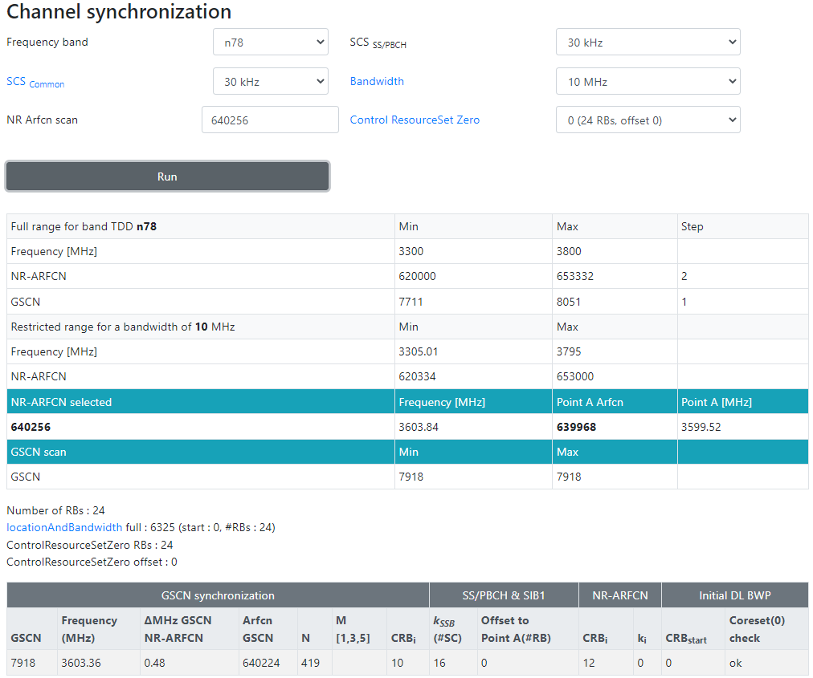
載波中心頻率 dlEarfcn 640256 = nDlCenterFreq 3603840,
SSB Subcarrier Offset =16, offsetToCarrier=0, offsetToPointA=0
Point A = nDlCenterFreq – carrierBw/2*12 sub*subCarrierSpacing – offsetToCarrier *12*15
SSB Freq = Point A + offsetToPointA*12*15 + SSB Subcarrier Offset *15 + 10RB*12*subCarrierSpacing
Ex:
Point A = 3603840 – 24/2*12 *30 – 0 *12*15 = 3599520
SSB Freq = 3599520+ 0*12*15 + 16*15 + 10*12*30 = 3603360 = 3000000+N*1440
<dlFreqInfo>
<absFreqPointA>3599520</absFreqPointA>
<absArfcnPointA>639968</absArfcnPointA>
<absFreqSsb> 3603360 </absFreqSsb>
<absArfcnSsb>640224</absArfcnSsb>
<nrFreqBand>78</nrFreqBand>
<subCarrierCfg>
<offsetToCarrier>0</offsetToCarrier>
<subCarrierSpacing>KHz30</subCarrierSpacing>
<carrierBw>273</carrierBw>
</subCarrierCfg>
<bSChannelBwDL>100MHZ</bSChannelBwDL>
<dlEarfcn>640256</dlEarfcn>
</dlFreqInfo>
<nDlCenterFreq>3603840</nDlCenterFreq>
<nUlCenterFreq>3603840</nUlCenterFreq>
3608160
3608160
(3000M以下) F = 0 + 0.005*(ARFCN-0)
(3000M以上) F = 3000 + 0.015*(ARFCN-600000)
Ex: F = 3603360 = 3603.36 MHz
3603.36 = 3000 + 0.015*(ARFCN-600000)
ARFCN = 640224
3563.04 = 3000+N*1.44, N=419, GSCN=7499+419=7918
Offset(RB)
24 RB*30 scs*12
24/2*12 *30
3603360
CORESET 0(24 RB)
CS0 is within the bandwidth part
10*12*30
3603840
1980/01/07 06:01:29.079 [0xB822] NR5G RRC MIB Info
DL Frequency = 504990
SSB Subcarrier Offset = 4
Subcarrier Spacing Common = SCSC30
3599760
24/2*12 *30
(3000M以下) F = 0 + 0.005*(ARFCN-0)
(3000M以上) F = 3000 + 0.015*(ARFCN-600000)
Ex: F = 3603840 = 3603.84 MHz
3603.84 = 3000 + 0.015*(ARFCN-600000)
ARFCN = 640256
16*15
[0xB821] BCCH_DL_SCH / SystemInformationBlockType1
frequencyInfoDL
{
frequencyBandList
{
{
freqBandIndicatorNR 41
}
},
offsetToPointA 26,
scs-SpecificCarrierList
{
{
offsetToCarrier 0,
subcarrierSpacing kHz30,
carrierBandwidth 273
}
}
},
initialDownlinkBWP
{
genericParameters
{
locationAndBandwidth 1099,
subcarrierSpacing kHz30
},
3599520
Offset(RB)
0RB*30 scs*12
0*12*15
3599520
3599520
0 *12*15
3599520
Notes:
3599520+ y*12*15 + 4*15 + 10*12*30 = 3000000+N*1440
3599520+ 4*15 + 10*12*30 - 3000000 + y*12*15 = +N*1440
603180 + y*12*15 = +N*1440
3351+y=8*N
3351+1=8*419=3352
3351+9=8*420=3360
==========================
載波中心頻率 dlEarfcn 513150 = nDlCenterFreq 2565750
Point A = nDlCenterFreq – carrierBw/2*12 sub*subCarrierSpacing – offsetToCarrier *12*15
SSB Freq = Point A + offsetToPointA*12*15 + SSB Subcarrier Offset *15 + 10RB*12*subCarrierSpacing
Ex:
Point A = 2565750 – 273/2*12 *30 – 0 *12*15 = 2516610
SSB Freq = 2516610 + 26*12*15 + 4*15 + 10*12*30 = 2524950

Slide 54
載波中心頻率 dlEarfcn 640256 = nDlCenterFreq 3603840,
SSB Subcarrier Offset =4, offsetToCarrier=0, offsetToPointA=26
Point A = nDlCenterFreq – carrierBw/2*12 sub*subCarrierSpacing – offsetToCarrier *12*15
SSB Freq = Point A + offsetToPointA*12*15 + SSB Subcarrier Offset *15 + 10RB*12*subCarrierSpacing
Ex:
Point A = 3350400 – 273/2*12 *30 – 0 *12*15 = 3301260
SSB Freq = 3301260 + 26*12*15 + 4*15 + 10*12*30 = 3309600
(3000M以下) F = 0 + 0.005*(ARFCN-0)
(3000M以上) F = 3000 + 0.015*(ARFCN-600000)
Ex: F = 3309600 = 3309.6 MHz
3309.6 = 3000 + 0.015*(ARFCN-600000)
ARFCN = 620640
3309.6 = 3000+N*1.44, N=215, GSCN=7499+215=7714
<dlFreqInfo>
<absFreqPointA>3301260</absFreqPointA>
<absArfcnPointA>620084</absArfcnPointA>
<absFreqSsb>3309600</absFreqSsb>
<absArfcnSsb>620640</absArfcnSsb>
<nrFreqBand>78</nrFreqBand>
<subCarrierCfg>
<offsetToCarrier>0</offsetToCarrier>
<subCarrierSpacing>KHz30</subCarrierSpacing>
<carrierBw>273</carrierBw>
</subCarrierCfg>
<bSChannelBwDL>100MHZ</bSChannelBwDL>
<dlEarfcn>623360</dlEarfcn>
</dlFreqInfo>
<nDlCenterFreq>3350400</nDlCenterFreq>
<nUlCenterFreq>3350400</nUlCenterFreq>
1980/01/07 06:01:29.079 [0xB822] NR5G RRC MIB Info
DL Frequency = 504990
SSB Subcarrier Offset = 4
Subcarrier Spacing Common = SCSC30
(3000M以下) F = 0 + 0.005*(ARFCN-0)
(3000M以上) F = 3000 + 0.015*(ARFCN-600000)
Ex: F = 3603840 = 3603.84 MHz
3603.84 = 3000 + 0.015*(ARFCN-600000)
ARFCN = 640256
[0xB821] BCCH_DL_SCH / SystemInformationBlockType1
frequencyInfoDL
{
frequencyBandList
{
{
freqBandIndicatorNR 41
}
},
offsetToPointA 26,
scs-SpecificCarrierList
{
{
offsetToCarrier 0,
subcarrierSpacing kHz30,
carrierBandwidth 273
}
}
},
initialDownlinkBWP
{
genericParameters
{
locationAndBandwidth 1099,
subcarrierSpacing kHz30
},
Notes:
載波中心頻率 dlEarfcn 513150 = nDlCenterFreq 2565750
Point A = nDlCenterFreq – carrierBw/2*12 sub*subCarrierSpacing – offsetToCarrier *12*15
SSB Freq = Point A + offsetToPointA*12*15 + SSB Subcarrier Offset *15 + 10RB*12*subCarrierSpacing
Ex:
Point A = 2565750 – 273/2*12 *30 – 0 *12*15 = 2516610
SSB Freq = 2516610 + 26*12*15 + 4*15 + 10*12*30 = 2524950

Slide 55
載波中心頻率 dlEarfcn 640256 = nDlCenterFreq 3603840,
SSB Subcarrier Offset =0, offsetToCarrier=0, offsetToPointA=0
Point A = nDlCenterFreq – carrierBw/2*12 sub*subCarrierSpacing – offsetToCarrier *12*15
SSB Freq = Point A + offsetToPointA*12*15 + SSB Subcarrier Offset *15 + 10RB*12*subCarrierSpacing
Ex:
Point A = 4849860 – 273/2*12 *30 – 0 *12*15 = 4800720
SSB Freq = 4800720 + 0*12*15 + 0*15 + 10*12*30 = 4804320 = 3000000+N*1440, N=1253
(3000M以下) F = 0 + 0.005*(ARFCN-0)
(3000M以上) F = 3000 + 0.015*(ARFCN-600000)
Ex: F = 3563040 = 3563.04 MHz
3563.04 = 3000 + 0.015*(ARFCN-600000)
ARFCN = 637536
3563.04 = 3000+N*1.44, N=391, GSCN=7499+391=7890
<dlFreqInfo>
<absFreqPointA>4800720</absFreqPointA>
<absArfcnPointA>720048</absArfcnPointA>
<absFreqSsb>4804320</absFreqSsb>
<absArfcnSsb>720288</absArfcnSsb>
<nrFreqBand>79</nrFreqBand>
<subCarrierCfg>
<offsetToCarrier>0</offsetToCarrier>
<subCarrierSpacing>KHz30</subCarrierSpacing>
<carrierBw>273</carrierBw>
</subCarrierCfg>
<bSChannelBwDL>100MHZ</bSChannelBwDL>
<dlEarfcn>723324</dlEarfcn>
</dlFreqInfo>
<nDlCenterFreq>4849860</nDlCenterFreq>
<nUlCenterFreq>4849860</nUlCenterFreq>
1980/01/07 06:01:29.079 [0xB822] NR5G RRC MIB Info
DL Frequency = 504990
SSB Subcarrier Offset = 4
Subcarrier Spacing Common = SCSC30
(3000M以下) F = 0 + 0.005*(ARFCN-0)
(3000M以上) F = 3000 + 0.015*(ARFCN-600000)
Ex: F = 3603840 = 3603.84 MHz
3603.84 = 3000 + 0.015*(ARFCN-600000)
ARFCN = 640256
[0xB821] BCCH_DL_SCH / SystemInformationBlockType1
frequencyInfoDL
{
frequencyBandList
{
{
freqBandIndicatorNR 41
}
},
offsetToPointA 26,
scs-SpecificCarrierList
{
{
offsetToCarrier 0,
subcarrierSpacing kHz30,
carrierBandwidth 273
}
}
},
initialDownlinkBWP
{
genericParameters
{
locationAndBandwidth 1099,
subcarrierSpacing kHz30
},
Notes:
<dlFreqInfo>\
<absFreqPointA>4800720</absFreqPointA>\
<absArfcnPointA>720048</absArfcnPointA>\
<absFreqSsb>4804320</absFreqSsb>\
<absArfcnSsb>720288</absArfcnSsb>\
<nrFreqBand>79</nrFreqBand>\
<subCarrierCfg>\
<offsetToCarrier>0</offsetToCarrier>\
<subCarrierSpacing>KHz30</subCarrierSpacing>\
<carrierBw>273</carrierBw>\
</subCarrierCfg>\
<bSChannelBwDL>100MHZ</bSChannelBwDL>\
<dlEarfcn>723324</dlEarfcn>\
</dlFreqInfo>
===============================
abs_freq_ssb = 720288
abs_freq_point_a = 720048
SSB Subcarrier Offset = 0
DL Arfcn = 723324
UL Arfcn = 723324
offsetToPointA 0,
scs-SpecificCarrierList
{
{
offsetToCarrier 0,
subcarrierSpacing kHz30,
carrierBandwidth 273

Slide 56
載波中心頻率 dlEarfcn 640256 = nDlCenterFreq 3603840,
SSB Subcarrier Offset =0, offsetToCarrier=0, offsetToPointA=0
Point A = nDlCenterFreq – carrierBw/2*12 sub*subCarrierSpacing – offsetToCarrier *12*15
SSB Freq = Point A + offsetToPointA*12*15 + SSB Subcarrier Offset *15 + 10RB*12*subCarrierSpacing
Ex:
Point A = 4849860 – 273/2*12 *30 – 0 *12*15 = 4800720
SSB Freq = 4800720 + 0*12*15 + 0*15 + 10*12*30 = 4804320 = 3000000+N*1440, N=1253
4899000
4807920
<dlFreqInfo>
<absFreqPointA>4800720</absFreqPointA>
<absArfcnPointA>720048</absArfcnPointA>
<absFreqSsb>4804320</absFreqSsb>
<absArfcnSsb>720288</absArfcnSsb>
<nrFreqBand>79</nrFreqBand>
<subCarrierCfg>
<offsetToCarrier>0</offsetToCarrier>
<subCarrierSpacing>KHz30</subCarrierSpacing>
<carrierBw>273</carrierBw>
</subCarrierCfg>
<bSChannelBwDL>100MHZ</bSChannelBwDL>
<dlEarfcn>723324</dlEarfcn>
</dlFreqInfo>
<nDlCenterFreq>4849860</nDlCenterFreq>
<nUlCenterFreq>4849860</nUlCenterFreq>
PDCCH Config SIB1 = 64 // 0100 0000 -> corset_zero_id = 4
Offset(RB)
24 RB*30 scs*12
273/2*12 *30
4804320
CS0 is within the bandwidth part
4849860
10*12*30
273/2*12 *30
0*15=0
4799280
4800720
Offset(RB)
4RB*30 scs*12
4800720
0*12*15=0
0 *12*15
4800720
Notes:
01:51:26.037 QTRACE [ 87/ 0/2] RRC/HighFreq/High/NR5GRRC [nr5g_rrc_csp_utils.c 2268] Resolve SSB list for band 79 SCS 1
//k_ssb 0
01:51:26.526 QTRACE [ 87/ 0/2] RRC/HighFreq/High/NR5GRRC [ nr5g_rrc_acq.c 2185] RRC ACQ DEBUG: Found cell - ARFCN 720288, PCI 1, scs 1, k_ssb 0
01:51:26.526 QTRACE [ 87/ 0/2] RRC/HighFreq/High/NR5GRRC [ nr5g_rrc_acq.c 1887] Triggering SIB1 read on ARFCN 720288, cell 1
1980/03/06 01:51:26.526 [0xB822] NR5G RRC MIB Info
Version = 3
Physical Cell ID = 1
DL Frequency = 720288
PDCCH Config SIB1 = 64
Subcarrier Spacing Common = SCSC30 //SCS30
//offsetToPointA 0,offsetToCarrier=0
1980/03/06 01:51:26.574 [0xB821] BCCH_DL_SCH / SystemInformationBlockType1
plmn-IdentityList
{
{
mcc
{
4,
6,
6
},
mnc
{
6,
6
}
frequencyInfoDL
{
frequencyBandList
{
{
freqBandIndicatorNR 79
}
},
offsetToPointA 0, //offsetToPointA=0
scs-SpecificCarrierList
{
{
offsetToCarrier 0, //offsetToCarrier=0
subcarrierSpacing kHz30, //SCS30
carrierBandwidth 273
}
initialDownlinkBWP
{
genericParameters
{
locationAndBandwidth 1099,
subcarrierSpacing kHz30
},
// abs_freq_ssb = 720288, abs_freq_point_a = 720048
// corset_zero_id = 4
1980/03/06 01:51:26.578 [0xB950] NR5G ML1 DL Common Config
per_cc_cfg
cell_info
band = SYS_SBAND_NR5G_BAND79
phy_cell_id = 1
ssb_sub_carrier_spacing = SSB_30KHZ
dl_cell_frequency = 720288
dl_freq_info[0]
abs_freq_ssb = 720288
abs_freq_point_a = 720048
num_scs_carriers = 1
multi_freq_band_list
num_bands = 1
freq_band_indicator = { 79, 0, 0, 0, 0, 0, 0, 0 }
scs_spec_carr_list
----------------------------------------------------------------
|# |offset_to_carr|carrier_bw_prb|scs |carrier_bw |
----------------------------------------------------------------
| 0| 0| 273| kHz30| NR5G_BW_200MHz|
ul_freq_info[0]
abs_freq_point_a = 720048
p_max = 230
add_spectrum_emission_present = 0
add_spectrum_emission = 0
freq_shift_7p5_khz = 0
num_scs_carriers = 1
multi_freq_band_list
num_bands = 1
freq_band_indicator = { 79, 0, 0, 0, 0, 0, 0, 0 }
scs_spec_carr_list
----------------------------------------------------------------
|# |offset_to_carr|carrier_bw_prb|scs |carrier_bw |
----------------------------------------------------------------
| 0| 0| 273| kHz30| NR5G_BW_200MHz|
dl_bwp_params[0]
bwp_generic_params
bwp_id = 0
loc_and_bw = 1099
sub_carr_spacing = kHz30
cyclic_prefix = NORMAL
cfg_mask = COMMON | DEDICATED
dl_bwp_common[0]
cfg_mask = PDCCH | PDSCH
pdcch_common[0]
enable = 1
corset_zero_id = 4
searchspace_zero_id = 0
coreset_active_bmask = 1
coreset_rel_bmask = 0
search_space_active_bmask = 0x0000000000000003
search_space_rel_bmask = 0x0000000000000000
search_space_id_RMSI = 0
search_space_id_OSI = 255
search_space_id_paging = 1
search_space_id_ra = 1
// DL Arfcn=723324, SSB Arfcn=720288
1980/03/06 01:51:27.465 [0xB825] NR5G RRC Configuration Info
Contiguous CC Info
------------------------------------------------------
| |Band | | |
|# |Number|DL BW Class |UL BW Class |
------------------------------------------------------
| 0| 79| NR5G_RRC_BWC_A| NR5G_RRC_BWC_A|
NR5G Serving Cell Info
--------------------------------------------------------------------------------------------------
| | | | | | | | | | |DL |UL |
| |CC |Cell | | | | | |DL Carrier|UL Carrier|Max |Max |
|# |Id |Id |DL Arfcn |UL Arfcn |SSB Arfcn |Band |Band Type|Bandwidth |Bandwidth |MIMO|MIMO|
--------------------------------------------------------------------------------------------------
| 0| 0| 1| 723324| 723324| 720288| 79| SUB6| BW_100MHz| BW_100MHz| NA| NA|
Radio Bearer Info
--------------------------------------------------------------------------------------------------------------------------------------------------------------------------
| | | | | | | | | | | | | |UL |UL PDCP |UL Data |
| |RB |Termination|DL RB | |DL ROHC| |DL Integrity |UL RB | |UL ROHC| |UL Integrity |Primary|Dup |Split |
|# |ID |Point |Type |DL RB Path|Enabled|DL Cipher Algo |Algo |Type |UL RB Path|Enabled|UL Cipher Algo |Algo |Path |Activated|Threshold |
--------------------------------------------------------------------------------------------------------------------------------------------------------------------------
| 0| 1| NR| DRB| NR| false| NONE (nea0)| SNOW3G (nea1)| DRB| NR| false| NONE (nea0)| SNOW3G (nea1)| NONE| false| 0|
| 1| 1| NR| SRB| NR| false| NONE (nea0)| SNOW3G (nea1)| SRB| NR| false| NONE (nea0)| SNOW3G (nea1)| NONE| false| 0|
| 2| 2| NR| SRB| NR| false| NONE (nea0)| SNOW3G (nea1)| SRB| NR| false| NONE (nea0)| SNOW3G (nea1)| NONE| false| 0|

Slide 57
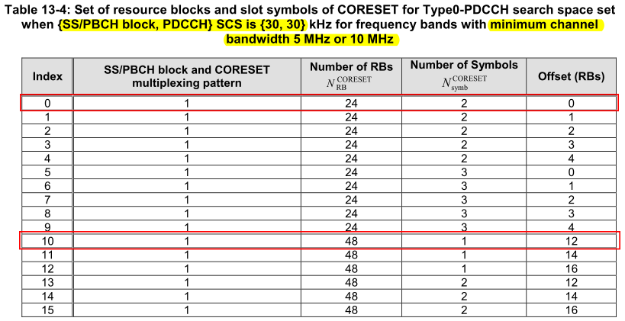
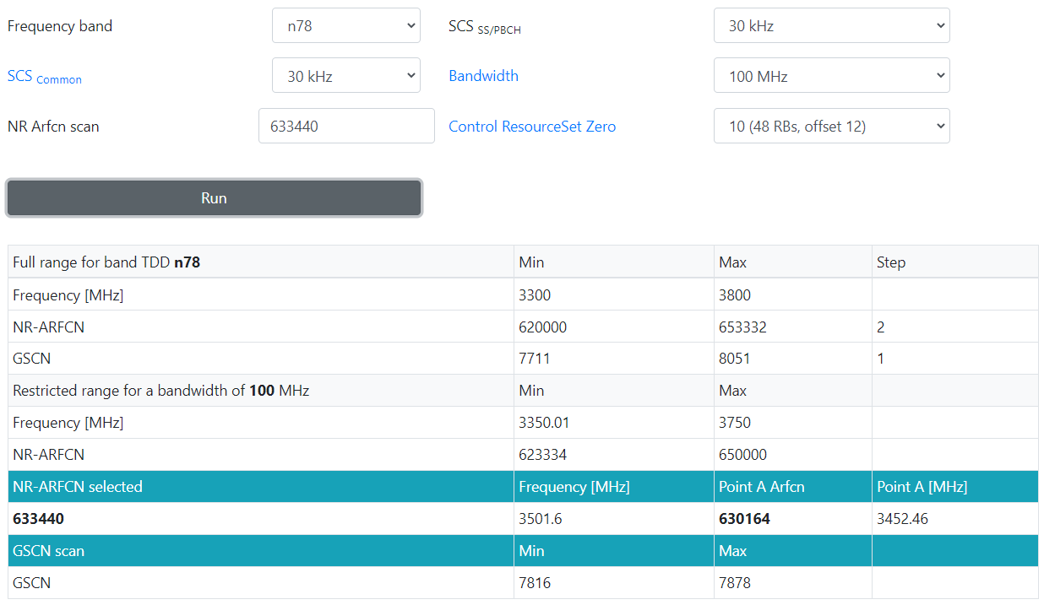
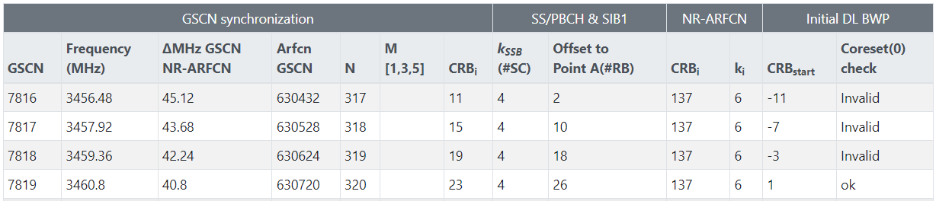
3550740
載波中心頻率 dlEarfcn 640256 = nDlCenterFreq 3603840,
SSB Subcarrier Offset =4, offsetToCarrier=0, offsetToPointA=26
Point A = nDlCenterFreq – carrierBw/2*12 sub*subCarrierSpacing – offsetToCarrier *12*15
SSB Freq = Point A + offsetToPointA*12*15 + SSB Subcarrier Offset *15 + 10RB*12*subCarrierSpacing
Ex:
Point A = 3501600 – 273/2*12 *30 – 0 *12*15 = 3452460
SSB Freq = 3452460 + 26*12*15 + 4*15 + 10*12*30 = 3460800
3470100
Number of RB
48 RB*30 scs*12
273/2*12 *30
(3000M以下) F = 0 + 0.005*(ARFCN-0)
(3000M以上) F = 3000 + 0.015*(ARFCN-600000)
Ex: F = 3309600 = 3309.6 MHz
3309.6 = 3000 + 0.015*(ARFCN-600000)
ARFCN = 620640
3309.6 = 3000+N*1.44, N=215, GSCN=7499+215=7714
<dlFreqInfo>
<absFreqPointA> 3452460 </absFreqPointA>
<absArfcnPointA> 630164 </absArfcnPointA>
<absFreqSsb> 3460800</absFreqSsb>
<absArfcnSsb> 630720</absArfcnSsb>
<nrFreqBand>78</nrFreqBand>
<subCarrierCfg>
<offsetToCarrier>0</offsetToCarrier>
<subCarrierSpacing>KHz30</subCarrierSpacing>
<carrierBw>273</carrierBw>
</subCarrierCfg>
<bSChannelBwDL>100MHZ</bSChannelBwDL>
<dlEarfcn> 633440 </dlEarfcn>
</dlFreqInfo>
<nDlCenterFreq> 3501600 </nDlCenterFreq>
<nUlCenterFreq> 3501600 </nUlCenterFreq>
absFreqSsb = 3460800
CS0 is within the BWP
nDlCenterFreq= 3501600
10*12*30
273/2*12 *30
4*15
3457140
Offset(RB)
12RB*30 scs*12
3452820
3452460
26*12*15
0 *12*15
1980/01/07 06:01:29.079 [0xB822] NR5G RRC MIB Info
DL Frequency = 504990
SSB Subcarrier Offset = 4
Subcarrier Spacing Common = SCSC30
absFreqPointA =3452460
(3000M以下) F = 0 + 0.005*(ARFCN-0)
(3000M以上) F = 3000 + 0.015*(ARFCN-600000)
Ex: F = 3603840 = 3603.84 MHz
3603.84 = 3000 + 0.015*(ARFCN-600000)
ARFCN = 640256
[0xB821] BCCH_DL_SCH / SystemInformationBlockType1
frequencyInfoDL
{
frequencyBandList
{
{
freqBandIndicatorNR 41
}
},
offsetToPointA 26,
scs-SpecificCarrierList
{
{
offsetToCarrier 0,
subcarrierSpacing kHz30,
carrierBandwidth 273
}
}
},
initialDownlinkBWP
{
genericParameters
{
locationAndBandwidth 1099,
subcarrierSpacing kHz30
},
dlEarfcn
dlEarfcn
nDlCenterFreq
absArfcnPointA
absFreqPointA
absFreqSsb
absArfcnSsb
Notes:
<dlFreqInfo>
<absFreqPointA>3452460</absFreqPointA>
<absArfcnPointA>630164</absArfcnPointA>
<absFreqSsb>3460800</absFreqSsb>
<absArfcnSsb>630720</absArfcnSsb>
<nrFreqBand>78</nrFreqBand>
<subCarrierCfg>
<offsetToCarrier>0</offsetToCarrier>
<subCarrierSpacing>KHz30</subCarrierSpacing>
<carrierBw>273</carrierBw>
</subCarrierCfg>
<bSChannelBwDL>100MHZ</bSChannelBwDL>
<dlEarfcn>633440</dlEarfcn>
</dlFreqInfo>
<nDlCenterFreq>3501600</nDlCenterFreq>
<nUlCenterFreq>3501600</nUlCenterFreq>
<nDlBw>100</nDlBw>
<nUlBw>100</nUlBw>
========================
載波中心頻率 dlEarfcn 513150 = nDlCenterFreq 2565750
Point A = nDlCenterFreq – carrierBw/2*12 sub*subCarrierSpacing – offsetToCarrier *12*15
SSB Freq = Point A + offsetToPointA*12*15 + SSB Subcarrier Offset *15 + 10RB*12*subCarrierSpacing
Ex:
Point A = 2565750 – 273/2*12 *30 – 0 *12*15 = 2516610
SSB Freq = 2516610 + 26*12*15 + 4*15 + 10*12*30 = 2524950

Slide 58
載波中心頻率 dlEarfcn 640256 = nDlCenterFreq 3603840,
SSB Subcarrier Offset =4, offsetToCarrier=0, offsetToPointA=26
Point A = nDlCenterFreq – carrierBw/2*12 sub*subCarrierSpacing – offsetToCarrier *12*15
SSB Freq = Point A + offsetToPointA*12*15 + SSB Subcarrier Offset *15 + 10RB*12*subCarrierSpacing
Ex:
Point A = 3501600 – 273/2*12 *30 – 0 *12*15 = 3452460
SSB Freq = 3452460 + 26*12*15 + 4*15 + 10*12*30 = 3460800
3550740
3470100
<dlFreqInfo>
<absFreqPointA> 3452460 </absFreqPointA>
<absArfcnPointA> 630164 </absArfcnPointA>
<absFreqSsb> 3460800</absFreqSsb>
<absArfcnSsb> 630720</absArfcnSsb>
<nrFreqBand>78</nrFreqBand>
<subCarrierCfg>
<offsetToCarrier>0</offsetToCarrier>
<subCarrierSpacing>KHz30</subCarrierSpacing>
<carrierBw>273</carrierBw>
</subCarrierCfg>
<bSChannelBwDL>100MHZ</bSChannelBwDL>
<dlEarfcn> 633440 </dlEarfcn>
</dlFreqInfo>
<nDlCenterFreq> 3501600 </nDlCenterFreq>
<nUlCenterFreq> 3501600 </nUlCenterFreq>
Number of RB
48 RB*30 scs*12
273/2*12 *30
3460800
CS0 is within the BWP
nDlCenterFreq= 3501600
10*12*30
273/2*12 *30
4*15
3457140
Offset(RB)
12RB*30 scs*12
3452820
3452460
26*12*15
0 *12*15
absFreqPointA =3452460

Slide 59
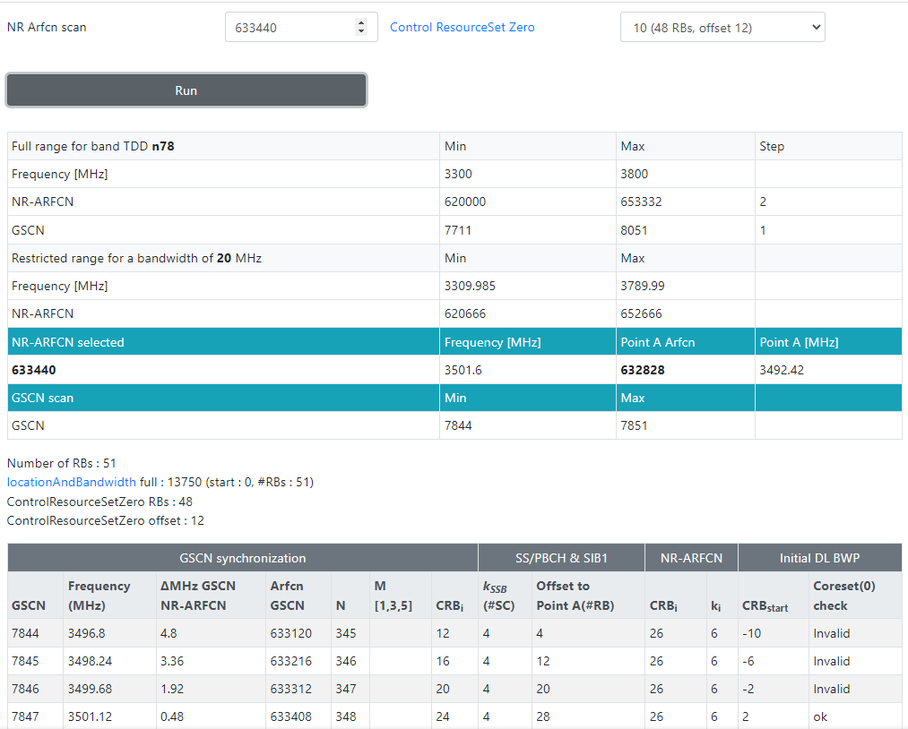
3510780
載波中心頻率 dlEarfcn 640256 = nDlCenterFreq 3603840,
SSB Subcarrier Offset =16, offsetToCarrier=0, offsetToPointA=26
Point A = nDlCenterFreq – carrierBw/2*12 sub*subCarrierSpacing – offsetToCarrier *12*15
SSB Freq = Point A + offsetToPointA*12*15 + SSB Subcarrier Offset *15 + 10RB*12*subCarrierSpacing
Ex:
Point A = 3501600 – 106/2*12 *30 – 0 *12*15 = 3482520
SSB Freq = 3482520 + 26*12*15 + 16*15 + 10*12*30 = 3491040 = 3000000+N*1440, N=320
3510420
Number of RB
48 RB*30 scs*12
51/2*12 *30
(3000M以下) F = 0 + 0.005*(ARFCN-0)
(3000M以上) F = 3000 + 0.015*(ARFCN-600000)
Ex: F = 3309600 = 3309.6 MHz
3309.6 = 3000 + 0.015*(ARFCN-600000)
ARFCN = 620640
3309.6 = 3000+N*1.44, N=215, GSCN=7499+215=7714
<dlFreqInfo>
<absFreqPointA> 3482520 </absFreqPointA>
<absArfcnPointA> 632168 </absArfcnPointA>
<absFreqSsb> 3491040</absFreqSsb>
<absArfcnSsb> 632736 </absArfcnSsb>
<nrFreqBand>78</nrFreqBand>
<subCarrierCfg>
<offsetToCarrier>0</offsetToCarrier>
<subCarrierSpacing>KHz30</subCarrierSpacing>
<carrierBw>106</carrierBw>
</subCarrierCfg>
<bSChannelBwDL>40MHZ</bSChannelBwDL>
<dlEarfcn> 633440 </dlEarfcn>
</dlFreqInfo>
<nDlCenterFreq> 3501600 </nDlCenterFreq>
<nUlCenterFreq> 3501600 </nUlCenterFreq>
absFreqSsb = 3501120
CS0 is within the BWP
nDlCenterFreq= 3501600
10*12*30
51/2*12 *30
3497520
4*15
3497460
Offset(RB)
12RB*30 scs*12
3493140
3492420
28*12*15
0 *12*15
1980/01/07 06:01:29.079 [0xB822] NR5G RRC MIB Info
DL Frequency = 504990
SSB Subcarrier Offset = 4
Subcarrier Spacing Common = SCSC30
absFreqPointA =3492420
(3000M以下) F = 0 + 0.005*(ARFCN-0)
(3000M以上) F = 3000 + 0.015*(ARFCN-600000)
Ex: F = 3603840 = 3603.84 MHz
3603.84 = 3000 + 0.015*(ARFCN-600000)
ARFCN = 640256
[0xB821] BCCH_DL_SCH / SystemInformationBlockType1
frequencyInfoDL
{
frequencyBandList
{
{
freqBandIndicatorNR 41
}
},
offsetToPointA 26,
scs-SpecificCarrierList
{
{
offsetToCarrier 0,
subcarrierSpacing kHz30,
carrierBandwidth 273
}
}
},
initialDownlinkBWP
{
genericParameters
{
locationAndBandwidth 1099,
subcarrierSpacing kHz30
},
dlEarfcn
dlEarfcn
nDlCenterFreq
absArfcnPointA
absFreqPointA
absFreqSsb
absArfcnSsb
Notes:
<dlFreqInfo>
<absFreqPointA>3452460</absFreqPointA>
<absArfcnPointA>630164</absArfcnPointA>
<absFreqSsb>3460800</absFreqSsb>
<absArfcnSsb>630720</absArfcnSsb>
<nrFreqBand>78</nrFreqBand>
<subCarrierCfg>
<offsetToCarrier>0</offsetToCarrier>
<subCarrierSpacing>KHz30</subCarrierSpacing>
<carrierBw>273</carrierBw>
</subCarrierCfg>
<bSChannelBwDL>100MHZ</bSChannelBwDL>
<dlEarfcn>633440</dlEarfcn>
</dlFreqInfo>
<nDlCenterFreq>3501600</nDlCenterFreq>
<nUlCenterFreq>3501600</nUlCenterFreq>
<nDlBw>100</nDlBw>
<nUlBw>100</nUlBw>
========================
載波中心頻率 dlEarfcn 513150 = nDlCenterFreq 2565750
Point A = nDlCenterFreq – carrierBw/2*12 sub*subCarrierSpacing – offsetToCarrier *12*15
SSB Freq = Point A + offsetToPointA*12*15 + SSB Subcarrier Offset *15 + 10RB*12*subCarrierSpacing
Ex:
Point A = 2565750 – 273/2*12 *30 – 0 *12*15 = 2516610
SSB Freq = 2516610 + 26*12*15 + 4*15 + 10*12*30 = 2524950

Slide 60
3510780
載波中心頻率 dlEarfcn 640256 = nDlCenterFreq 3603840,
SSB Subcarrier Offset =16, offsetToCarrier=0, offsetToPointA=30
Point A = nDlCenterFreq – carrierBw/2*12 sub*subCarrierSpacing – offsetToCarrier *12*15
SSB Freq = Point A + offsetToPointA*12*15 + SSB Subcarrier Offset *15 + 10RB*12*subCarrierSpacing
Ex:
Point A = 3501600 – 78/2*12 *30 – 0 *12*15 = 3487560
SSB Freq = 3487560 + 30*12*15 + 16*15 + 10*12*30 = 3491040 = 3000000+N*1440, N=320
3510420
Number of RB
48 RB*30 scs*12
51/2*12 *30
(3000M以下) F = 0 + 0.005*(ARFCN-0)
(3000M以上) F = 3000 + 0.015*(ARFCN-600000)
Ex: F = 3309600 = 3309.6 MHz
3309.6 = 3000 + 0.015*(ARFCN-600000)
ARFCN = 620640
3309.6 = 3000+N*1.44, N=215, GSCN=7499+215=7714
<dlFreqInfo>
<absFreqPointA> 3487560 </absFreqPointA>
<absArfcnPointA> 632504 </absArfcnPointA>
<absFreqSsb> 3496800</absFreqSsb>
<absArfcnSsb> 633120 </absArfcnSsb>
<nrFreqBand>78</nrFreqBand>
<subCarrierCfg>
<offsetToCarrier>0</offsetToCarrier>
<subCarrierSpacing>KHz30</subCarrierSpacing>
<carrierBw>78</carrierBw>
</subCarrierCfg>
<bSChannelBwDL>30MHZ</bSChannelBwDL>
<dlEarfcn> 633440 </dlEarfcn>
</dlFreqInfo>
<nDlCenterFreq> 3501600 </nDlCenterFreq>
<nUlCenterFreq> 3501600 </nUlCenterFreq>
absFreqSsb = 3501120
CS0 is within the BWP
nDlCenterFreq= 3501600
10*12*30
51/2*12 *30
3497520
4*15
3497460
Offset(RB)
12RB*30 scs*12
3493140
3492420
28*12*15
0 *12*15
1980/01/07 06:01:29.079 [0xB822] NR5G RRC MIB Info
DL Frequency = 504990
SSB Subcarrier Offset = 4
Subcarrier Spacing Common = SCSC30
absFreqPointA =3492420
(3000M以下) F = 0 + 0.005*(ARFCN-0)
(3000M以上) F = 3000 + 0.015*(ARFCN-600000)
Ex: F = 3603840 = 3603.84 MHz
3603.84 = 3000 + 0.015*(ARFCN-600000)
ARFCN = 640256
[0xB821] BCCH_DL_SCH / SystemInformationBlockType1
frequencyInfoDL
{
frequencyBandList
{
{
freqBandIndicatorNR 41
}
},
offsetToPointA 26,
scs-SpecificCarrierList
{
{
offsetToCarrier 0,
subcarrierSpacing kHz30,
carrierBandwidth 273
}
}
},
initialDownlinkBWP
{
genericParameters
{
locationAndBandwidth 1099,
subcarrierSpacing kHz30
},
dlEarfcn
dlEarfcn
nDlCenterFreq
absArfcnPointA
absFreqPointA
absFreqSsb
absArfcnSsb
Notes:
<dlFreqInfo>
<absFreqPointA>3452460</absFreqPointA>
<absArfcnPointA>630164</absArfcnPointA>
<absFreqSsb>3460800</absFreqSsb>
<absArfcnSsb>630720</absArfcnSsb>
<nrFreqBand>78</nrFreqBand>
<subCarrierCfg>
<offsetToCarrier>0</offsetToCarrier>
<subCarrierSpacing>KHz30</subCarrierSpacing>
<carrierBw>273</carrierBw>
</subCarrierCfg>
<bSChannelBwDL>100MHZ</bSChannelBwDL>
<dlEarfcn>633440</dlEarfcn>
</dlFreqInfo>
<nDlCenterFreq>3501600</nDlCenterFreq>
<nUlCenterFreq>3501600</nUlCenterFreq>
<nDlBw>100</nDlBw>
<nUlBw>100</nUlBw>
========================
載波中心頻率 dlEarfcn 513150 = nDlCenterFreq 2565750
Point A = nDlCenterFreq – carrierBw/2*12 sub*subCarrierSpacing – offsetToCarrier *12*15
SSB Freq = Point A + offsetToPointA*12*15 + SSB Subcarrier Offset *15 + 10RB*12*subCarrierSpacing
Ex:
Point A = 2565750 – 273/2*12 *30 – 0 *12*15 = 2516610
SSB Freq = 2516610 + 26*12*15 + 4*15 + 10*12*30 = 2524950

Slide 61
3510780
載波中心頻率 dlEarfcn 640256 = nDlCenterFreq 3603840,
SSB Subcarrier Offset =4, offsetToCarrier=0, offsetToPointA=28
Point A = nDlCenterFreq – carrierBw/2*12 sub*subCarrierSpacing – offsetToCarrier *12*15
SSB Freq = Point A + offsetToPointA*12*15 + SSB Subcarrier Offset *15 + 10RB*12*subCarrierSpacing
Ex:
Point A = 3501600 – 51/2*12 *30 – 0 *12*15 = 3492420
SSB Freq = 3492420 + 28*12*15 + 4*15 + 10*12*30 = 3501120 = 3000000+N*1440, N=320
3510420
Number of RB
48 RB*30 scs*12
51/2*12 *30
(3000M以下) F = 0 + 0.005*(ARFCN-0)
(3000M以上) F = 3000 + 0.015*(ARFCN-600000)
Ex: F = 3309600 = 3309.6 MHz
3309.6 = 3000 + 0.015*(ARFCN-600000)
ARFCN = 620640
3309.6 = 3000+N*1.44, N=215, GSCN=7499+215=7714
<dlFreqInfo>
<absFreqPointA> 3492420 </absFreqPointA>
<absArfcnPointA> 632828 </absArfcnPointA>
<absFreqSsb> 3501120</absFreqSsb>
<absArfcnSsb> 633408</absArfcnSsb>
<nrFreqBand>78</nrFreqBand>
<subCarrierCfg>
<offsetToCarrier>0</offsetToCarrier>
<subCarrierSpacing>KHz30</subCarrierSpacing>
<carrierBw>51</carrierBw>
</subCarrierCfg>
<bSChannelBwDL>20MHZ</bSChannelBwDL>
<dlEarfcn> 633440 </dlEarfcn>
</dlFreqInfo>
<nDlCenterFreq> 3501600 </nDlCenterFreq>
<nUlCenterFreq> 3501600 </nUlCenterFreq>
absFreqSsb = 3501120
CS0 is within the BWP
nDlCenterFreq= 3501600
10*12*30
51/2*12 *30
3497520
4*15
3497460
Offset(RB)
12RB*30 scs*12
3493140
3492420
28*12*15
0 *12*15
1980/01/07 06:01:29.079 [0xB822] NR5G RRC MIB Info
DL Frequency = 504990
SSB Subcarrier Offset = 4
Subcarrier Spacing Common = SCSC30
absFreqPointA =3492420
(3000M以下) F = 0 + 0.005*(ARFCN-0)
(3000M以上) F = 3000 + 0.015*(ARFCN-600000)
Ex: F = 3603840 = 3603.84 MHz
3603.84 = 3000 + 0.015*(ARFCN-600000)
ARFCN = 640256
[0xB821] BCCH_DL_SCH / SystemInformationBlockType1
frequencyInfoDL
{
frequencyBandList
{
{
freqBandIndicatorNR 41
}
},
offsetToPointA 26,
scs-SpecificCarrierList
{
{
offsetToCarrier 0,
subcarrierSpacing kHz30,
carrierBandwidth 273
}
}
},
initialDownlinkBWP
{
genericParameters
{
locationAndBandwidth 1099,
subcarrierSpacing kHz30
},
dlEarfcn
dlEarfcn
nDlCenterFreq
absArfcnPointA
absFreqPointA
absFreqSsb
absArfcnSsb
Notes:
<dlFreqInfo>
<absFreqPointA>3452460</absFreqPointA>
<absArfcnPointA>630164</absArfcnPointA>
<absFreqSsb>3460800</absFreqSsb>
<absArfcnSsb>630720</absArfcnSsb>
<nrFreqBand>78</nrFreqBand>
<subCarrierCfg>
<offsetToCarrier>0</offsetToCarrier>
<subCarrierSpacing>KHz30</subCarrierSpacing>
<carrierBw>273</carrierBw>
</subCarrierCfg>
<bSChannelBwDL>100MHZ</bSChannelBwDL>
<dlEarfcn>633440</dlEarfcn>
</dlFreqInfo>
<nDlCenterFreq>3501600</nDlCenterFreq>
<nUlCenterFreq>3501600</nUlCenterFreq>
<nDlBw>100</nDlBw>
<nUlBw>100</nUlBw>
========================
載波中心頻率 dlEarfcn 513150 = nDlCenterFreq 2565750
Point A = nDlCenterFreq – carrierBw/2*12 sub*subCarrierSpacing – offsetToCarrier *12*15
SSB Freq = Point A + offsetToPointA*12*15 + SSB Subcarrier Offset *15 + 10RB*12*subCarrierSpacing
Ex:
Point A = 2565750 – 273/2*12 *30 – 0 *12*15 = 2516610
SSB Freq = 2516610 + 26*12*15 + 4*15 + 10*12*30 = 2524950

Slide 62
3510780
載波中心頻率 dlEarfcn 640256 = nDlCenterFreq 3603840,
SSB Subcarrier Offset =4, offsetToCarrier=0, offsetToPointA=28
Point A = nDlCenterFreq – carrierBw/2*12 sub*subCarrierSpacing – offsetToCarrier *12*15
SSB Freq = Point A + offsetToPointA*12*15 + SSB Subcarrier Offset *15 + 10RB*12*subCarrierSpacing
Ex:
Point A = 3501600 – 51/2*12 *30 – 0 *12*15 = 3492420
SSB Freq = 3492420 + 28*12*15 + 4*15 + 10*12*30 = 3501120 = 3000000+N*1440, N=320
3510420
Number of RB
48 RB*30 scs*12
51/2*12 *30
(3000M以下) F = 0 + 0.005*(ARFCN-0)
(3000M以上) F = 3000 + 0.015*(ARFCN-600000)
Ex: F = 3309600 = 3309.6 MHz
3309.6 = 3000 + 0.015*(ARFCN-600000)
ARFCN = 620640
3309.6 = 3000+N*1.44, N=215, GSCN=7499+215=7714
<dlFreqInfo>
<absFreqPointA> 3492420 </absFreqPointA>
<absArfcnPointA> 632828 </absArfcnPointA>
<absFreqSsb> 3501120</absFreqSsb>
<absArfcnSsb> 633408</absArfcnSsb>
<nrFreqBand>78</nrFreqBand>
<subCarrierCfg>
<offsetToCarrier>0</offsetToCarrier>
<subCarrierSpacing>KHz30</subCarrierSpacing>
<carrierBw>51</carrierBw>
</subCarrierCfg>
<bSChannelBwDL>20MHZ</bSChannelBwDL>
<dlEarfcn> 633440 </dlEarfcn>
</dlFreqInfo>
<nDlCenterFreq> 3501600 </nDlCenterFreq>
<nUlCenterFreq> 3501600 </nUlCenterFreq>
absFreqSsb = 3501120
CS0 is within the BWP
nDlCenterFreq= 3501600
10*12*30
51/2*12 *30
3497520
4*15
3497460
Offset(RB)
12RB*30 scs*12
3493140
3492420
28*12*15
0 *12*15
1980/01/07 06:01:29.079 [0xB822] NR5G RRC MIB Info
DL Frequency = 504990
SSB Subcarrier Offset = 4
Subcarrier Spacing Common = SCSC30
absFreqPointA =3492420
(3000M以下) F = 0 + 0.005*(ARFCN-0)
(3000M以上) F = 3000 + 0.015*(ARFCN-600000)
Ex: F = 3603840 = 3603.84 MHz
3603.84 = 3000 + 0.015*(ARFCN-600000)
ARFCN = 640256
[0xB821] BCCH_DL_SCH / SystemInformationBlockType1
frequencyInfoDL
{
frequencyBandList
{
{
freqBandIndicatorNR 41
}
},
offsetToPointA 26,
scs-SpecificCarrierList
{
{
offsetToCarrier 0,
subcarrierSpacing kHz30,
carrierBandwidth 273
}
}
},
initialDownlinkBWP
{
genericParameters
{
locationAndBandwidth 1099,
subcarrierSpacing kHz30
},
dlEarfcn
dlEarfcn
nDlCenterFreq
absArfcnPointA
absFreqPointA
absFreqSsb
absArfcnSsb
Notes:
<dlFreqInfo>
<absFreqPointA>3452460</absFreqPointA>
<absArfcnPointA>630164</absArfcnPointA>
<absFreqSsb>3460800</absFreqSsb>
<absArfcnSsb>630720</absArfcnSsb>
<nrFreqBand>78</nrFreqBand>
<subCarrierCfg>
<offsetToCarrier>0</offsetToCarrier>
<subCarrierSpacing>KHz30</subCarrierSpacing>
<carrierBw>273</carrierBw>
</subCarrierCfg>
<bSChannelBwDL>100MHZ</bSChannelBwDL>
<dlEarfcn>633440</dlEarfcn>
</dlFreqInfo>
<nDlCenterFreq>3501600</nDlCenterFreq>
<nUlCenterFreq>3501600</nUlCenterFreq>
<nDlBw>100</nDlBw>
<nUlBw>100</nUlBw>
========================
載波中心頻率 dlEarfcn 513150 = nDlCenterFreq 2565750
Point A = nDlCenterFreq – carrierBw/2*12 sub*subCarrierSpacing – offsetToCarrier *12*15
SSB Freq = Point A + offsetToPointA*12*15 + SSB Subcarrier Offset *15 + 10RB*12*subCarrierSpacing
Ex:
Point A = 2565750 – 273/2*12 *30 – 0 *12*15 = 2516610
SSB Freq = 2516610 + 26*12*15 + 4*15 + 10*12*30 = 2524950

Slide 63
載波中心頻率 dlEarfcn 640256 = nDlCenterFreq 3603840,
SSB Subcarrier Offset =4, offsetToCarrier=0, offsetToPointA=30
Point A = nDlCenterFreq – carrierBw/2*12 sub*subCarrierSpacing – offsetToCarrier *12*15
SSB Freq = Point A + offsetToPointA*12*15 + SSB Subcarrier Offset *15 + 10RB*12*subCarrierSpacing
Ex:
Point A = 3501600 – 245/2*12 *30 – 0 *12*15 = 3457500
SSB Freq = 3457500 + 30*12*15 + 4*15 + 10*12*30 = 3466560
(3000M以下) F = 0 + 0.005*(ARFCN-0)
(3000M以上) F = 3000 + 0.015*(ARFCN-600000)
Ex: F = 3309600 = 3309.6 MHz
3309.6 = 3000 + 0.015*(ARFCN-600000)
ARFCN = 620640
3309.6 = 3000+N*1.44, N=215, GSCN=7499+215=7714
<dlFreqInfo>
<absFreqPointA> 3457500 </absFreqPointA>
<absArfcnPointA> 630500 </absArfcnPointA>
<absFreqSsb> 3466560</absFreqSsb>
<absArfcnSsb> 631104</absArfcnSsb>
<nrFreqBand>78</nrFreqBand>
<subCarrierCfg>
<offsetToCarrier>0</offsetToCarrier>
<subCarrierSpacing>KHz30</subCarrierSpacing>
<carrierBw>245</carrierBw>
</subCarrierCfg>
<bSChannelBwDL>90MHZ</bSChannelBwDL>
<dlEarfcn> 633440 </dlEarfcn>
</dlFreqInfo>
<nDlCenterFreq> 3501600 </nDlCenterFreq>
<nUlCenterFreq> 3501600 </nUlCenterFreq>
1980/01/07 06:01:29.079 [0xB822] NR5G RRC MIB Info
DL Frequency = 504990
SSB Subcarrier Offset = 4
Subcarrier Spacing Common = SCSC30
(3000M以下) F = 0 + 0.005*(ARFCN-0)
(3000M以上) F = 3000 + 0.015*(ARFCN-600000)
Ex: F = 3603840 = 3603.84 MHz
3603.84 = 3000 + 0.015*(ARFCN-600000)
ARFCN = 640256
[0xB821] BCCH_DL_SCH / SystemInformationBlockType1
frequencyInfoDL
{
frequencyBandList
{
{
freqBandIndicatorNR 41
}
},
offsetToPointA 26,
scs-SpecificCarrierList
{
{
offsetToCarrier 0,
subcarrierSpacing kHz30,
carrierBandwidth 273
}
}
},
initialDownlinkBWP
{
genericParameters
{
locationAndBandwidth 1099,
subcarrierSpacing kHz30
},
Notes:
載波中心頻率 dlEarfcn 513150 = nDlCenterFreq 2565750
Point A = nDlCenterFreq – carrierBw/2*12 sub*subCarrierSpacing – offsetToCarrier *12*15
SSB Freq = Point A + offsetToPointA*12*15 + SSB Subcarrier Offset *15 + 10RB*12*subCarrierSpacing
Ex:
Point A = 2565750 – 273/2*12 *30 – 0 *12*15 = 2516610
SSB Freq = 2516610 + 26*12*15 + 4*15 + 10*12*30 = 2524950

Slide 64
載波中心頻率 dlEarfcn 640256 = nDlCenterFreq 3603840,
SSB Subcarrier Offset =4, offsetToCarrier=0, offsetToPointA=30
Point A = nDlCenterFreq – carrierBw/2*12 sub*subCarrierSpacing – offsetToCarrier *12*15
SSB Freq = Point A + offsetToPointA*12*15 + SSB Subcarrier Offset *15 + 10RB*12*subCarrierSpacing
Ex:
Point A = 4819800 – 245/2*12 *30 – 0 *12*15 = 3457500
SSB Freq = 3457500 + 30*12*15 + 4*15 + 10*12*30 = 3466560
3550740
3569220
<dlFreqInfo>
<absoluteFreqPointA>3550860</absoluteFreqPointA>
<absoluteArfcnPointA>636724</absoluteArfcnPointA>
<absoluteFreqSsb>3560160</absoluteFreqSsb>
<absoluteArfcnSsb>637344</absoluteArfcnSsb>
<nrFreqBand>48</nrFreqBand>
<subCarrierCfg>
<offsetToCarrier>0</offsetToCarrier>
<subCarrierSpacing>scs_KHz30</subCarrierSpacing>
<carrierBw>273</carrierBw>
</subCarrierCfg>
<bSChannelBwDL>CHAN_BW_40MHZ</bSChannelBwDL>
<dlEarfcn>640000</dlEarfcn>
</dlFreqInfo>
<nDlCenterFreq>3600000</nDlCenterFreq>
<nUlCenterFreq>4819800</nUlCenterFreq>
<nDlBandwidth>40</nDlBandwidth>
<nUlBandwidth>40</nUlBandwidth>
Number of RB
48 RB*30 scs*12
273/2*12 *30
3560160
CS0 is within the BWP
nDlCenterFreq= 3600000
10*12*30
273/2*12 *30
20*15
3556260
Offset(RB)
12RB*30 scs*12
3551940
3550860
30*12*15
0 *12*15
absFreqPointA =3550860
Notes:
1980/01/06 00:00:39.217 [0xB821] BCCH_BCH / Mib
Radio Bearer ID = 255, Physical Cell ID = 154
NR Cell Global Id = N/A
Freq = 720288
value BCCH-BCH-Message ::=
{
message mib :
{
systemFrameNumber '100000'B,
subCarrierSpacingCommon scs30or120,
ssb-SubcarrierOffset 0,
dmrs-TypeA-Position pos2,
pdcch-ConfigSIB1
{
controlResourceSetZero 4,

Slide 65
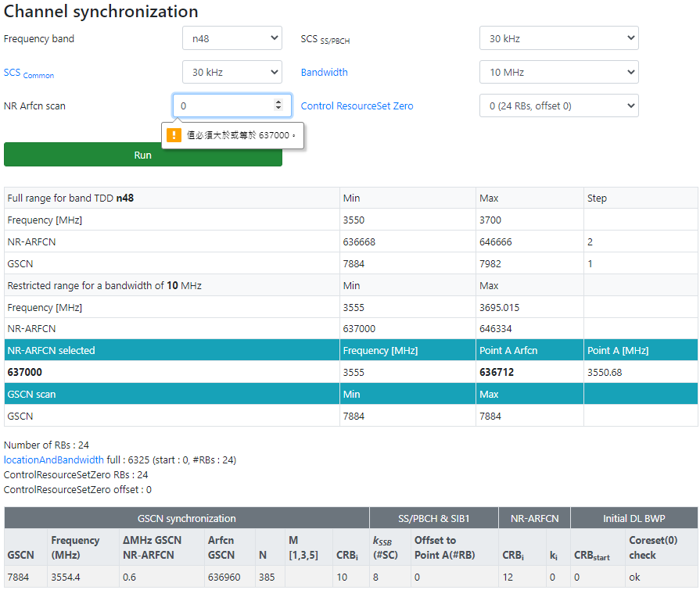
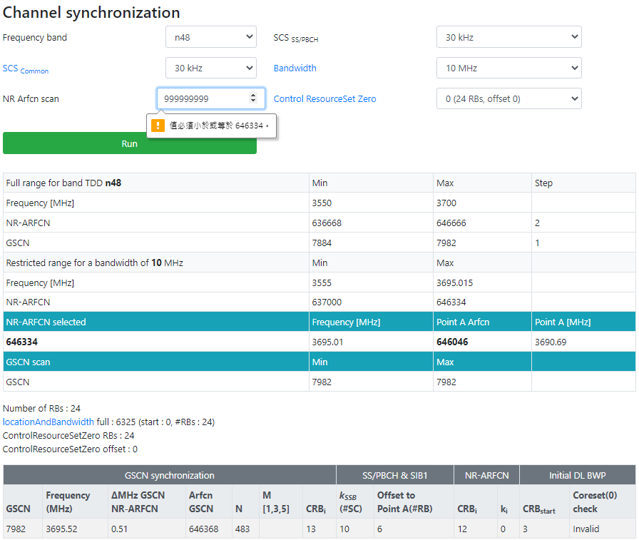
‘band’ : 48 coreset0:0, 24RB
3570000, 3580000, 637000~ 637008(3555000)-> 646334-2y(3695010) =9334
Freq: 'lowest_freq' : 3550000 (arfcn= 636667), 'highest_freq' : 3700000 (arfcn= 646667),
Arfcn: 'lowerset_n_ref' : 636668 (freq= 3550020), 'highest_n_ref' : 646666 (freq= 3699990), 'n_ref_step' : 2
Gscn: ‘lowerest_gscn’ : 7884 (freq 3554400 ->3555840 -> 3557280 , arfcn 636960 -> 637056 ->637152), ‘highest_gscn’ : 7982 (freq 3695520 ,arfcn 646368), 'gscn_step' : 1
1440
1440
96
96
3700000
3699990
<dlFreqInfo>
<absoluteFreqPointA>3550680</absoluteFreqPointA>
<absoluteArfcnPointA>636712</absoluteArfcnPointA>
<absoluteFreqSsb>3554400</absoluteFreqSsb>
<absoluteArfcnSsb>636960</absoluteArfcnSsb>
<nrFreqBand>48</nrFreqBand>
<subCarrierCfg>
<offsetToCarrier>0</offsetToCarrier>
<subCarrierSpacing>scs_KHz30</subCarrierSpacing>
<carrierBw>273</carrierBw>
</subCarrierCfg>
<bSChannelBwDL>CHAN_BW_40MHZ</bSChannelBwDL>
<dlEarfcn> 637000 </dlEarfcn>
</dlFreqInfo>
<nDlCenterFreq>3555000</nDlCenterFreq>
<nUlCenterFreq>3555000</nUlCenterFreq>
<nDlBandwidth>40</nDlBandwidth>
<nUlBandwidth>40</nUlBandwidth>
3695520
3695010
3580000
n48
freq
n_ref(2)
Gscn(1)
BW
3570000
3555000
3550020
3554400
3550000
載波中心頻率 dlEarfcn 640256 = nDlCenterFreq 3603840,
SSB Subcarrier Offset =8, offsetToCarrier=0, offsetToPointA=0
Point A = nDlCenterFreq – carrierBw/2*12 sub*subCarrierSpacing – offsetToCarrier *12*15
SSB Freq = Point A + offsetToPointA*12*15 + SSB Subcarrier Offset *15 + 10RB*12*subCarrierSpacing
Ex:
Point A = 3555000 – 24/2*12 *30 – 0 *12*15 = 3550680
SSB Freq = 3550680 + 0*12*15 + 8*15 + 10*12*30 = 3554400
3559320
3559320
Number of RB
24 RB*30 scs*12
24/2*12 *30
3554400
CS0 is within the BWP
nDlCenterFreq= 3555000
10*12*30
24/2*12 *30
8*15
3550680
Offset(RB)
0RB*30 scs*12
3550680
3550680
0*12*15
0 *12*15
absFreqPointA =3550680
(3000M以下) F = 0 + 0.005*(ARFCN-0)
(3000M以上) F = 3000 + 0.015*(ARFCN-600000)
Ex: F = 3563040 = 3563.04 MHz
3563.04 = 3000 + 0.015*(ARFCN-600000)
ARFCN = 637536
3563.04 = 3000+N*1.44, N=391, GSCN=7499+391=7890

Slide 66
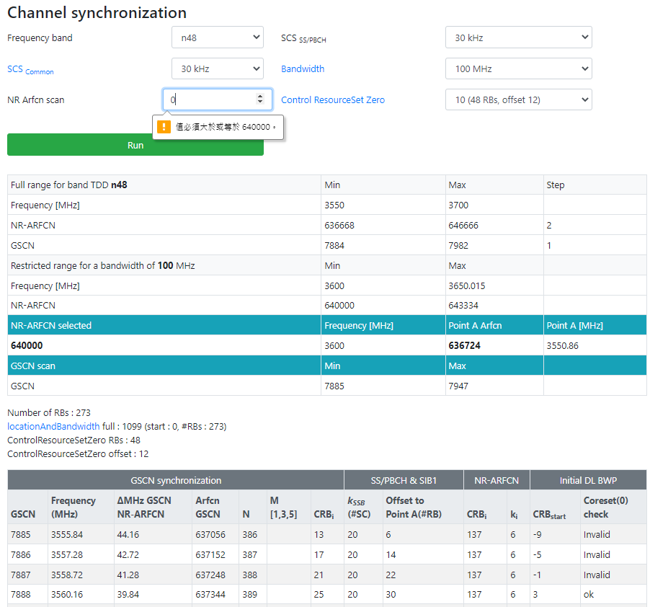
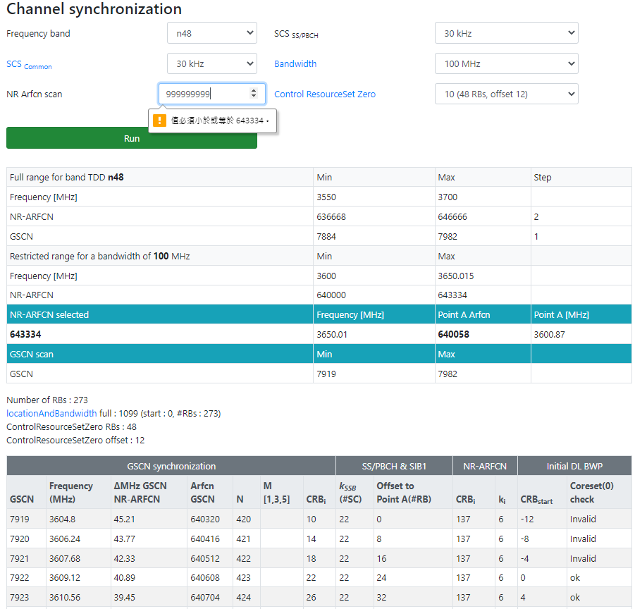
3700000
3699990
‘band’ : 48 coreset0:0, 24RB
3570000, 3580000, 637000~ 637008(3555000)-> 646334-2y(3695010) =9334
Freq: 'lowest_freq' : 3550000 (arfcn= 636667), 'highest_freq' : 3700000 (arfcn= 646667),
Arfcn: 'lowerset_n_ref' : 636668 (freq= 3550020), 'highest_n_ref' : 646666 (freq= 3699990), 'n_ref_step' : 2
Gscn: ‘lowerest_gscn’ : 7884 (freq 3554400 ->3555840 , arfcn 636960 -> 637056),
‘highest_gscn’ : 7982 (freq 3695520 ,arfcn 646368), 'gscn_step' : 1
3695520
3695010
3580000
n48
freq
n_ref(2)
Gscn(1)
BW
3570000
3555000
3550020
3554400
3550000
3699990
Number of RB
48 RB*30 scs*12
3695520
absFreqSsb
nDlCenterFreq
3554400
10*12*30
24/2*12 *30
Kssb*15
Offset(RB)
12RB*30 scs*12
3550020
OffsetToCarrier *12*15
OffsetToPointA*12*15
absoluteFreqPointA
gscn= 7898 ,
absArfcnSsb= 638304 ,
absFreqSsb= 3574560 kHz ,
absoluteFreqPointA= 3570000 ,
absoluteArfcnPointA= 638000.0 ,
nDlCenterFreq= 3574320.0 ,
dlEarfcn= 638288.0
Notes:
absFreqSsb-10*12*30-Kssb*15-12*30*12 > 3550020
absFreqSsb-10*12*30-Kssb*15-12*30*12 + 48*30*12 < 3699990

Slide 67
載波中心頻率 dlEarfcn 640256 = nDlCenterFreq 3603840,
SSB Subcarrier Offset =0, offsetToCarrier=0, offsetToPointA=0
Point A = nDlCenterFreq – carrierBw/2*12 sub*subCarrierSpacing – offsetToCarrier *12*15
SSB Freq = Point A + offsetToPointA*12*15 + SSB Subcarrier Offset *15 + 10RB*12*subCarrierSpacing
Ex:
Point A = 4849860 – 273/2*12 *30 – 0 *12*15 = 4800720
SSB Freq = 4800720 + 0*12*15 + 0*15 + 10*12*30 = 4804320
●log-20230614-160255_n79_BW100
4899000
4800732
PDCCH Config SIB1 = 64
controlResourceSetZero 4,
RRM_CS0_RB_OFFSET:0:RRM_CS0_SIZE:48
<dlFreqInfo>
<absFreqPointA>4800720</absFreqPointA>
<absArfcnPointA>720048</absArfcnPointA>
<absFreqSsb>4804320</absFreqSsb>
<absArfcnSsb>720288</absArfcnSsb>
<nrFreqBand>79</nrFreqBand>
<subCarrierCfg>
<offsetToCarrier>0</offsetToCarrier>
<subCarrierSpacing>KHz30</subCarrierSpacing>
<carrierBw>273</carrierBw>
</subCarrierCfg>
<bSChannelBwDL>100MHZ</bSChannelBwDL>
<dlEarfcn>723324</dlEarfcn>
</dlFreqInfo>
<nDlCenterFreq>4849860</nDlCenterFreq>
<nUlCenterFreq>4849860</nUlCenterFreq>
Number of RB
48 RB*30 scs*12
273/2*12 *30
4804320
CS0 is within the BWP
nDlCenterFreq= 4849860
10*12*30
273/2*12 *30
0*15
4800720
Offset(RB)
0RB*30 scs*12
4800720
4800720
0*12*15
0 *12*15
absFreqPointA =4800720

Slide 68
●log-20230614-160255_n79_BW40
載波中心頻率 dlEarfcn 640256 = nDlCenterFreq 3603840,
SSB Subcarrier Offset =4, offsetToCarrier=0, offsetToPointA=30
Point A = nDlCenterFreq – carrierBw/2*12 sub*subCarrierSpacing – offsetToCarrier *12*15
SSB Freq = Point A + offsetToPointA*12*15 + SSB Subcarrier Offset *15 + 10RB*12*subCarrierSpacing
Ex:
Point A = 4849860 – 273/2*12 *30 – 0 *12*15 = 3457500
SSB Freq = 3457500 + 30*12*15 + 4*15 + 10*12*30 = 3466560
4899000
4800732
coreset0RB=48
coreset0offset=12
gscn=8784,
absFreqPointA=4830780,
absArfcnPointA=722052,
absFreqSsb=4850400,
absArfcnSsb=723360,
dlEarfcn=723324,
nDlCenterFreq=4849860,
Kssb=12,
offsetToPointA=88
coreset0RB=48 coreset0offset=0
gscn=8784, absFreqPointA=4830780, absArfcnPointA=722052, absFreqSsb=4850400, absArfcnSsb=723360, dlEarfcn=723324, nDlCenterFreq=4849860, Kssb=12,
offsetToPointA=88
Number of RB
48 RB*30 scs*12
106/2*12 *30
4850400
CS0 is within the BWP
nDlCenterFreq= 4849860
10*12*30
4846800
106/2*12 *30
12*15
0*15
4846620
Offset(RB)
0RB*30 scs*12
4800720
4800720
88*12*15
89*12*15
0 *12*15
absFreqPointA =4830780
Notes:
4849860-106/2*12 *30= 4830780
4830780+88*12*15+12*15
12*15+88*12*15=16020
0*15+89*12*15=16020

Slide 69
absFreqPointA=4830780,
absArfcnPointA=722052,
absFreqSsb=4850400,
absArfcnSsb=723360,
dlEarfcn=723324,
nDlCenterFreq=4849860,
Kssb=12, offsetToPointA=88
absFreqPointA=4830780, absArfcnPointA=722052, absFreqSsb=4850400, absArfcnSsb=723360, dlEarfcn=723324, nDlCenterFreq=4849860, Kssb=12,
offsetToPointA=88

Slide 70
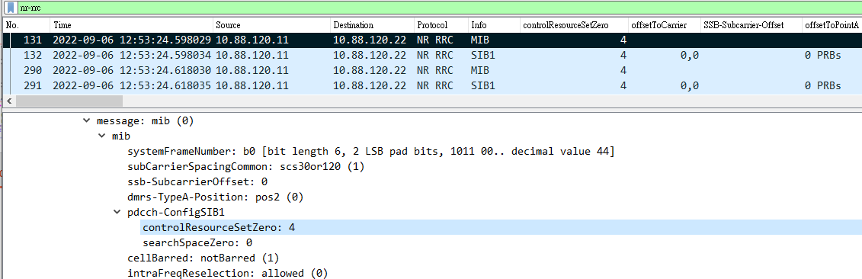
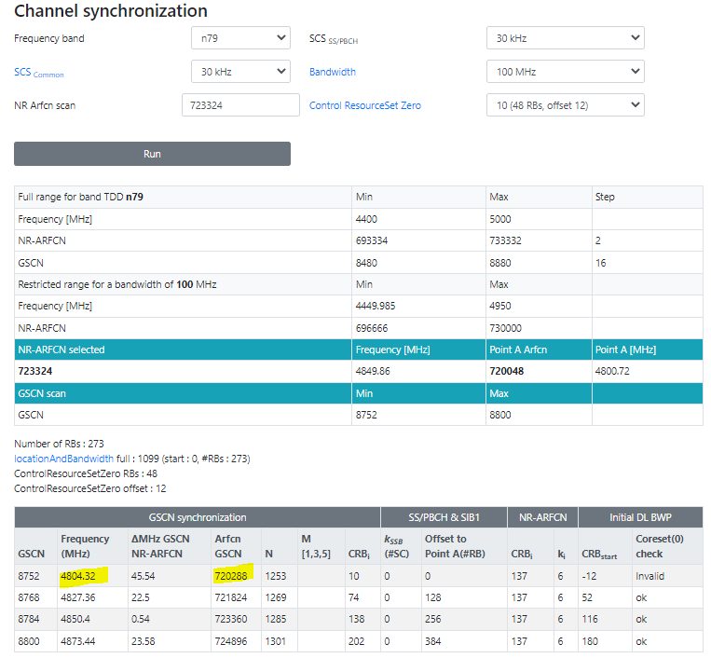
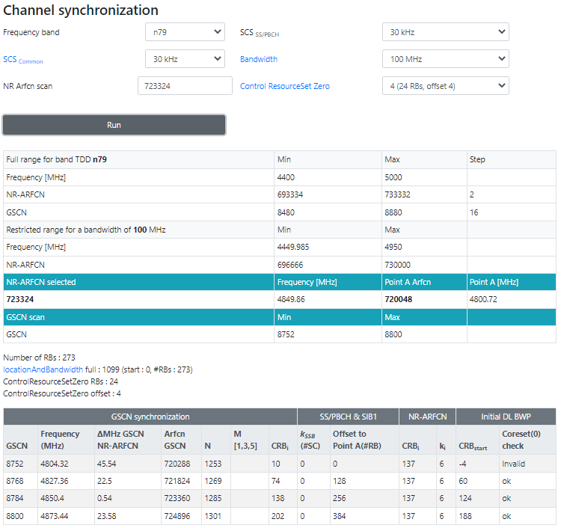
<dlFreqInfo>qSsb>
<absFreqPointA>4800720</absFreqPointA>
<absArfcnPointA>720048</absArfcnPointA>
<absFreqSsb>4804320</absFre
<absArfcnSsb>720288</absArfcnSsb>
<nrFreqBand>79</nrFreqBand>
<subCarrierCfg>
<offsetToCarrier>0</offsetToCarrier>
<subCarrierSpacing>KHz30</subCarrierSpacing>
<carrierBw>273</carrierBw>
</subCarrierCfg>
<bSChannelBwDL>100MHZ</bSChannelBwDL>
<dlEarfcn>723324</dlEarfcn>
</dlFreqInfo>
<nDlCenterFreq>4849860</nDlCenterFreq> <nUlCenterFreq>4849860</nUlCenterFreq>
<nDlBw>100</nDlBw>

Slide 71
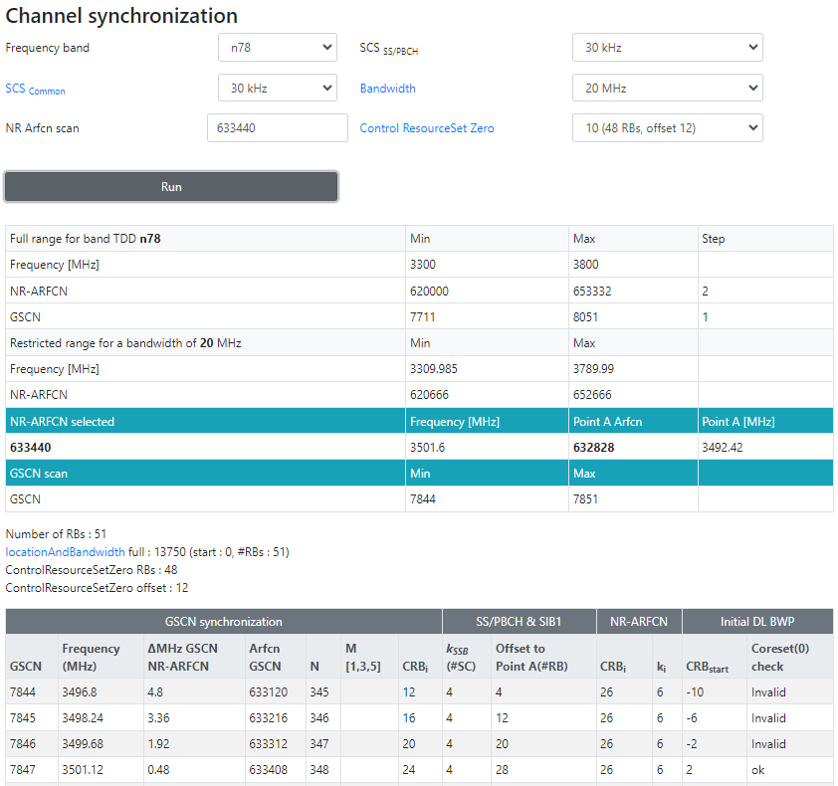
N78 cig BW20
gscn=7847,
absFreqPointA=3492420,
absArfcnPointA=632828,
absFreqSsb=3501120,
absArfcnSsb=633408,
dlEarfcn=633440,
nDlCenterFreq=3501600,
Kssb=4,
offsetToPointA=28
<dlFreqInfo>
<absFreqPointA>3452460</absFreqPointA>
<absArfcnPointA>630164</absArfcnPointA>
<absFreqSsb>3460800</absFreqSsb>
<absArfcnSsb>630720</absArfcnSsb>
<nrFreqBand>78</nrFreqBand>
<subCarrierCfg>
<offsetToCarrier>0</offsetToCarrier>
<subCarrierSpacing>KHz30</subCarrierSpacing>
<carrierBw>51</carrierBw>
</subCarrierCfg>
<bSChannelBwDL>20MHZ</bSChannelBwDL>
<dlEarfcn>633440</dlEarfcn>
</dlFreqInfo>
<nDlCenterFreq>3501600</nDlCenterFreq>
<nUlCenterFreq>3501600</nUlCenterFreq>
51RB

Slide 72
https://www.sqimway.com/nr_refA.php
載波中心頻率 dlEarfcn 640256 = nDlCenterFreq 3603840,
SSB Subcarrier Offset =16, offsetToCarrier=0, offsetToPointA=0
Point A = nDlCenterFreq – carrierBw/2*12 sub*subCarrierSpacing – offsetToCarrier *12*15
SSB Freq = Point A + offsetToPointA*12*15 + SSB Subcarrier Offset *15 + 10RB*12*subCarrierSpacing
Ex:
Point A = 3603840 – 24/2*12 *30 – 0 *12*15 = 3599520
SSB Freq = 3599520+ 0*12*15 + 16*15 + 10*12*30 = 3603360 = 3000000+N*1440
3608160
3572340
<dlFreqInfo>
<absFreqPointA>3554700</absFreqPointA>
<absArfcnPointA>636980</absArfcnPointA>
<absFreqSsb>3563040</absFreqSsb>
<absArfcnSsb>637536</absArfcnSsb>
<nrFreqBand>78</nrFreqBand>
<subCarrierCfg>
<offsetToCarrier>0</offsetToCarrier>
<subCarrierSpacing>KHz30</subCarrierSpacing>
<carrierBw>273</carrierBw>
</subCarrierCfg>
<bSChannelBwDL>100MHZ</bSChannelBwDL>
<dlEarfcn>640256</dlEarfcn>
</dlFreqInfo>
<nDlCenterFreq>3603840</nDlCenterFreq>
<nUlCenterFreq>3603840</nUlCenterFreq>
Offset(RB)
48 RB*30 scs*12
273/2*12 *30
3563040
CORESET 0(24 RB)
CS0 is within the bandwidth part
10*12*30
3603840
273/2*12 *30
4*15
3599520
Offset(RB)
12RB*30 scs*12
26*12*15
3554700
3555060
0 *12*15
3554700
MIB
PDCCH Config SIB1 = 0 = 0000 0000

